Slide 1
The Danish Pluralism Project
Some findings and some conclusions

Slide 2
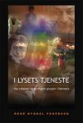
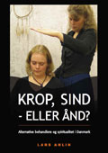
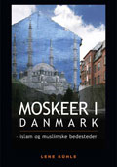
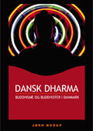
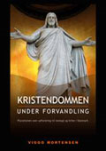
Publications

Slide 3
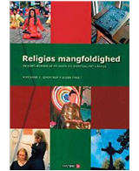
The Case Study

Slide 4
The interview guide
1. Presentation and name.
2. The group's history in local area
3. Organization.
4. Members.
5. Economic conditions.
6. Religious/spiritual practice
7. External relationships.

Slide 5
Categories
Christian groups
Muslim groups
Hindu groups
Buddhist groups
New spiritual and religious groups

Slide 6
Common characteristics for the New spiritual and religious groups
relatively new in Denmark
origin outside Denmark
differ significantly from the traditional religion
regarded with suspicion by the majority
the members are Danes.

Slide 7
Establishment in Aarhus
- 1968
Towards the Light/The Light | 1913 /1995
Christian Science | 1936
Anthroposophical Society | 1955
The Christian Community | 1968
The 1980s
Center for Living Wisdom (earlier Theosphical Association Århus) | 1982
Iskcon (Hare Krishna) | 1985
Martinus Cosmology | 1985
Sri Ram Chandra Mission | 1985
Liberal Catholic Church | 1986
Karma Kadjy School | 1987
Summit Lighthouse | 1987
The 1970s
Transcendental Meditation | 1971
Bahá´í Århus | 1972
Scandinavien Yoga and Meditation School | 1975
Church of Scientology | 1979
Sathya Sai Baba Århus | 1980
Theosophical
Hindu
Buddhist
Other

Slide 8
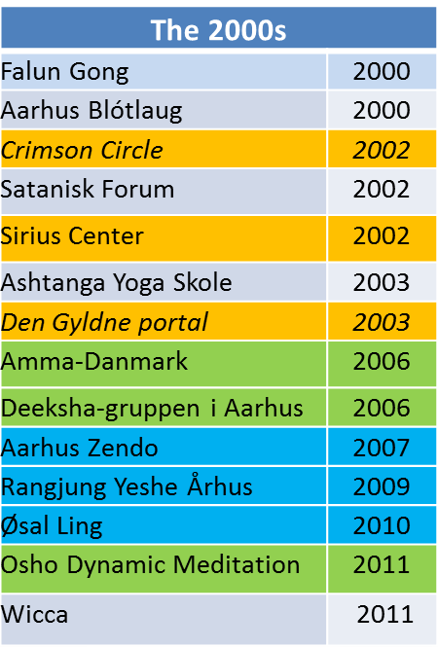
Establishment II
Theosophical
Hindu
Buddhist
Other
The 1990s
Soka Gakkes | 1990
Kundalini Network | 1992
The Golden Circle | 1994
Brahma Kumaris | 1999
Bruno Grönings Friends | 1999
Isikaja Wicca | 1999
Theosophical
Hindu
Buddhist
Other

Slide 9
Other common characteristics?

Slide 10
Religion?
No
A majority considers themselves not to be a religion or part of a religion
Christianity = ”religion”
No dogmas, no absolute beliefs, no rituals, no concepts of
This view is entirely independent of background, Buddhist, Hindu, theosophy or other

Slide 11
Religion?
Yes
Soka Gakkei. Buddhist. Part of religion. In Copenhagen applied for a approval
Liberal Catholic Church. Theosophical. Approval 2012.

Slide 12
Approved religious communities – religions?
Karma Kagya School. Buddhist. Ambivalent. Part of Buddhism but not traditional religion. Instead ”work with the mind”.
Ranjang Yeshe. Buddhist. Ambivalent. ”a way to growth and philosophy of life”
Brahma Kumaris. Hindu. Ambivalence. Internally – religion. Externally – no-religion

Slide 13
Requirements
Very low requirements
Definitely no problems being simultaneously engaged in two or more groups
True both for groups regarding themselves as part of a religion and groups approved as belief communities.
No exclusive ”memberships”, but very open

Slide 14
”entirely up to the individual”
Ranjung Yeshe
Anthroposophical Society
The Golden Circle
Center for Living Wisdom
Deeksha-group
Bruno Grönning’s Friends
Falun Gong
Martinus Cosmology

Slide 15

Relations to other groups
Growth Center in Nørre Snede
Falun Gong
Theosophy
Martinus cosmology
Bruno Grønning
Buddhism
Hinduism
Scientology
Neopagan

Slide 16
Other common characteristics?

Slide 17
meditation

Slide 18
Theosophic inspired
The Golden Portal– healing meditation
Sirius center – no longer meditation, but guided Gral-services
Liberal Catholic Church. Not meditation. Meditative people
The golden cirkel. Guided meditations
Center for living wisdom. More meditations than earlier. Maitreya-meditation.
Antrophosophical Society. No meditation.

Slide 19
Hindu inspired
Dynamic Meditation . Meditation a central practise
Deeksha-group. Meditate over webcast together with Baghavan
Transcendental meditation. Meditation is the central practise
Shri Ram Chandra Mission. The spiritual practice IS meditation
Skandinavisk Yoga and Meditation school
ISCON. Meditate together, chanting the ”Hare Krishna”-mantra
Amma. Medite using Ammas IAM-meditation

Slide 20
Buddhist inspired
Aarhus Zendo. Meditation practice very important
Øsal Ling. Quiet meditation
Ranjung Yeshe. Meditation is the essence of practice
Karma Kadjy Skolen. Central elements in practice is Nundro-meditation and powa-meditation
Sokka Gakkei. Chanting. No meditation

Slide 21
Other
Jara-heksene. Private meditation
Aarhus blotlaug. No meditation.
Scientology. No meditation.
Martinus Cosmology. No meditation.
The Light. Central parts in practise is prayer, meditation and invocation
Falun Gong. Healing- and meditation practises
Bruno Grönning’s Friends. Meditation is not mentioned but they have a practice reminding of meditation

Slide 22
Conklusion
One spiritual milieu
Fluid character
No exclusivity
No requirements on the single engaged
”entirely up to the individual”
Meditation – self development
An individualistic milieu well adapted to the requirements and needs in the late modern society

