Slide 1
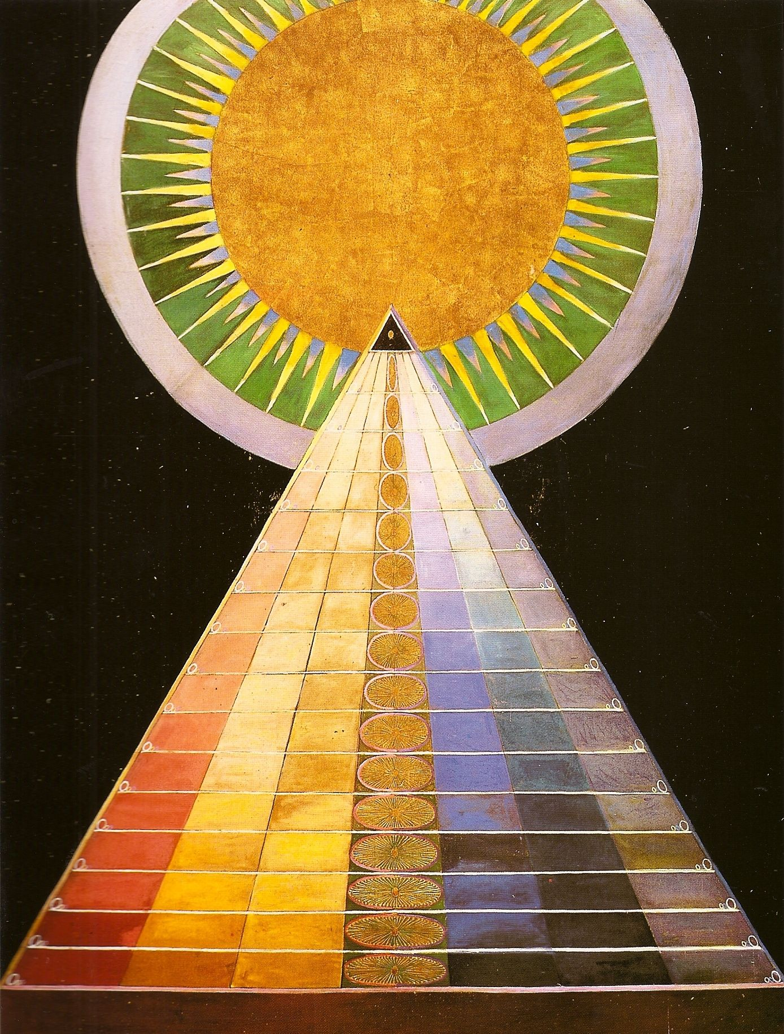
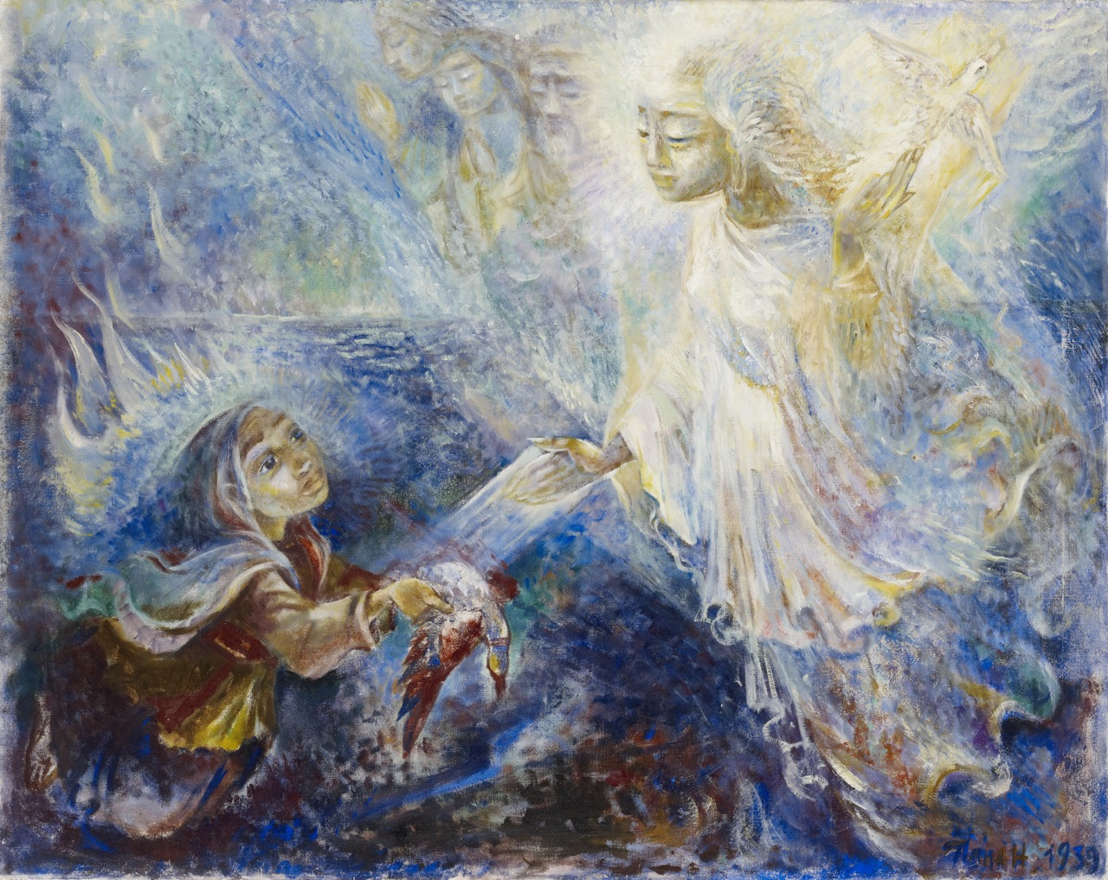
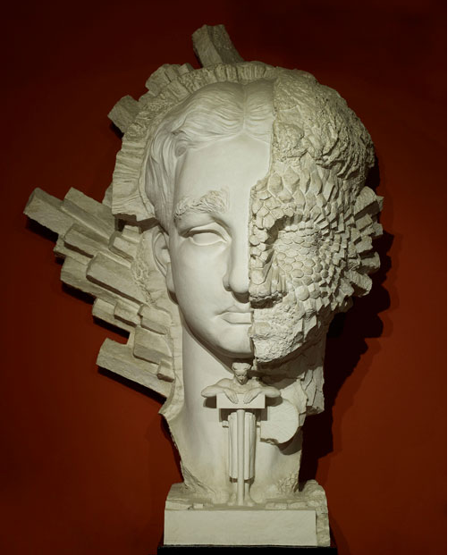

Theosophy and the Visual Arts: The Nordic Connection
Massimo Introvigne (CESNUR-UPS, Torino, Italy)
International Conference on Theosophical History
London September 20-21, 2014

Slide 2
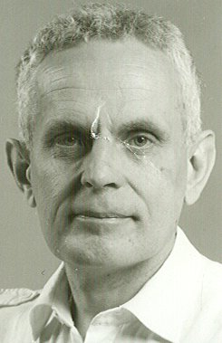
Theosophy Rediscovered
Only a few specialized academics studied Theosophy before 1970. Then, Finnish art historian Sixten Ringbom (left, 1935-1992) published a pioneer study, The Sounding Cosmos, claiming that Theosophy had a decisive influence on Wassily Kandinsky (1866-1944) and the genesis of modern abstract art
Although Ringbom was criticized on several grounds, the cat was out of the bag and scholars discovered how many leading modern artists had been in touch with the Theosophical Society

Slide 3
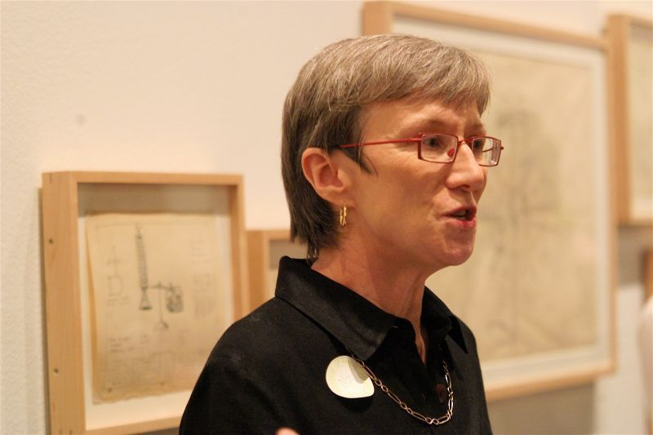
The Fourth Dimension
In 1983, Linda Dalrymple Henderson (right) published the first edition of her landmark study The Fourth Dimension and Non-Euclidean Geometry in Modern Art, where she noted how Theosophists contributed to explore the idea of a spatial (rather than temporal) fourth dimension, which was crucially influential on modern art

Slide 4
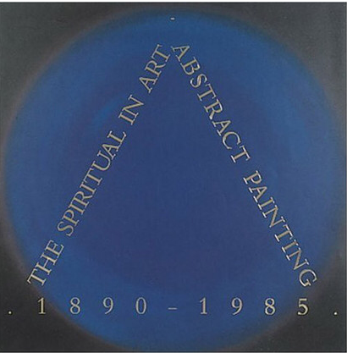
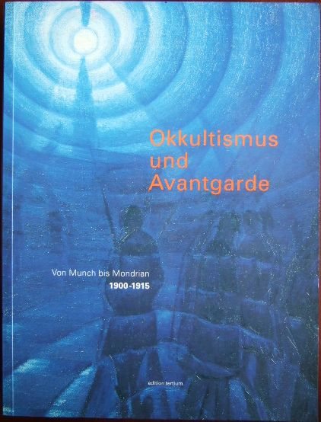
Exhibitions
In 1986 and 1995, two large exhibitions, The Spiritual in Art (Los Angeles 1986) and Okkultismus und Avantgarde (Frankfurt 1995), popularized the connection between Theosophy and modern art for a larger audience

Slide 5
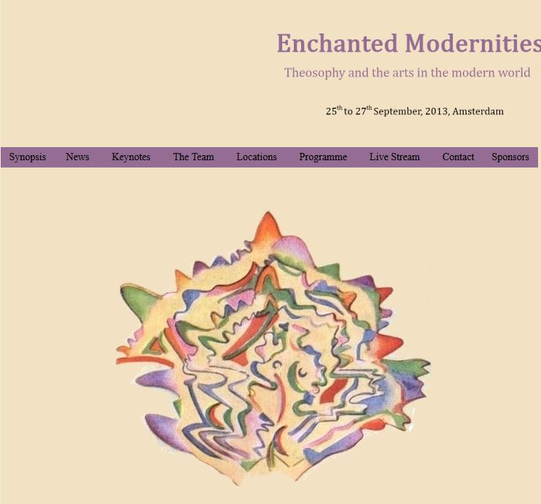
The Amsterdam Conference (2013)
In 2013, the conference Enchanted Modernities: Theosophy and the Arts in the Modern World at the University of Amsterdam included some 50 papers, with an audience of 140 scholars plus some 2,000 connected via streaming from all over the world
There is now an explosion of sort of scholarly interest in the question why Theosophy, a comparatively small movement, had such a great impact on modern visual arts

Slide 6
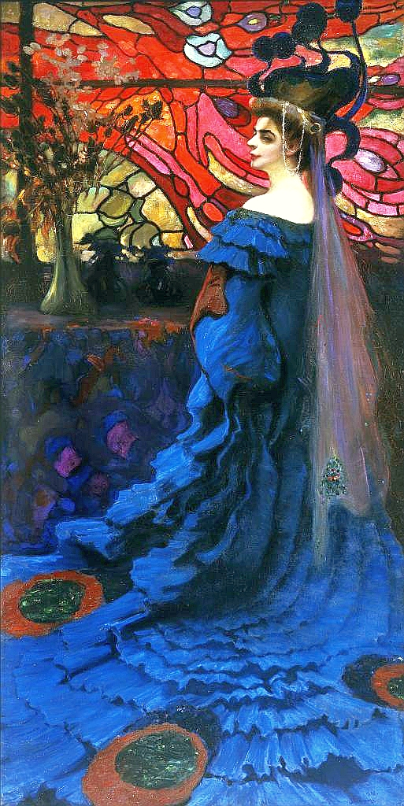
Country-based studies
Although the study can be based on trends and movements e.g. by exploring Theosophy's relationship with Symbolism, or with abstract art, the Amsterdam conference demonstrated that country-based studies of Theosophical influences on visual arts may also be useful
In some countries, the first Theosophical organizations were founded and/or led by artists, as happened in Poland with one of the main local Symbolist painters, Lithuanian-born Kazimierz Stabrowski (1869-1929; see Stained Glass Background: A Peacock, 1908), and in Bulgaria with Nikolay Rainov (1889-1954)

Slide 7
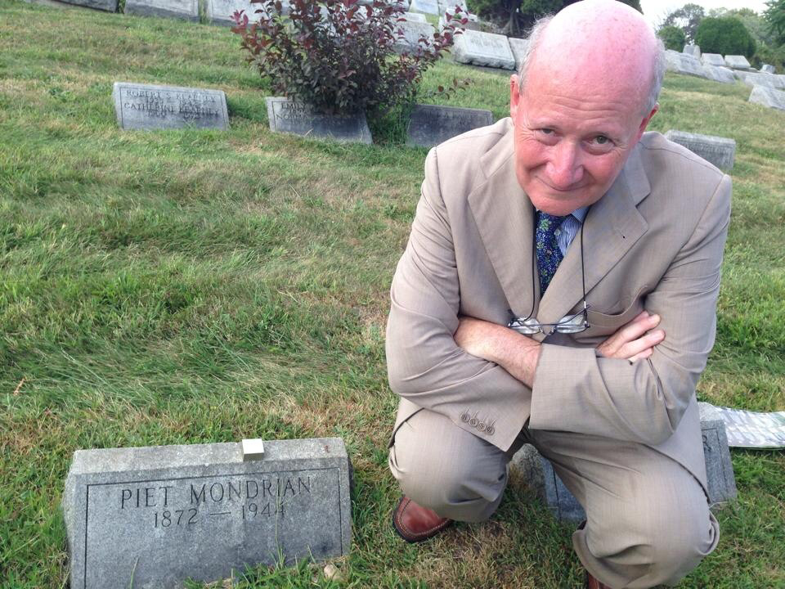
The Netherlands and Australia
Examples of book-length country-based scholarly treatments of how Theosophy influenced visual arts are Marty Bax's The Web of Creation: Theosophy and Art in the Netherlands from Lauweriks to Mondrian (in Dutch: Amsterdam 2006), with an understandable emphasis on Piet Mondrian (1872-1944), who joined the Theosophical Society in 1909 (left: the author at Mondrian's grave in New York), and Jenny McFarlane's Concerning the Spiritual: The Influence of the Theosophical Society on Australian Artists 1899-1934 (Melbourne 2012)

Slide 8
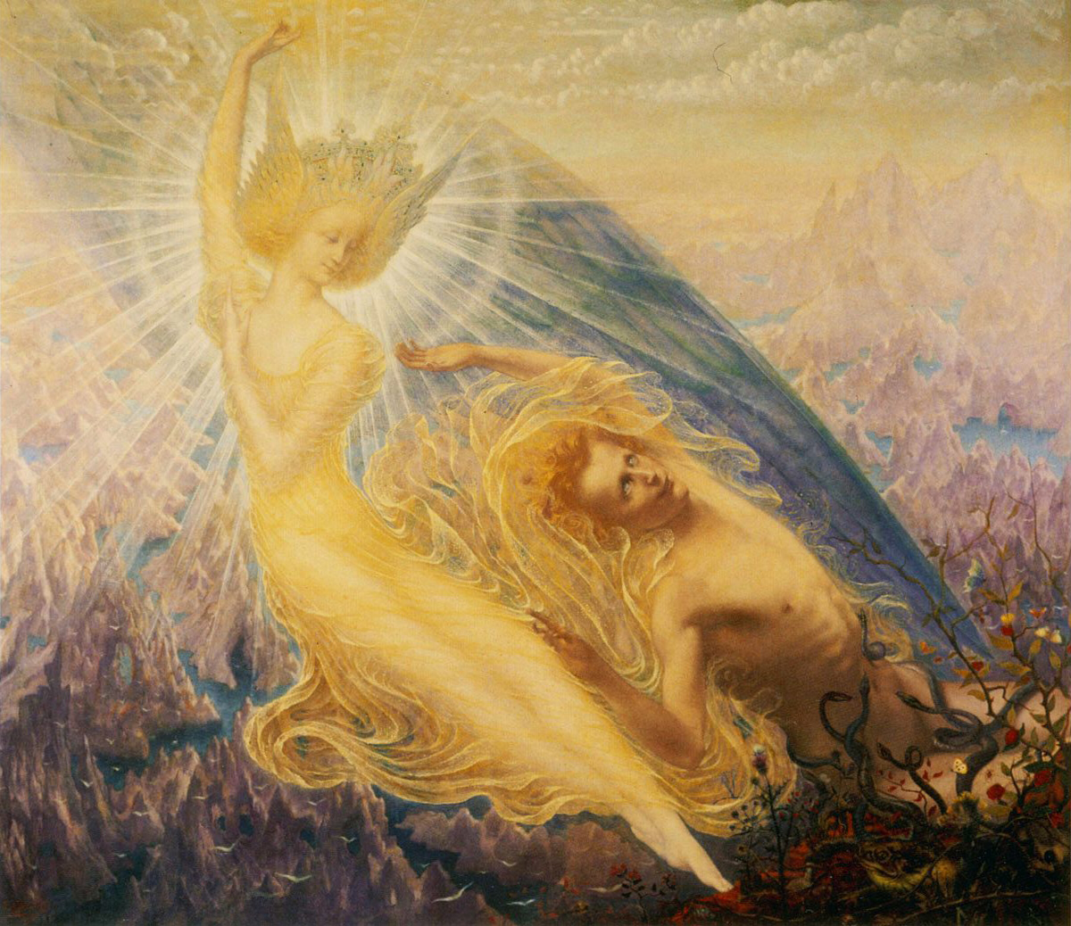
A European Phenomenon
Although not yet matured into book-length treatments, there are several important articles on Theosophy and the visual arts in Belgium (Sébastien Clerbois' book is about art and esotericism, not only Theosophy) – Jean Delville (1867-1952, left: The Angel of Splendor) was a prominent Theosophist –, Germany, Switzerland, Czechoslovakia, Hungary, Greece, France – Paul Sérusier (1864-1927), Maurice Chabas (1862-1947) –, UK, Ireland….

Slide 9
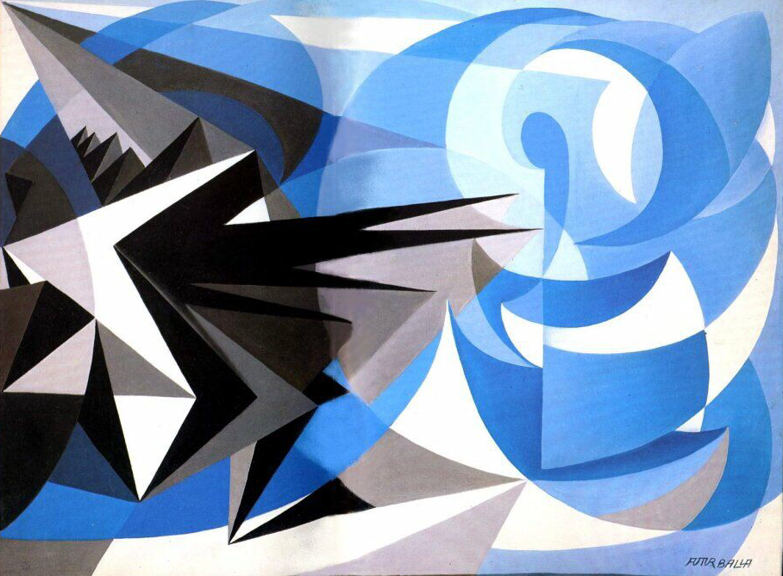
A Tale of Several Countries
…Italy – Futurists, such as Giacomo Balla (1871-1958: Pessimism and Optimism, 1923, left), but also Filippo De Pisis (1896-1956) –, Poland, Lithuania – M.K. Čiurlionis (1875-1911) learned about Theosophy from Stabrowski –, Bulgaria, Russia – Kandinsky and Nicholas Roerich (1874-1947), of course, but others knew Theosophy through P.D. Ouspensky (1878-1947), including Kazimir Malevich (1879-1935) –...

Slide 10
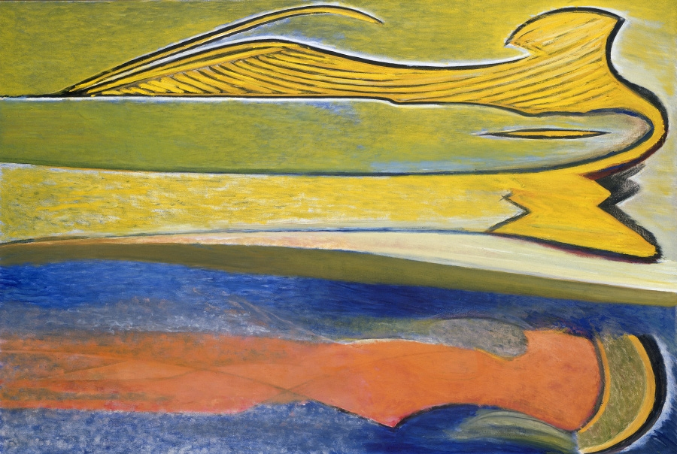
Beyond Europe
And it went beyond Europe: India, Japan, Australia, Mexico – several muralistas, with all their Marxism, were exposed to Theosophy –, Canada: Lawren Harris (1885-1970: Atma Buddhi Manas, 1960, right), the best known Canadian painter of the 20th century, was a very active Theosophist, and gathered around him other Theosophists in the Group of Seven

Slide 11
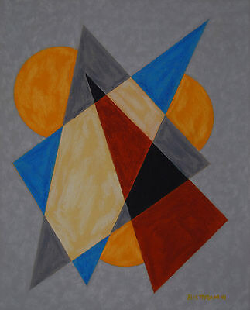
United States
In the US, there were art schools in the Theosophical colonies of Lomaland and Halcyon, and Lawren Harris was among the founders in New Mexico of the Transcendental Painting Group, which was in contact with Roerich and included Emil Bisttram (1895-1976: Encaustic, 1941, left) and Raymond Jonson (1891-1982), all Theosophists. Even such luminaries as Jackson Pollock (1912-1956) and Georgia O'Keeffe (1897-1986) were exposed to Theosophy during certain periods of their lives

Slide 12
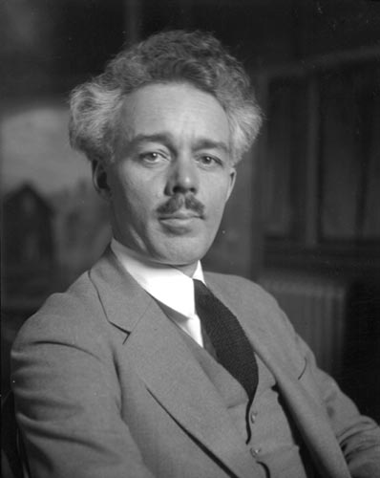
Theosophical Art?
But is the fact that so many artists were associated with the Theosophical Society a mere coincidence? Or did a «Theosophical art», as Mondrian claimed, exist?
Lawren Harris (right) claimed that Madame Helena Blavatsky (1831-1891) inaugurated a new aesthetic, where art should no longer try to preach a religion or spirituality, neither directly nor indirectly, i.e. through symbols
A real «Theosophical art», Harris concluded, should rather induce its audience to experience a higher plane of being through beauty. Although this effect may be obtained through different forms of art, Harris claimed that in this stage of human evolution abstract art is more effective

Slide 13
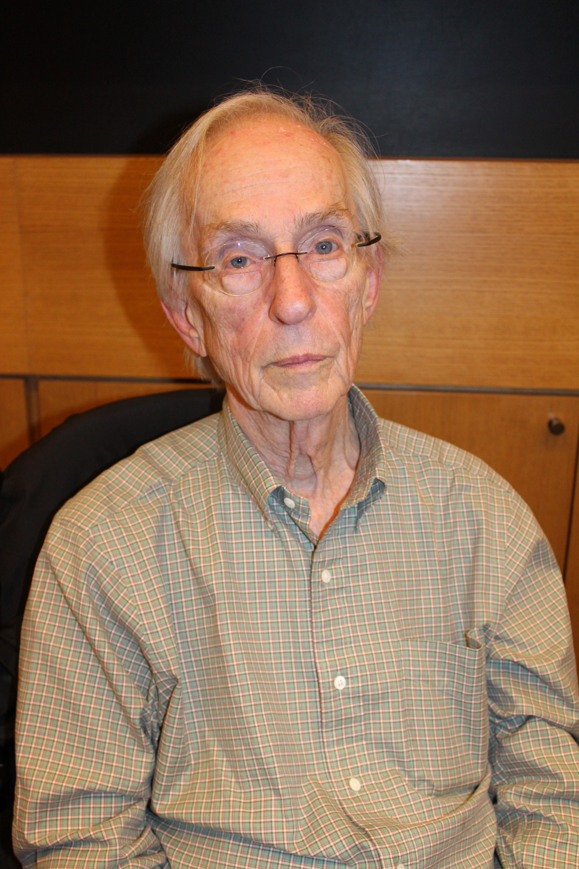
A Theosophical «World of Art»
American sociologist Howard S. Becker (left), in his important contribution to sociology of art, argues that art is a social construction produced by «worlds of art», where the artist is never alone and the work of art is co-produced by many other agents
The role of the Theosophical Society, through its special interest in art, is best seen as acting as one such agent, and contributing to the creation of one (or rather more) peculiar «world(s) of art»

Slide 14
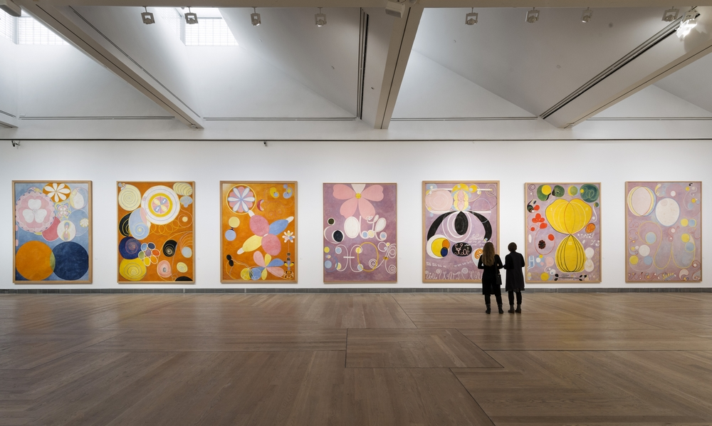
Scandinavia
Coming back to the national studies on Theosophy and the arts, Scandinavia was somewhat overlooked, at least until recently when, through several major exhibitions and conferences, the Swedish Theosophist Hilma af Klint (1862-1944) was recognized as an important pioneer of abstract art

Slide 15
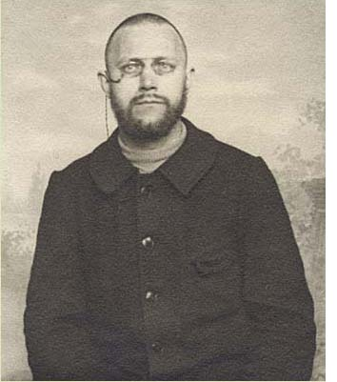
Ivan Aguéli (1869-1917)
Perhaps the first significant Scandinavian artist to encounter Theosophy, «to which he was introduced by [his mentor French painter Émile] Bernard [1868-1941] in 1891 and which he never fully rejected» (M. Sedgwick, Against the Modern World [2004], 60) was the Swedish painter Ivan Aguéli (right)

Slide 16
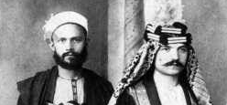
Conversion to Islam
In Paris, Aguéli developed a close relationship with Theosophist, anarchist, and animal right activist Marie Huot (1846-1930). He later converted to Islam as Abd al-Hadi, and spent several years in Egypt, where he was initiated in the Sufi Shadhiliyya brotherhood in 1907. With fellow Muslim convert Enrico Insabato (1878-1963 – bottom: Aguéli, left, and Insabato), he published in Cairo il Convito – an- Nadi, a magazine devoted to Islam that maintained quite ambiguous ties with the Italian intelligence

Slide 17
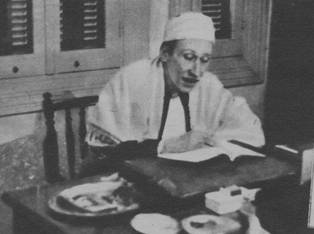
Aguéli and Guénon
Probably – but the point remains controversial – it was Aguéli who initiated the French esotericist René Guénon (1886-1951, left) into the Shadhiliyya, under the authority of his Egyptian Shaykh 'Abd al-Rahman Ilaysh al-Kabir (1840–1921). In the early 1910s, both the painter and Guénon were part of the Universal Gnostic Church and wrote in the Paris journal La Gnose
Appreciations of Aguéli’s Sufism vary. M. Sedgwick regards it as a «Romantical and Theosophical neo-Sufism» («Neo-Sufism», in The Cambridge Companion to New Religious Movements [2012], 204)

Slide 18
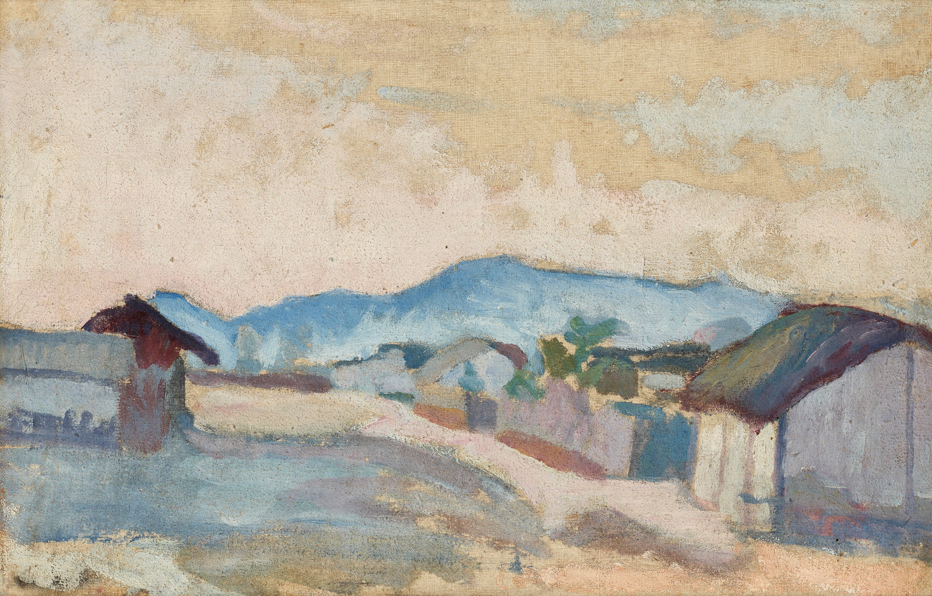
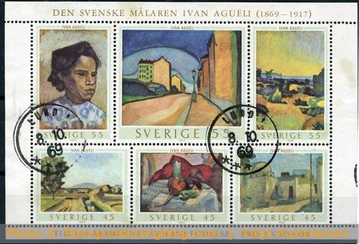
An Influential Painter
In Sweden, however, Aguéli is primarily well-known as an original and influential painter (Bergsby, 1916-17, above). He was honored by a series of stamps in 1969, the centenary year of his birth, and a museum is dedicated to him in his native town of Sala

Slide 19
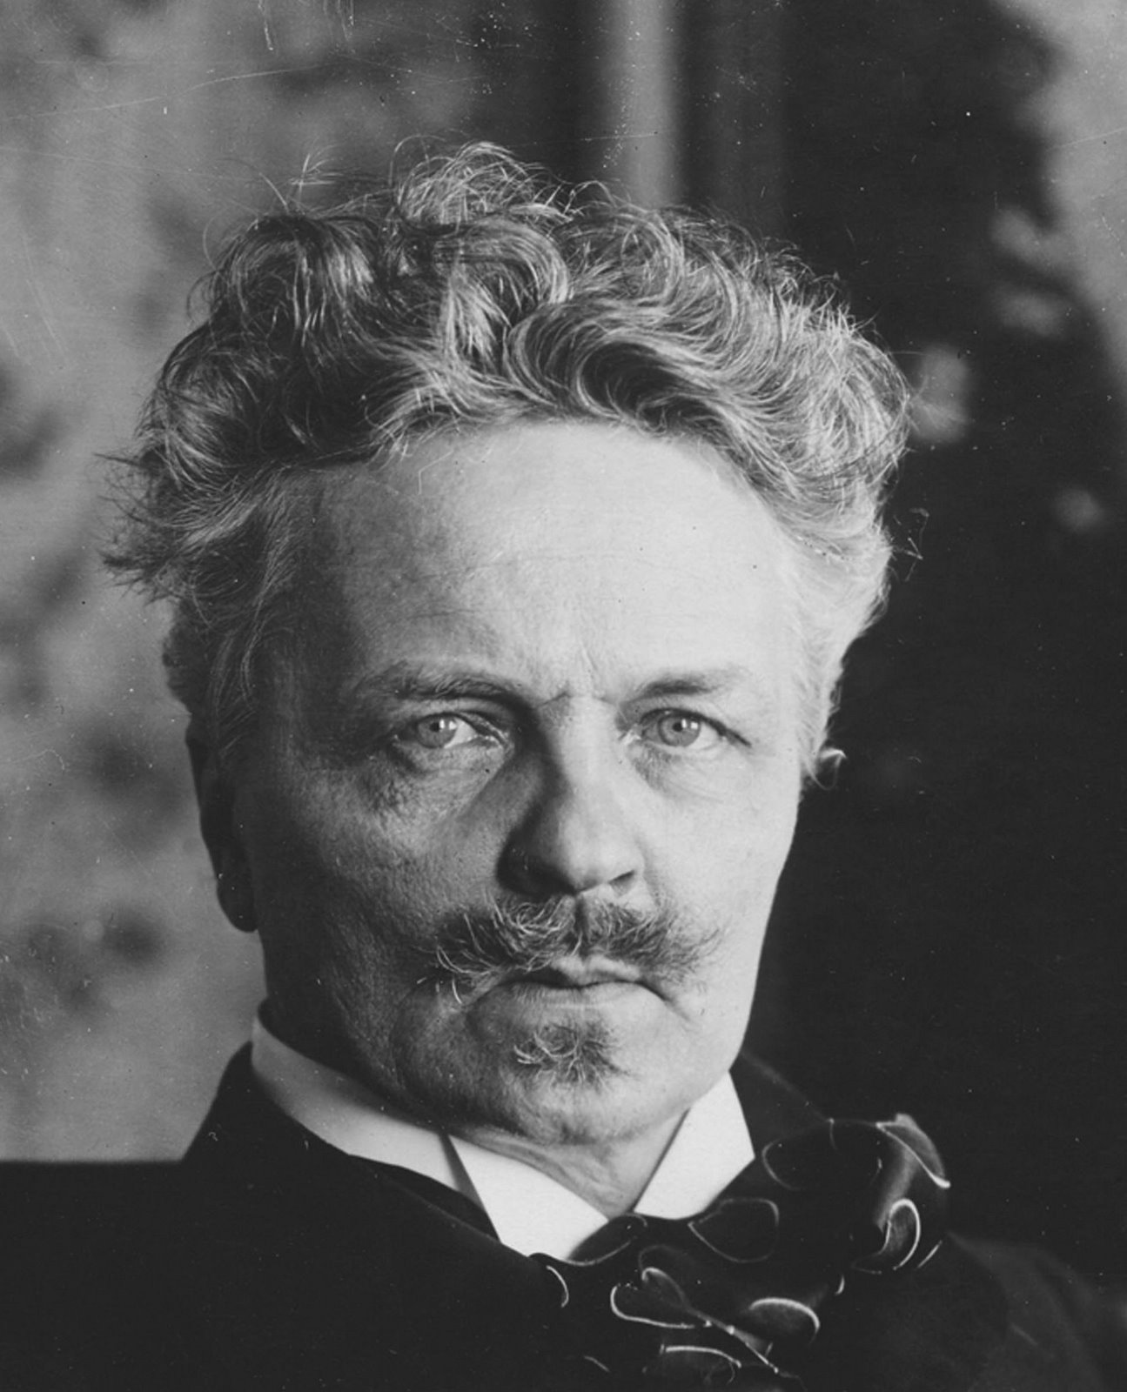
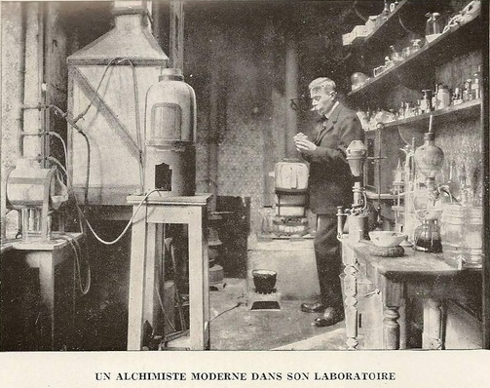
Strindberg and Theosophy
In Paris, shortly after Aguéli, and evolving in different circles, such an important Swedish intellectual as August Strindberg (1849-1912, right) became involved with the Isis Lodge of the Independent Theosophical Society of French alchemist François Jollivet-Castelot (1874-1937, bottom)

Slide 20
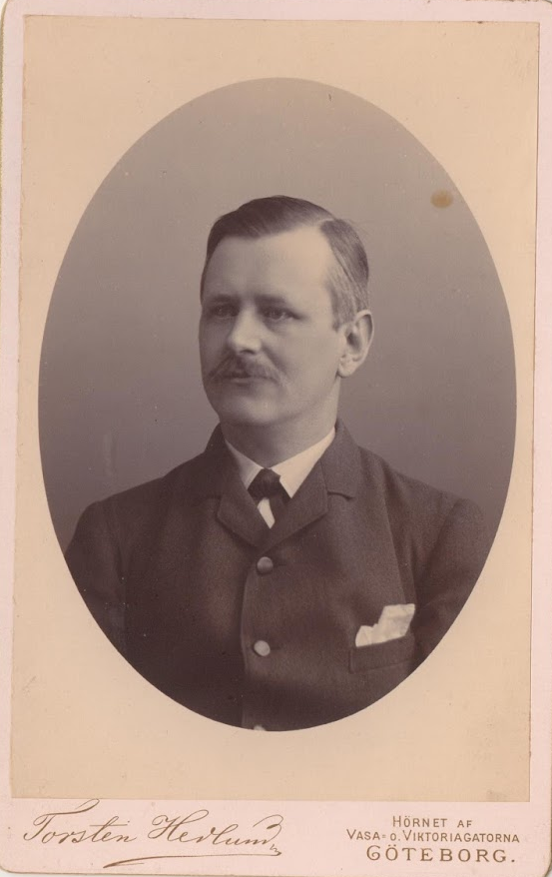
The Hedlund Connection
Strindberg had already explored Theosophy after meeting in Sweden the publisher and Theosophist Torsten Hedlund (1855-1935, left). Although later he also criticized Theosophy as «outdated», Ester Kiss Szalczer and Harry G. Carlson demonstrated how Strindberg always kept reading Theosophical publications and was constantly influenced by them

Slide 21
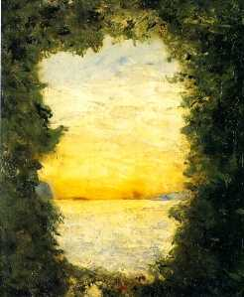
Strindberg as Painter
Although mostly well-known as a writer and playwright, Strindberg was also a painter. Theosophical influences are perhaps more apparent in some of his paintings (Baby’s First Cradle, 1901, left) than in his literary work

Slide 22
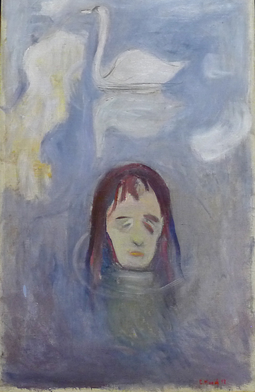
The Esoteric Munch
While several Swedish artists met Theosophy in Paris, it was in Berlin that in the 1890s Norwegian Edvard Munch (1863-1944, The Vision, 1892, right) «associated almost exclusively with a group of occultists, believers in Mesmerism and Theosophy» (M. Tuchman, «Hidden Meanings in Abstract Art» [1986], 33). He had as his closest friend Polish Romantic Satanist Stanislaw Przybyszewski (1868-1927), attended séances, and read both Blavatsky and Emanuel Swedenborg (1688-1772)

Slide 23
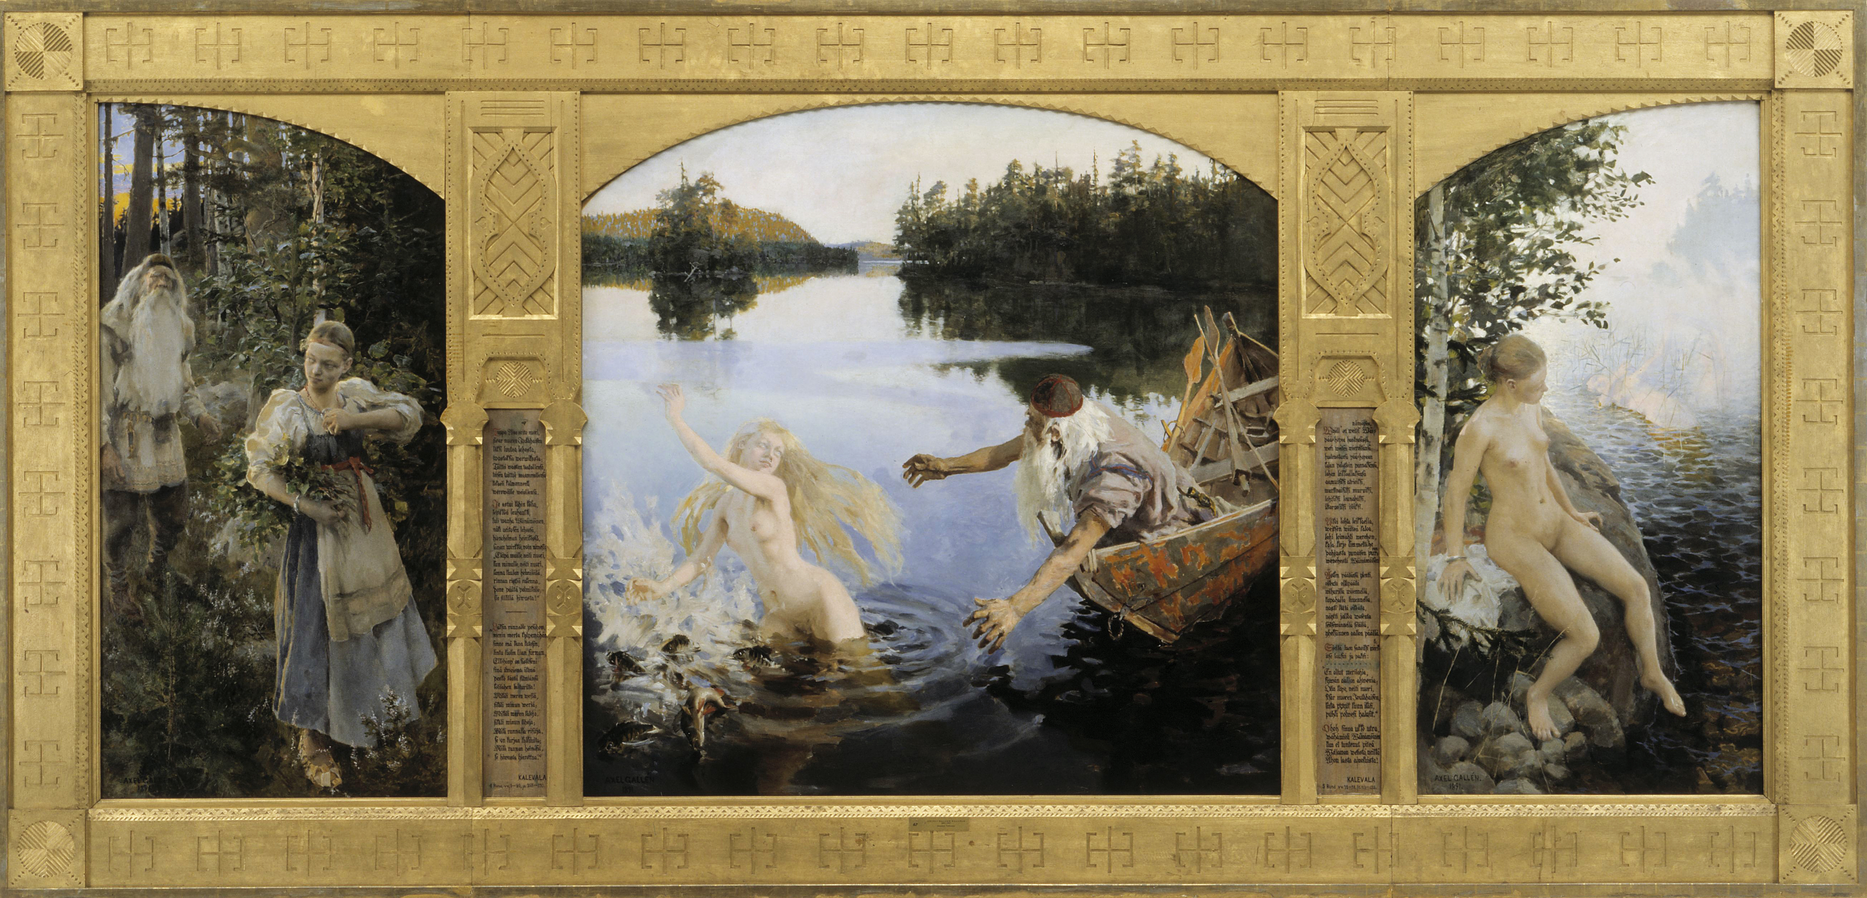
Galen-Kallela and the esoteric Kalevala
Munch’s Theosophical-occult circle in Berlin included the Finnish Symbolist painter Akseli Gallen-Kallela (1865-1931), who was a friend of Roerich, read Theosophical literature, and started interpreting the Finnish national epic Kalevala according to fin-de-siècle esotericism and Theosophy (Aino Triptych, 1891)

Slide 24
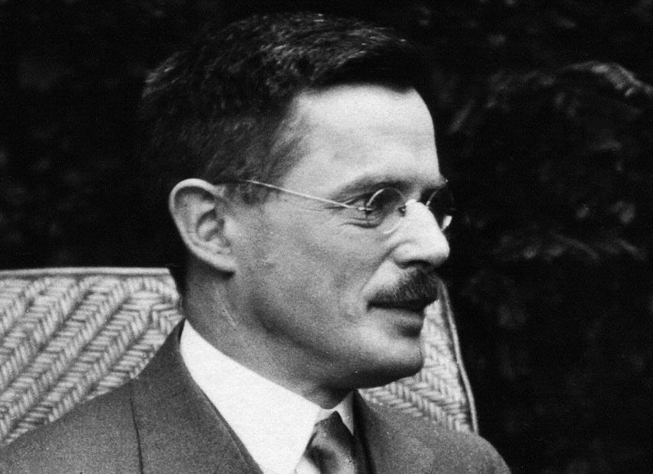
Osvald Sirén (1879-1966) and Theosophy
Born in Finland, art historian Osvald Sirén became a professor at the University of Stockholm and curator of Asian works at the Swedish National Museum
Theosophy played an important part in his life, and inspired him to make Chinese art and culture (particularly Buddhist) known in the West. He inspired several Scandinavian artists and sided with the American Theosophical faction of Katherine Tingley (1847-1929), which had a section in Sweden

Slide 25
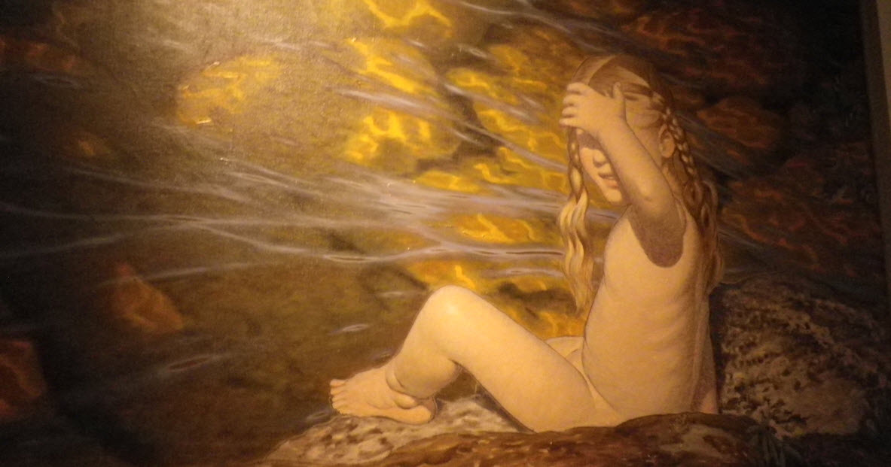
Gustaf Fjæstad and the Rackstad Colony
An important episode of the relationship between art and Theosophy in Sweden was the Rackstad Colony on Lake Racken, whose leaders were the painter Gustaf Fjæstad (1868-1943: Sunlight on Shallow Water, 1906) and his wife and fellow painter Maja (1873-1961). Gustaf, Maja and other artists from the colony joined in 1909 the Theosophical Lodge of Arvika and lectured often on behalf of Theosophy. Fjæstad’s art was even criticized as merely «preaching» Theosophy

Slide 26
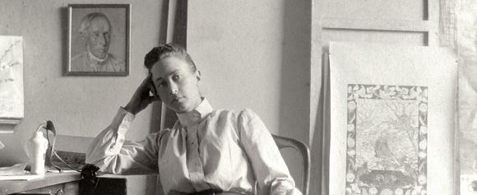
Hilma af Klint (1862-1944)
From the 1986 exhibition The Spiritual in Art to the great European displays of 2013 and 2014, Hilma af Klint (above) has been truly rediscovered as a forgotten but important pioneer of abstract art. Professionally trained at Stockholm’s Royal Academy of Fine Arts, she was known for her landscapes and botanical watercolors, but never exhibited her abstract works during her lifetime. They were revealed to the world only in 1986

Slide 27
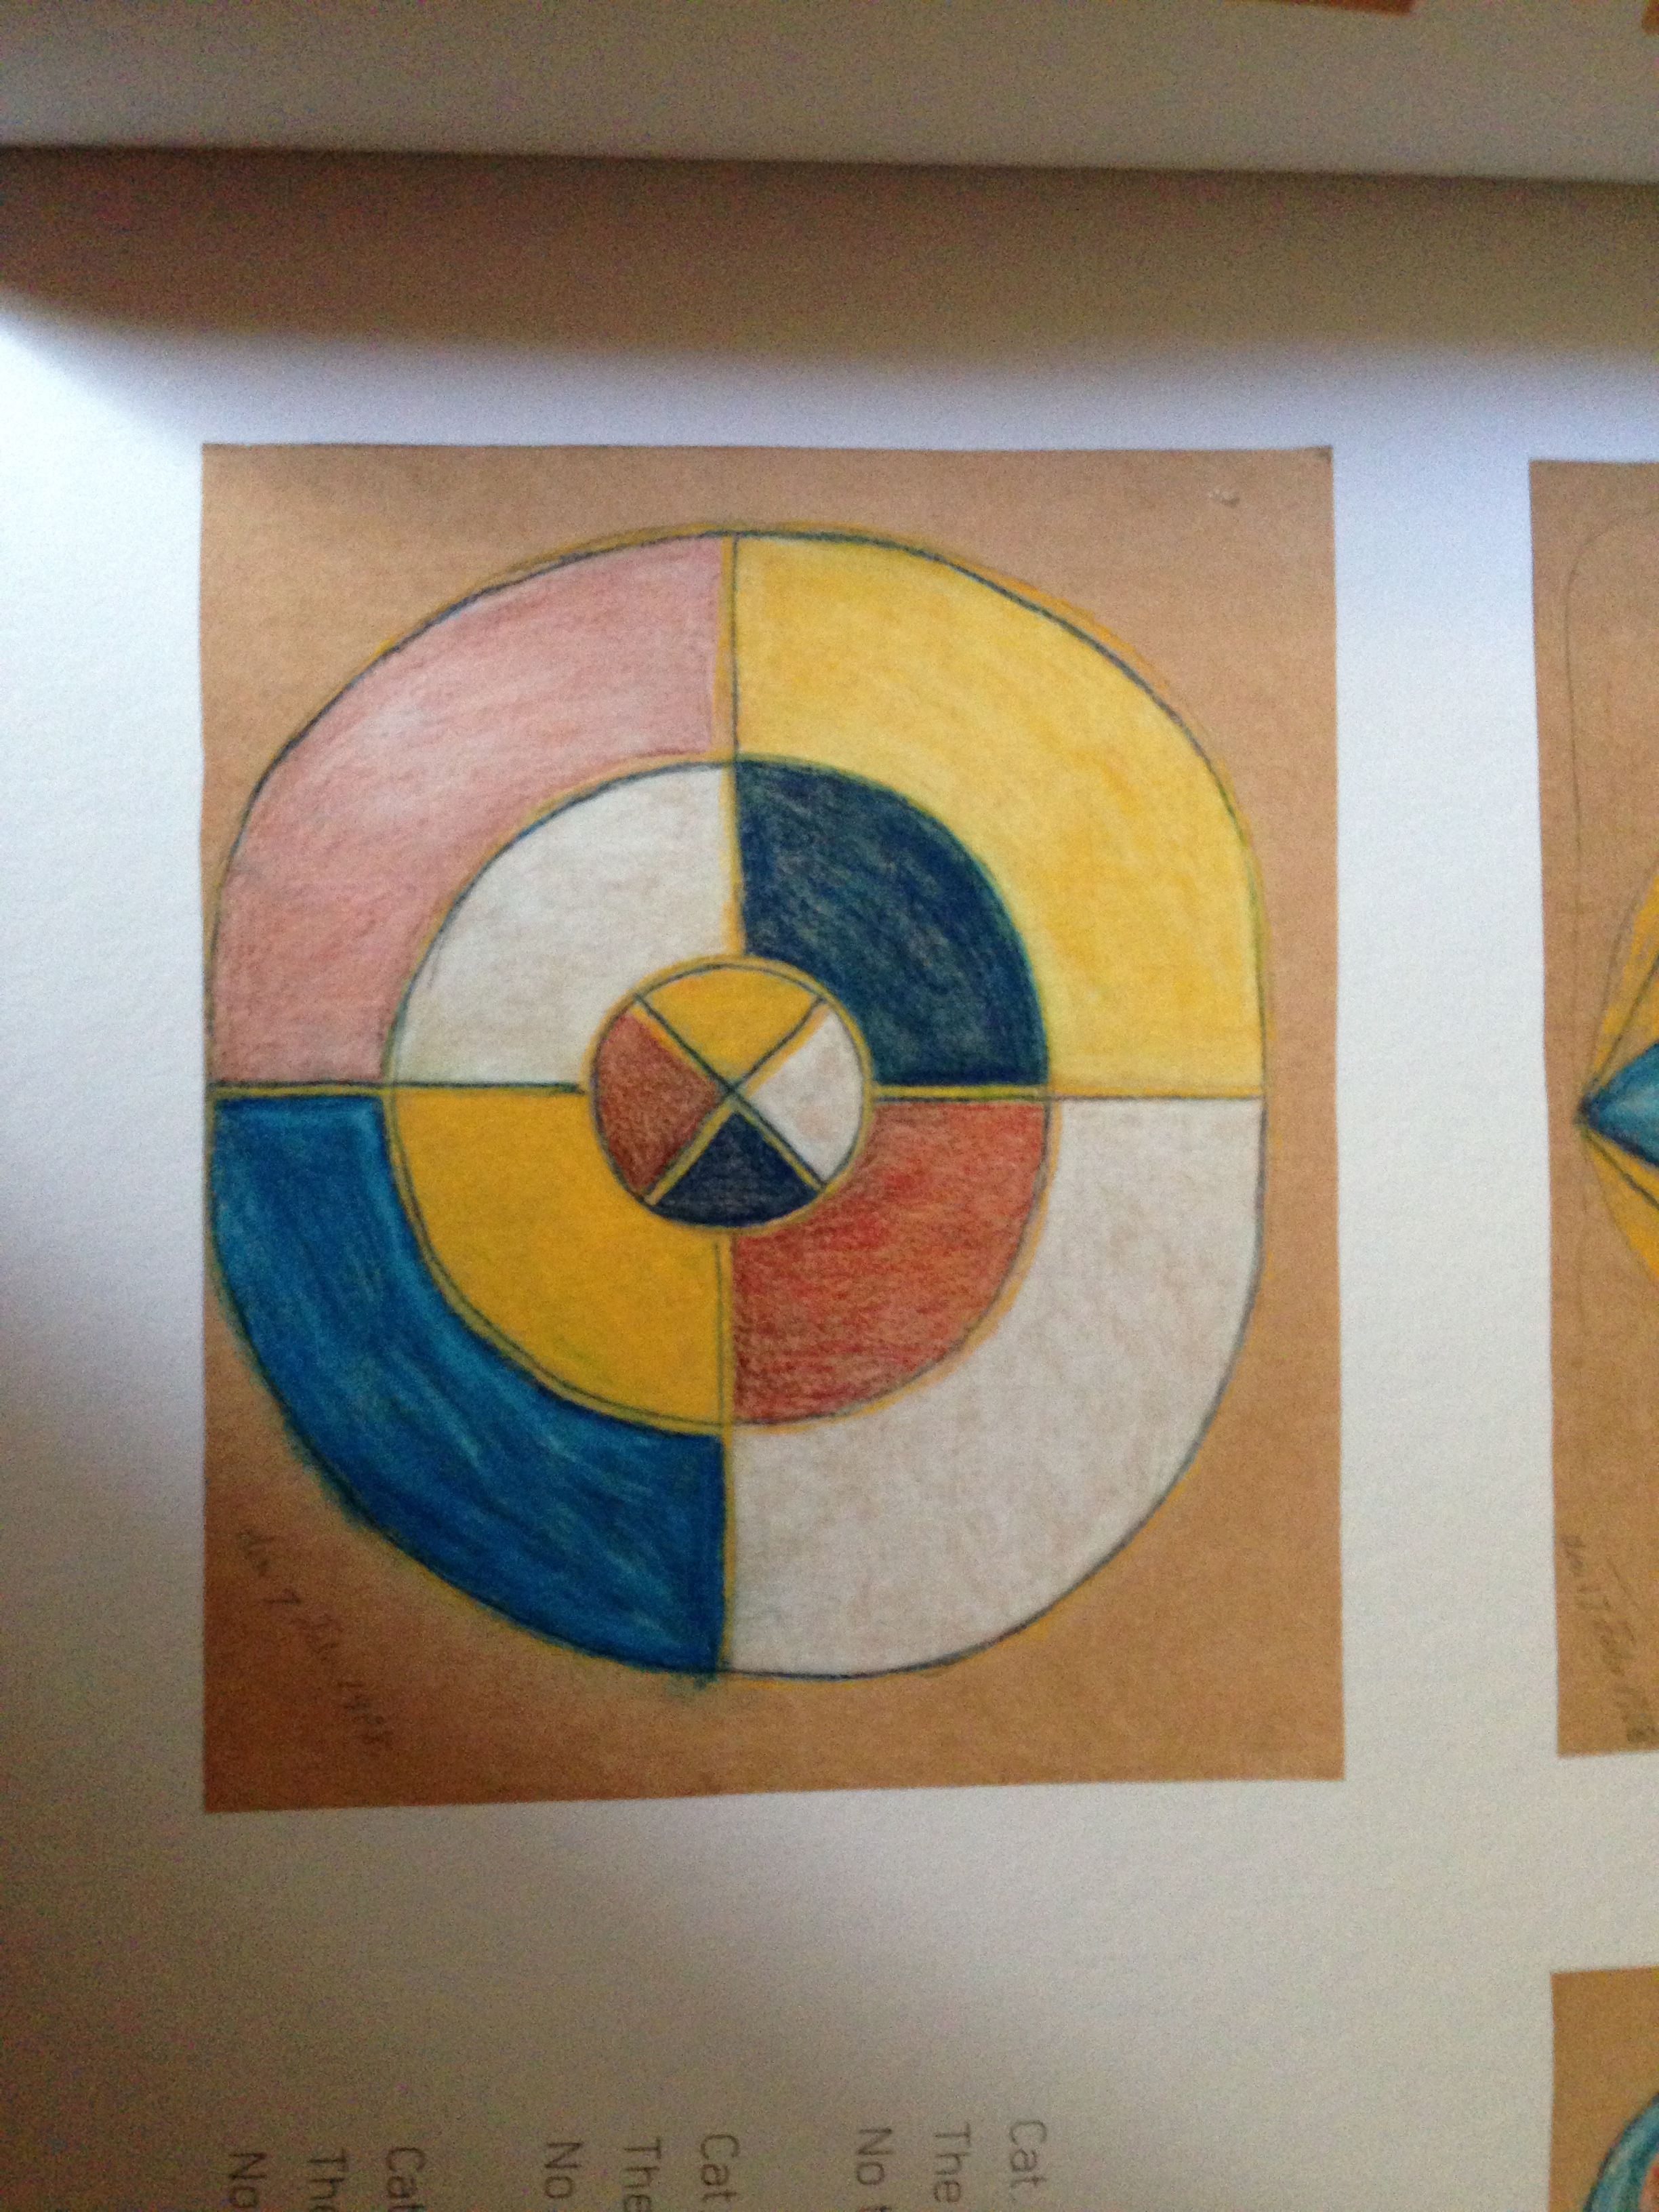
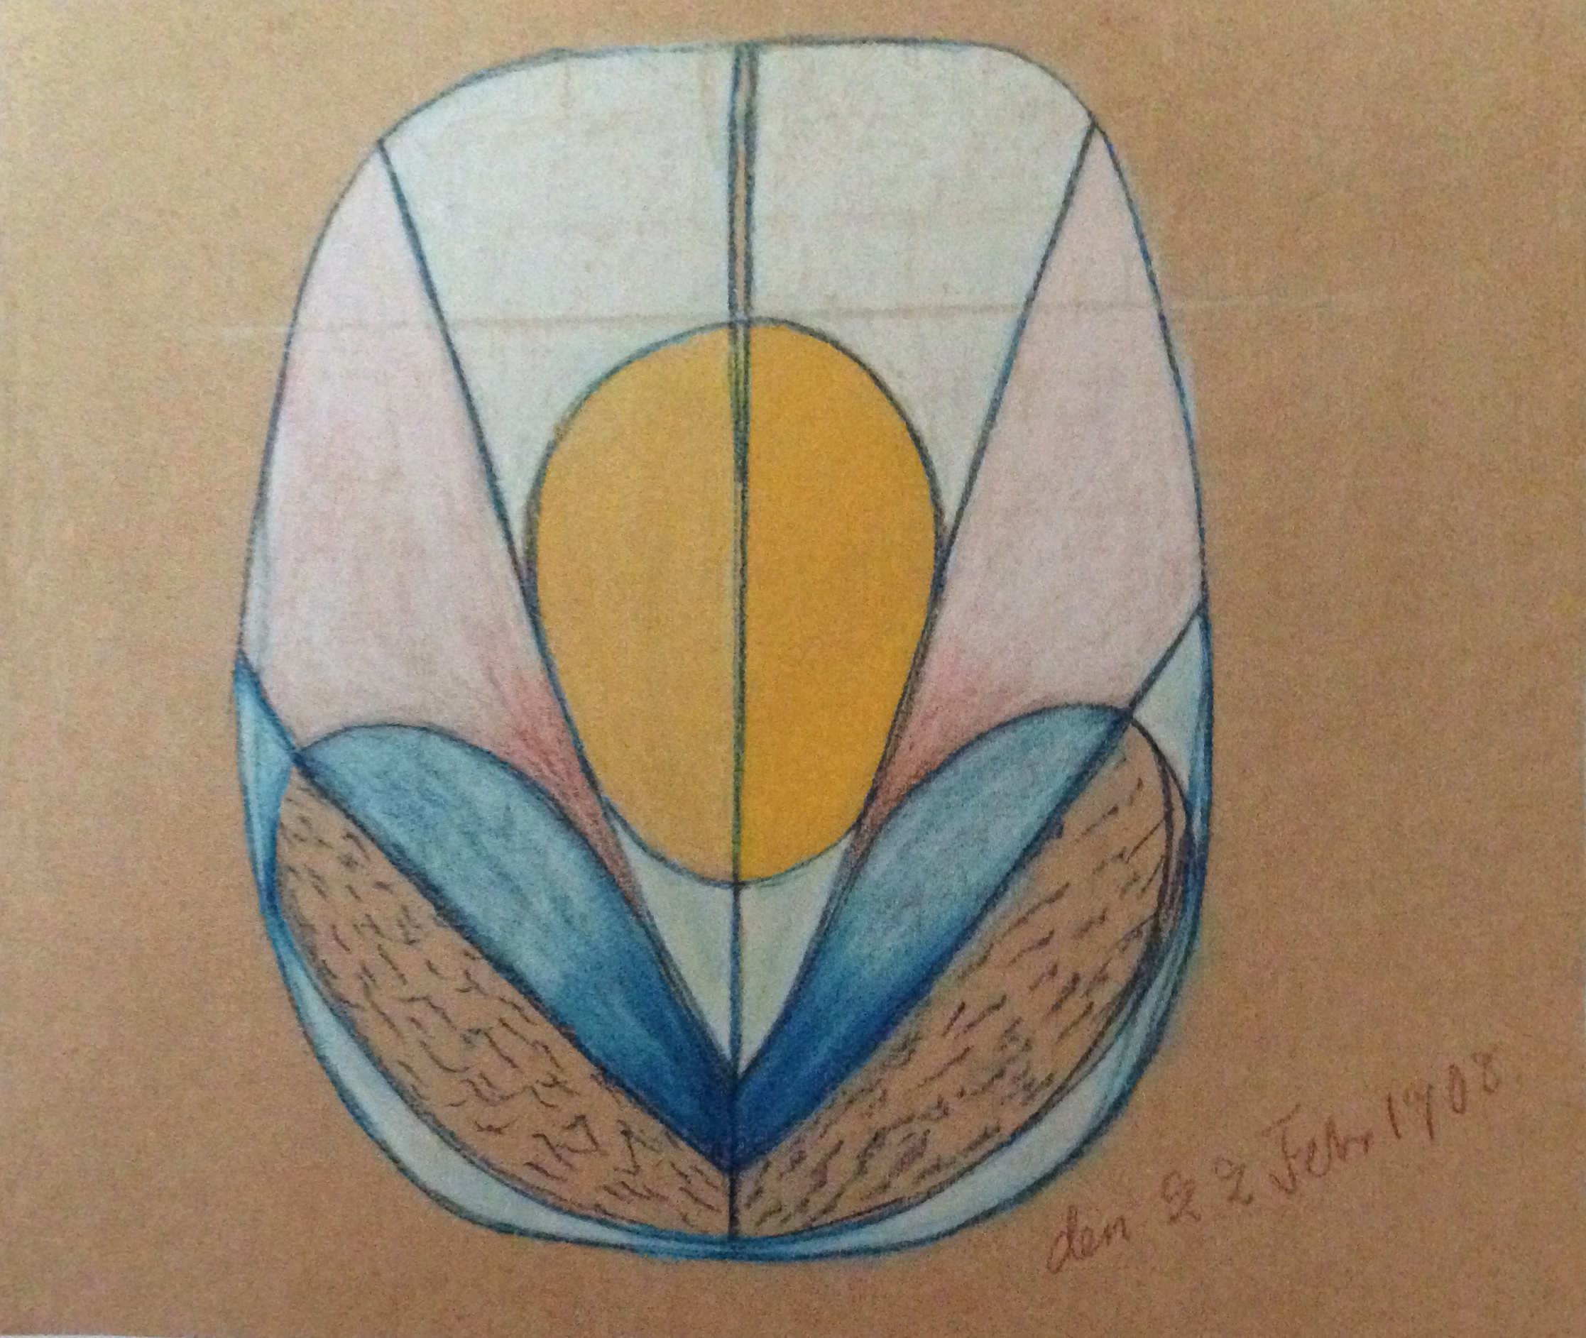
Spiritualism and The Five
Hilma af Klint explored Spiritualism since the 1870s and later became herself a medium. In 1896,with four other women artists, she formed the group De Fem (The Five), which produced automatic paintings – most often simply signed «De Fem» (above) – under the guidance of the spirits Gregor, Clemens, Gidro, Amaliel, Ananda and Esther

Slide 28
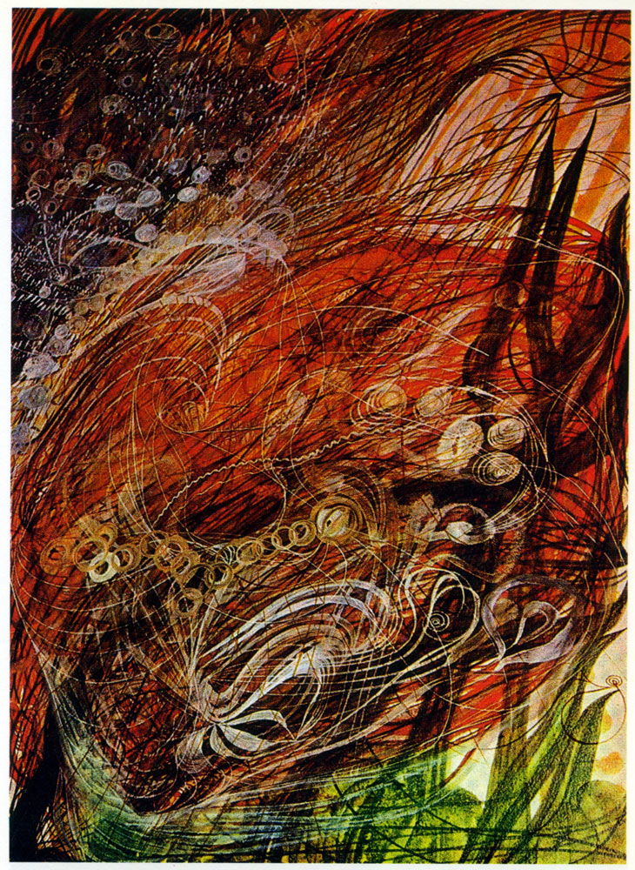
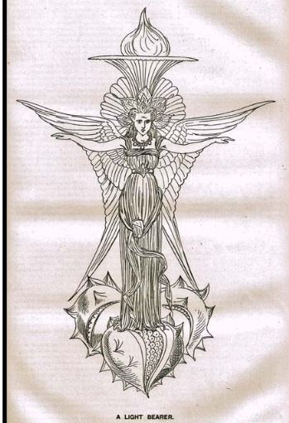
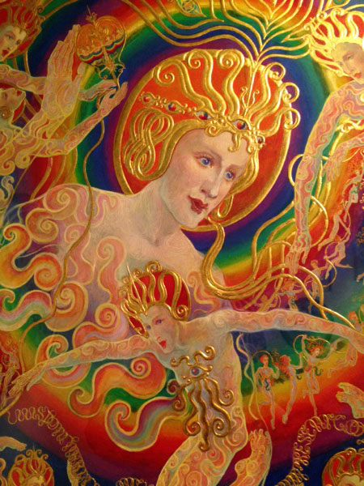
Spirit Painting
Hilma af Klint did not invent mediumistic painting. As Marco Pasi has noted, it had a long tradition in Spiritualist and Theosophical milieus. It has been studied by Rachel Oberter in her 2007 Yale Ph.D. dissertation, and includes inter alia Georgiana Houghton (1814-1884, left), Anna Mary Howitt-Watts (1824-1884,center), and Ethel Le Rossignol (1873-1970, right)

Slide 29
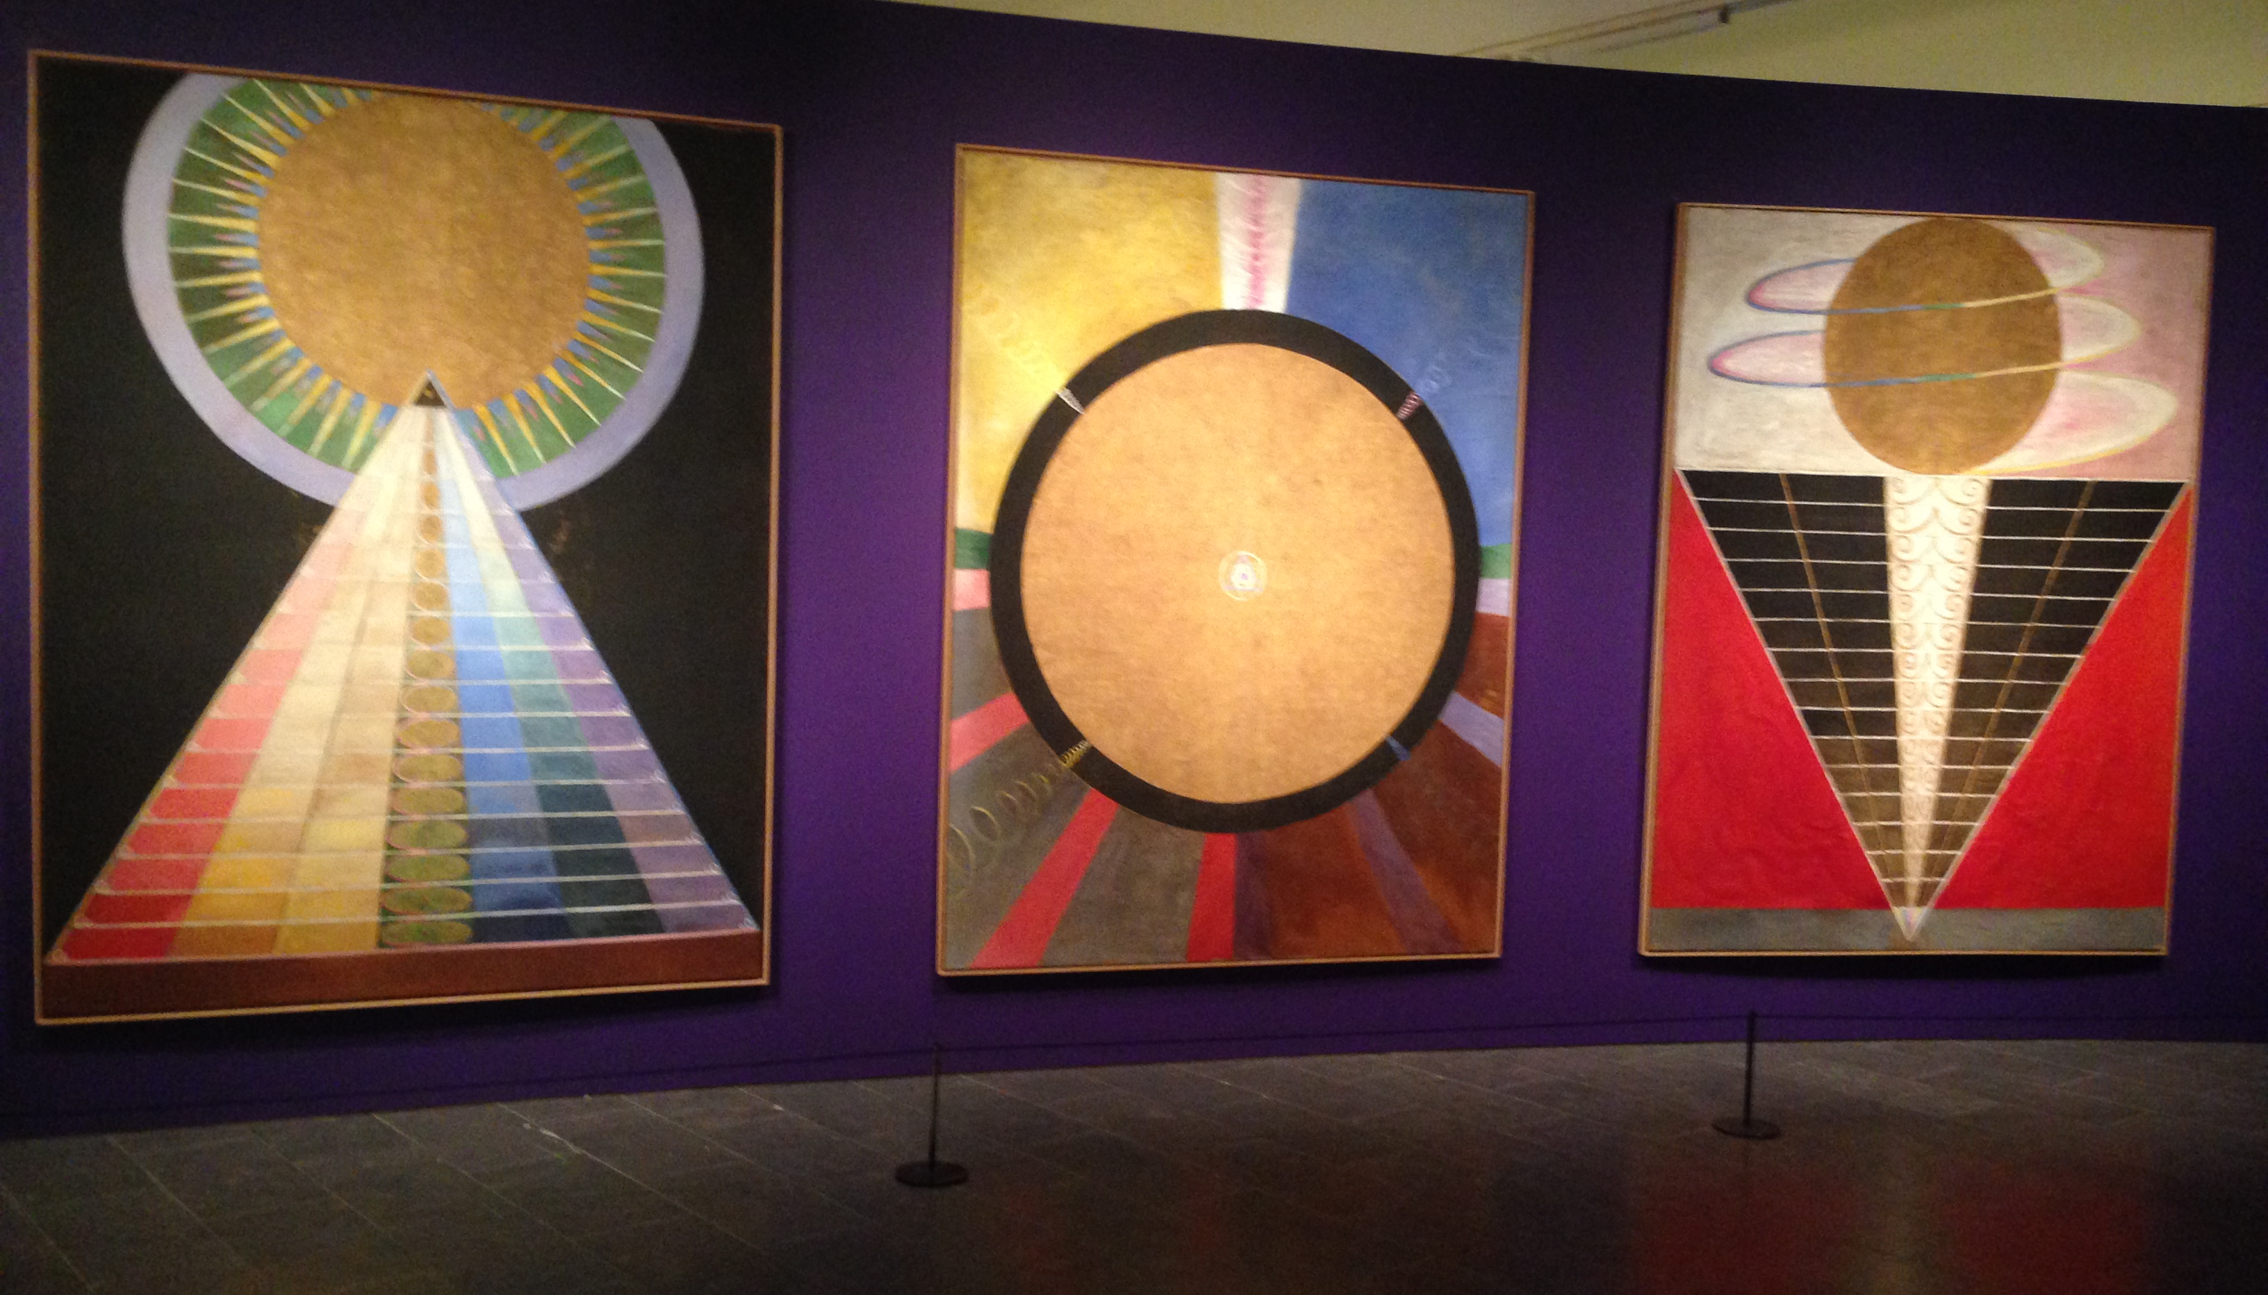
The Paintings for the Temple
In 1905, Hilma af Klint was asked by the spirit Amaliel to produce the Paintings for the Temple. She completed the commission only in 1915 with three Altarpieces (above), and produced 193 paintings illustrating the origins of the world and the evolution of the soul

Slide 30
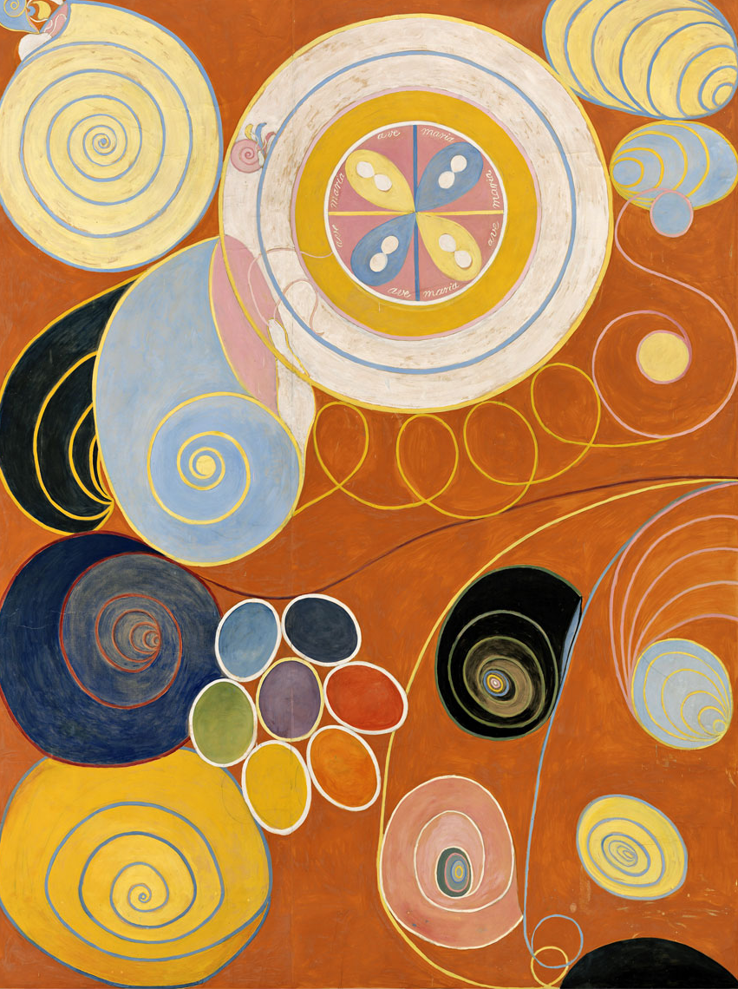

Steiner and Besant
While she worked on the huge Ten Largest, depicting the spiritual evolution, Hilma af Klint met Rudolf Steiner (1861-1925), at the time still with the Theosophical Society, in 1908. She had been registered as a member of the Adyar Society on May 23, 1904:
In 1913, she met Annie Besant (1847-1933) at the Stockholm conference of the Theosophical Society, where she remained until 1920, when she joined the Anthroposophical Society and started spending long periods in Dornach

Slide 31
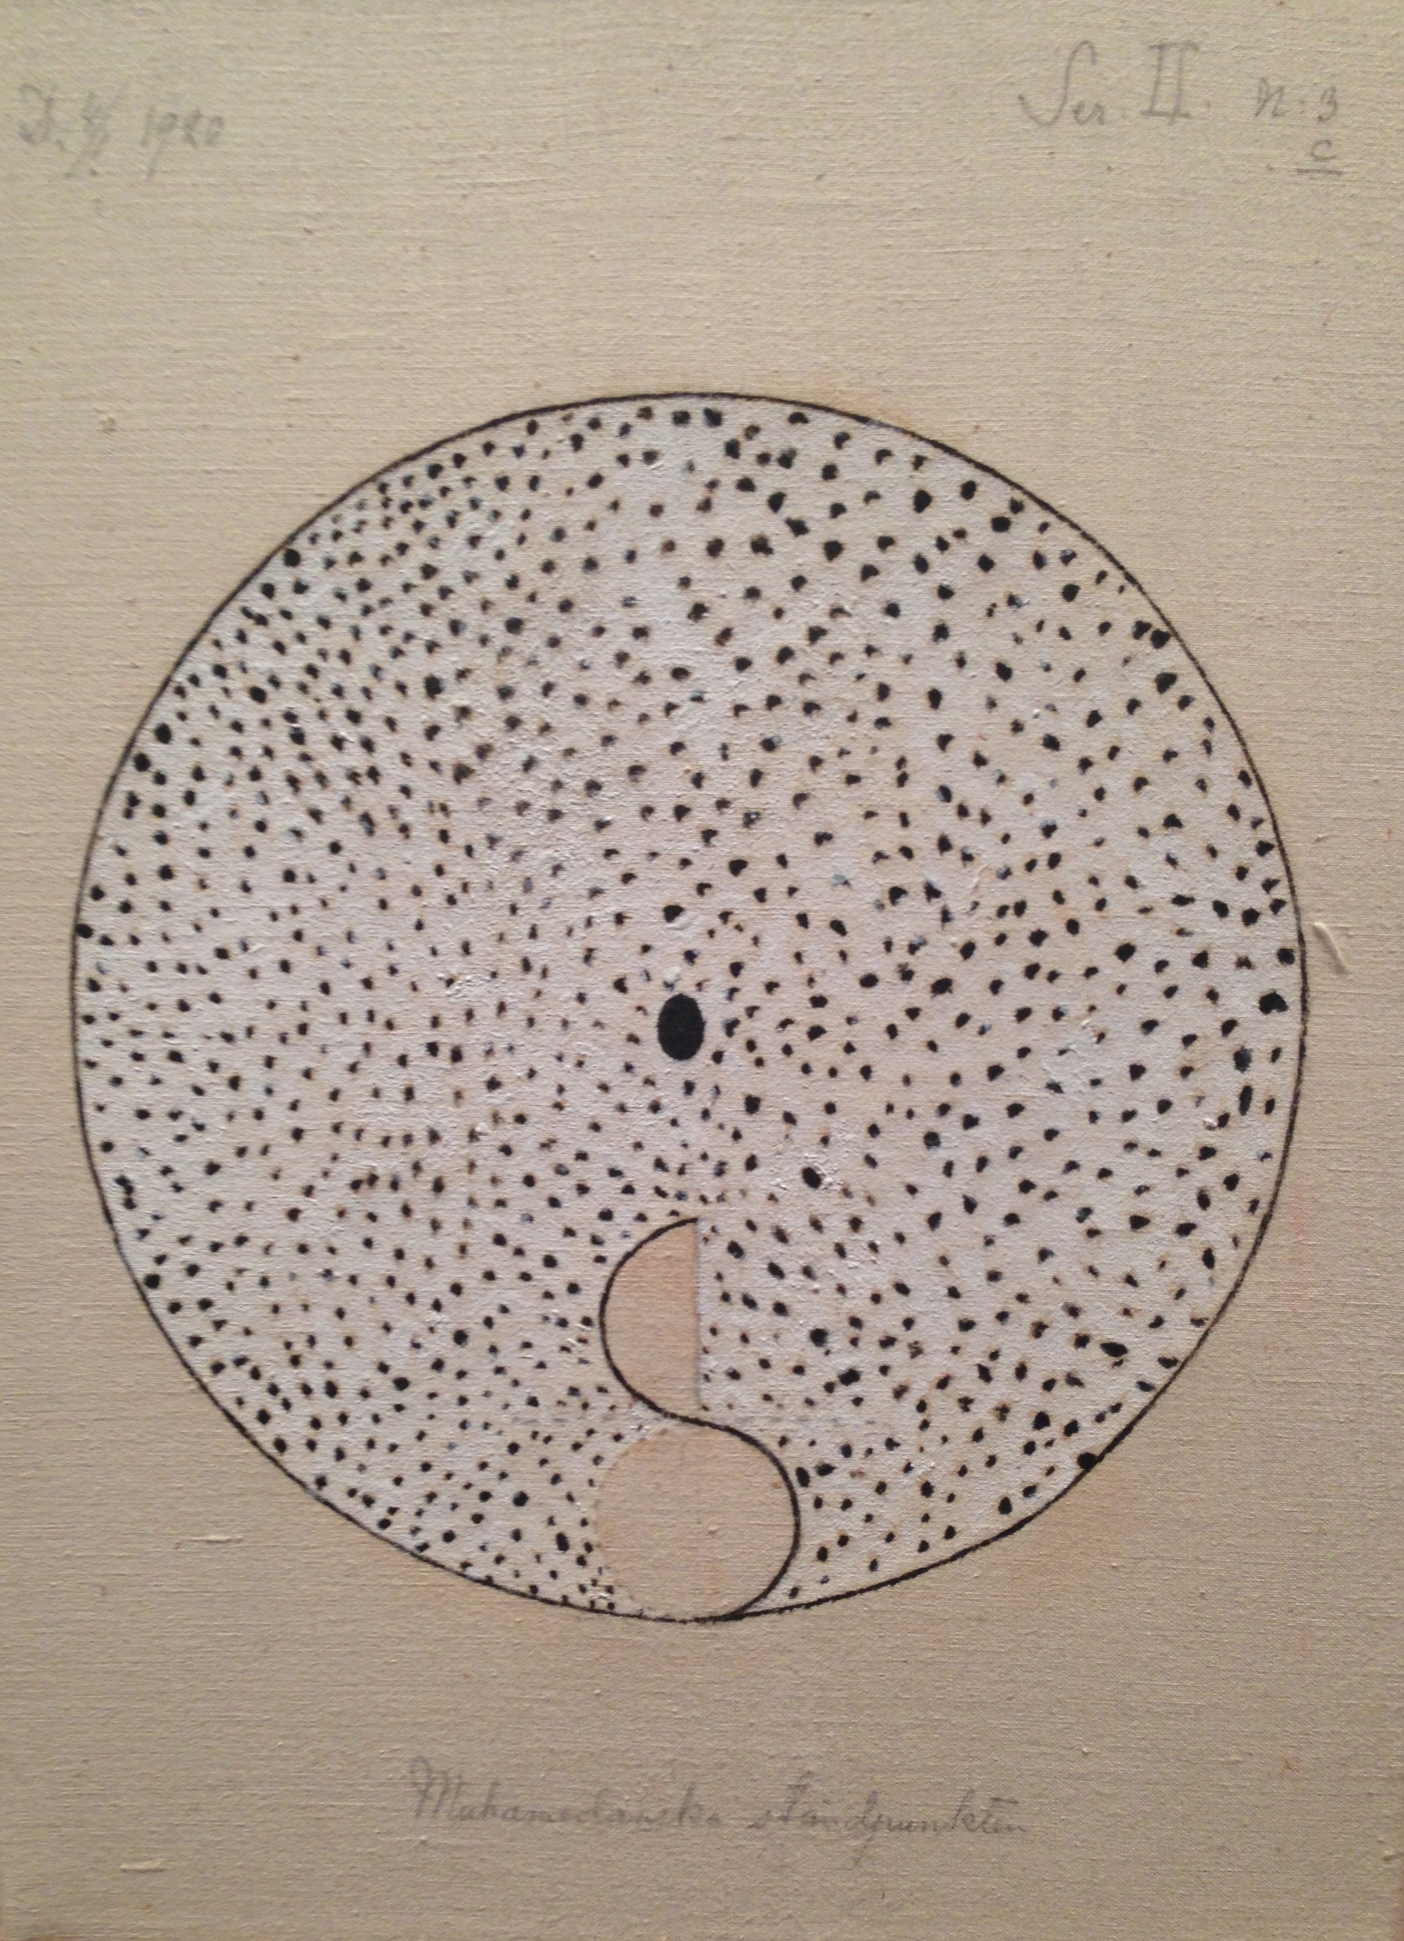
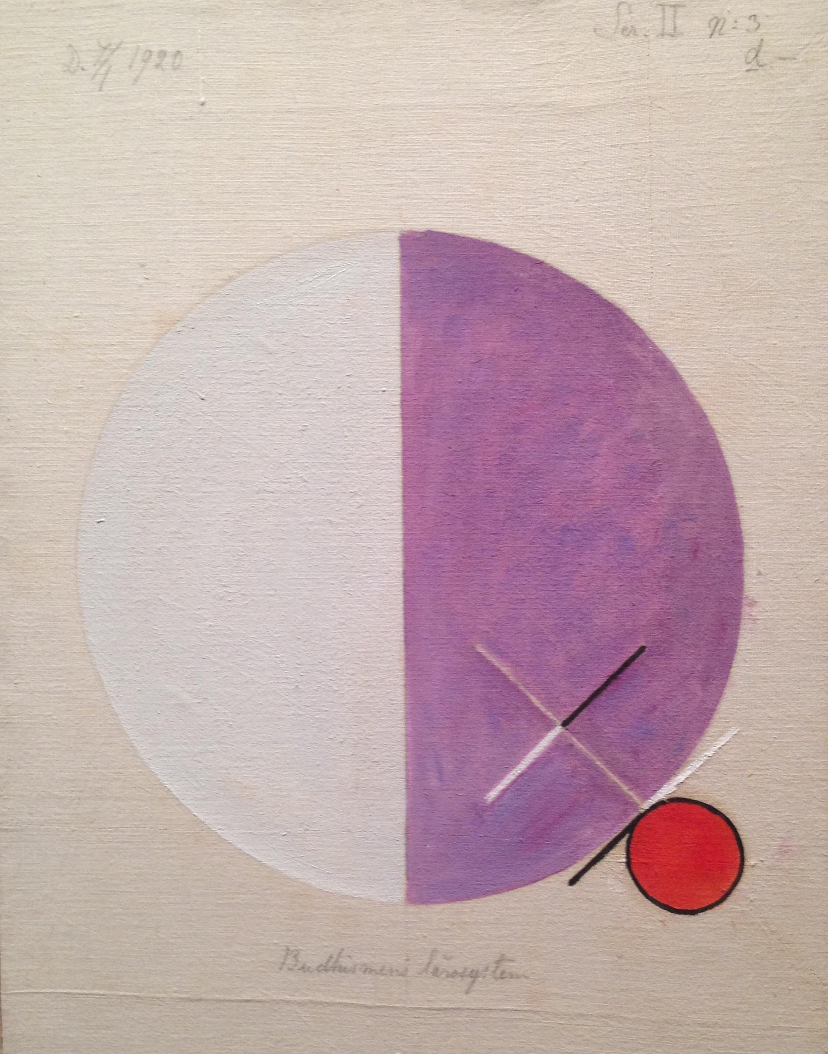
An Esoteric View of Religion
In 1920, when she was moving to the Anthroposophical Society, Hilma af Klint produced her series on the esoteric interpretation of the great religions (Islam, left, and Buddhism, right). She died at age eighty-two in 1944, coincidentally the same year when Mondrian, Kandinsky, and Munch also died

Slide 32
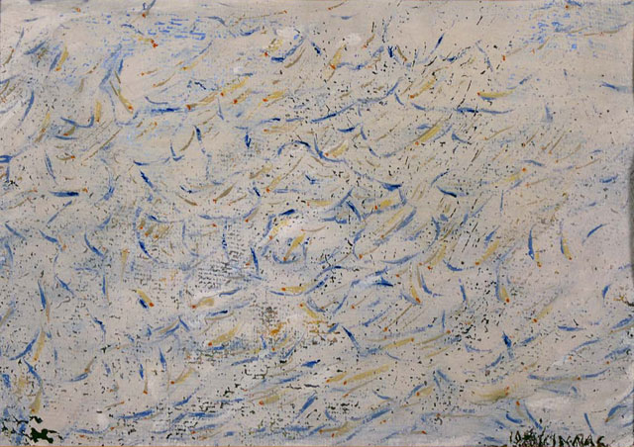
The First Abstract Artist?
When Hilma af Klint was rediscovered, some hailed her as the first abstract artist, preceding Kandinsky. Clearly, Kandinsky was the first who fully theorized abstraction. Who produced the first modern abstract paintings is perhaps not so important – in this case another member of the Theosophical Society, Italian Futurist Arnaldo Ginanni Corradini, «Ginna» (1890-1982: Neurasthenia, 1908, left), and Čiurlionis may also have their claims –, while the influence of Theosophical ideas on the road leading to abstraction remains worth noticing

Slide 33
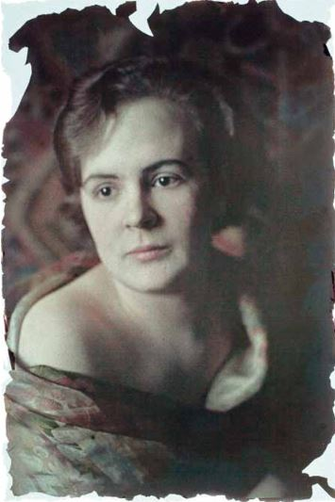
Ilona Harima (1911-1986)
In 2001, an exhibition at the Ateneum Art Museum in Helsinki «rediscovered» also the Finnish artist Ilona Harima (1911-1986)
The daughter of the prominent Ostrobothnian businessman Samuli Hohenthal (1879-1962), who legally changed his last name into Harima in 1936, Ilona never completed her formal training at Helsinki’s Central School of Applied Arts and abandoned a promising career in advertising in order to devote herself to the study of esotericism and Eastern religions, and to a very personal style of painting

Slide 34
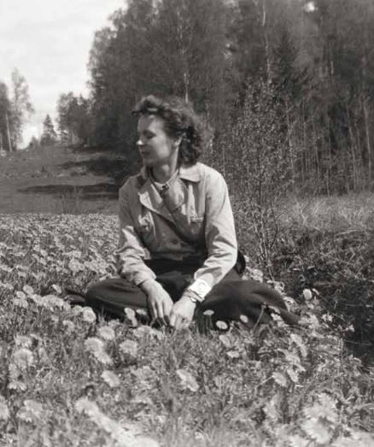
Theosophy and Freemasonry
Ilona joined the Theosophical Society in 1936 and met there her future husband, an architect. She became so absorbed by the Society’s activity and Eastern religions that she could only explain it with the idea that she had already encountered these doctrines in a previous life
She also joined the lodge Viisikanta («Pentagram»: still existing today) of the mixed Freemasonry Le Droit Humain, which had strict connections with Theosophy, and became an active and enthusiastic Freemason

Slide 35
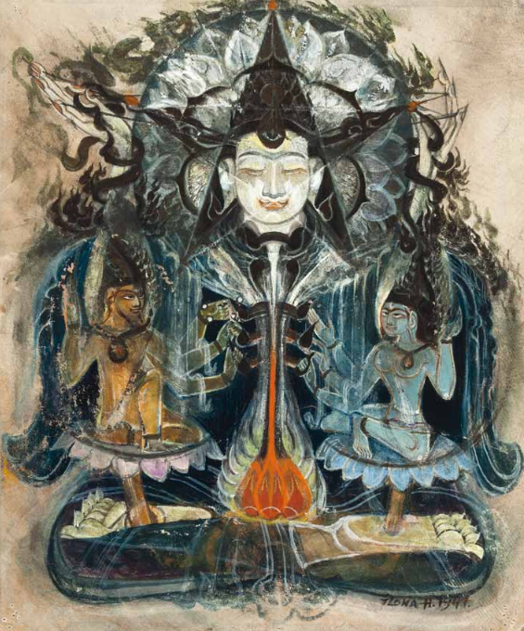
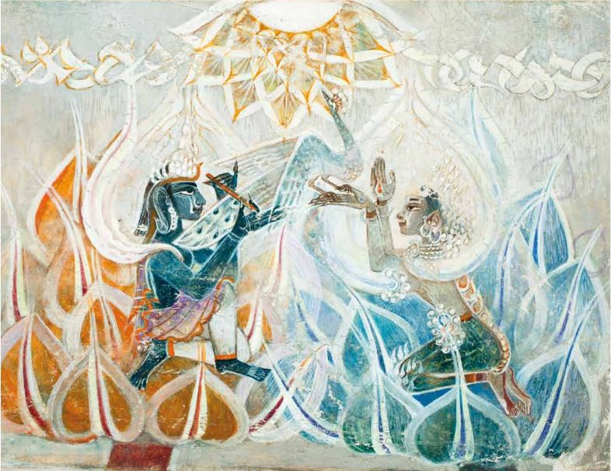
A Passion for the East
In 1934, Hilma af Klint became aware of Ilona Harima’s activities, praised her work, and wrote to her suggesting that she should study Steiner and join the Anthroposophical Society. Ilona, however, remained loyal to the spirituality oriented towards the East of the Theosophical Society, and constantly returned to Buddhist and Hindu themes (Krishna and Rada 1953, left; Buddha and Two Bodhisattvas, ca. 1950, right)

Slide 36
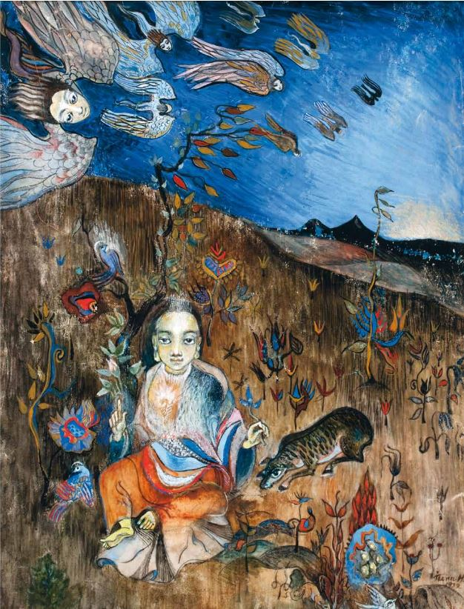
Reverie (1932)
Although the East was never far away, many paintings by Ilona Harima put together symbols derived from different religious and esoteric traditions, emphasizing the truly Theosophical idea that all religions ultimately converge

Slide 37
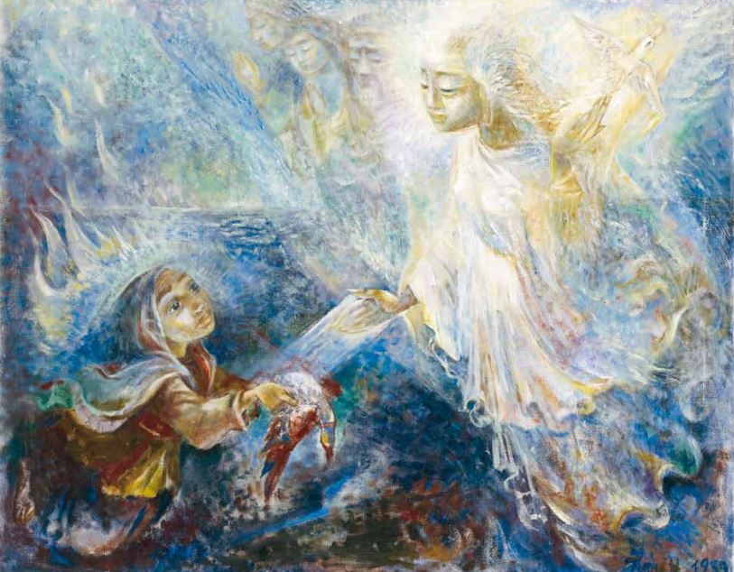
Enlightened (1939)
In one of Ilona Harima’s most famous paintings, a melancholic girl presents to the Masters a dying bird (the imperfect soul). On the upper right, the bird – the enlightened soul – is alive and well, and ready to fly

Slide 38
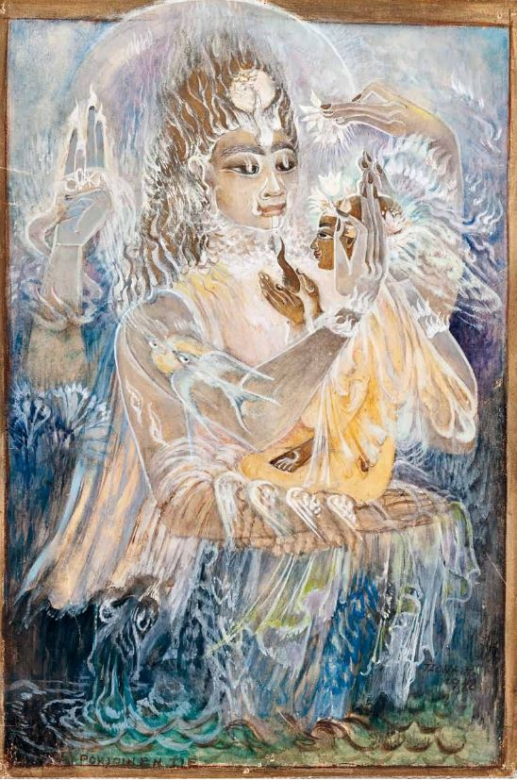
Northern Road (1948)
A Master (depicted here as Lord Krishna) raises a human soul to awareness, and crowns her with a garland. The enlightened soul deposes its heavier material substance, as she no longer needs it

Slide 39
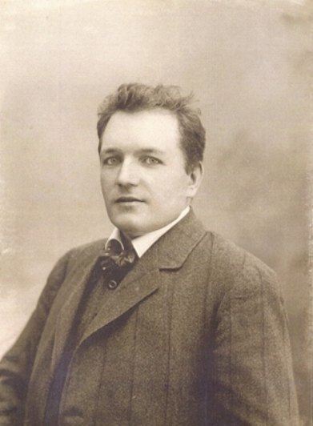
A Theosophical Circle
Ilona Harima, who was independently wealthy and did not need to sell, rarely exhibited during her lifetime. But she was not isolated, and felt part of a larger circle of Finnish artists interested in Theosophy and esotericism
Many of them followed Pekka Ervast (1875-1934, left), the founder of the Theosophical Society in Finland (who in 1920 seceded from it and founded the independent Rosy Cross Association), in its standard interpretation of the Kalevala through Blavatskyan lenses

Slide 40
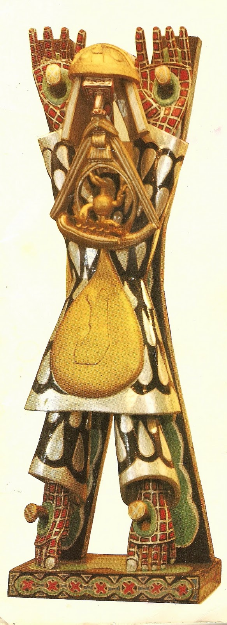


A Continuing Tradition
Artists in this tradition included Expressionist painter Eemu Myntti (1890-1943: The Swan Madonna, left) and sculptor Eemil Halonen (1875-1950: Marjatta, 1916, bottom), followed in a later generation by sculptor Heikki Virolainen (1936-2004: Kalevala’s Väinämöinen, 1968, right)

Slide 41

Einar Jónsson (1874-1954)
In the early 20th century, Theosophy had more adherents per capita in Iceland than in any other nation of the world (Swatos and Gissurarson, Icelandic Spiritualism [1997], 192), and Spiritualism was also widespread
This affected the artistic community, including Iceland’s national sculptor Einar Jónsson (left). He was a child prodigy, and the Icelandic Parliament itself financed his artistic training in Copenhagen and Rome

Slide 42

Þorfinnr Karlsefni
In 1914, Einar was selected to sculpt the statue of 11th century Icelandic explorer of America Þorfinnr Karlsefni to be placed in Philadelphia (right)
Karlsefni allegedly created the first European settlement in North America, and the statue offered to Einar the opportunity to celebrate Iceland as «the home of the Goddess of northern lights», as the statue’s inscription recites

Slide 43

Einar and Theosophy
«Einar developed contact with Theosophy around 1910 and the theories and ideas of Theosophy became the foundation for the main body of his work from that point on» (from the presentation of The Einar Jónsson Museum, Reykjavík).
He also read Swedenborg and later had several meetings with Martinus (Thomsen, 1890-1981), the founder of the Danish esoteric movement Martinus Institute

Slide 44

The Spell Broken
Einar deepened his esoteric interests after his return to Iceland in 1920, where he remained until his death in 1954. Reykjavík hosts several statues by Einar. He worked for 11 years, from 1916 to 1927, to complete The Spell Broken. It represents St George and the dragon, but he interpreted the story through Besant’s reading: by slaying the dragon of lust and bad karma the initiate achieves true enlightenment

Slide 45

The Birth of Psyche
In The Birth of Psyche (1915-1918) Einar, by his own account, tried to represent «the birth of the material as housing for the spirit and its development towards exalted worlds, the birth of the spirit into the material»

Slide 46
Rest (1915-1935)
Rest, of which different versions exist, is perhaps Einar’s most Theosophical work. It represents art emerging from rough raw material. But the metaphor of the sculpture was used by Besant herself in a 1907 lecture collected in The Spiritual Life. With enlightenment, divinity emerges from the rough stone of humanity

Slide 47


A Company of Artists
Einar shared esoteric and Theosophical interests with the two other most significant Icelandic artists of his generation: Guðmundur Thorsteinsson («Muggur», 1891-1924: Seventh Day in Paradise, 1920, left) and Jóhannes S. Kjarval (1885-1972: The Winged Boy, 1935, right)

Slide 48

An Attempt to Harness the Light
In 2013, the Hafnarborg Museum in Hafnarfjörður organized an exhibition on Theosophy, Spiritualism and the New Age in Icelandic art, showing how Einar’s tradition continued to the present days. The exhibition was called An Attempt to Harness the Light, with reference to how contemporary artist Daði Guðbjörnsson (above) describes his own work: «harnessing the light» means achieving enlightenment

Slide 49

A «Theosophical» Virgin Mary
In 1989, during Pope John Paul II’s (1920-2005) visit to Iceland, a woman interested in Theosophy who was trying to establish a spiritual center for members of all religions in Snæfellsnes, Guðfinna Hjálmarsdóttir, had a vision of the Virgin Mary near a spring at Hellnar. A tradition about an alleged previous apparition in the 13th century may have been invented post factum
A statue was created by a well-known non-Catholic feminist artist, Kristín Guðrún Gunnlaugsdóttir, and blessed by a Lutheran priest. A Catholic apparition to a Theosophist generated a Lutheran pilgrimage: this emblematic incident may well serve as a conclusion to our story

Slide 50

That’s all Folks!

