Slide 1

The Viewpoints of Church History and the Concept of ‘New Religion’ in Korea
Chongsuh Kim (Seoul National University)
Contents:
1. The Concept of ‘New Religion’ in the Typology of Religious Organization
2. The Korean Development of the ‘Viewpoints of Church History’
3. The Conceptual Changes of ‘New Religion’ in accordance with the
Changing Viewpoints of Church History
4. A Typological Reflection of Religious Organization from the Korean
Viewpoints of Church History

Slide 2
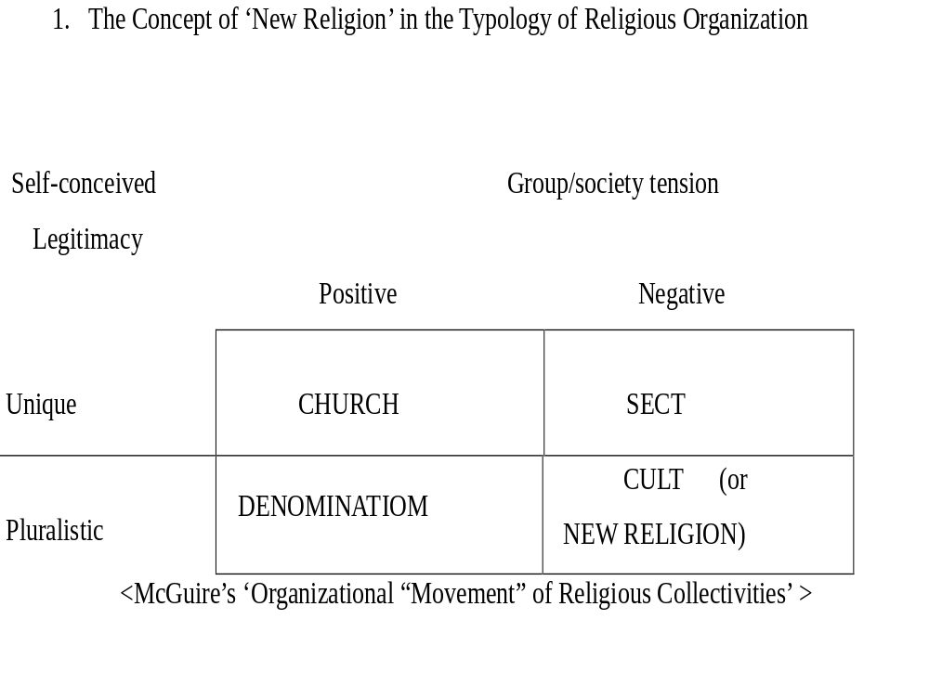

Slide 3
1-2
In Korea, it can be specially said that the concepts of Christian oriented new religions have been very closely related to the Viewpoints of Church History. In other words, the negativity, pluralistic legitimacy and alien aspects of most Christian oriented new religions can be said to be changed according to the Viewpoints of Church History in Korea.

Slide 4
2. The Korean Development of the ‘Viewpoints of Church History’
The roles of western missionaries were thought to be the most important in the early Protestant Church histories in Korea and the early histories of Korean Protestant Churches were mainly written from the ‘Viewpoint of Mission History’. It was in this context that L. George Paik’s The History of Protestant Mission in Korea, 1832-1910 (Han-guk gaeshin-gyosa) was known as the first representative work in the field.

Slide 5
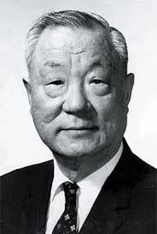
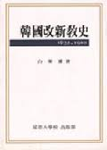
L. George Paik & The History of Protestant Mission in Korea, 1832-1910
Notes:
L. George Paik & The History of Protestant Mission in Korea, 1832-1910

Slide 6
2-2
Above all, it is important that the existing Korean church histories were written from a Korean national perspective after the Viewpoint of Mission History. It is little doubt that Kyeongbae Min’s A History of Korean Christian Churches (Han-guk gidokgyohoesa) in the 1970s first started to seriously embrace the Korean national perspective in writing Korean Church histories. Then, there have appeared many Protestant Church history books emphasizing the Viewpoint of National Church History.

Slide 7
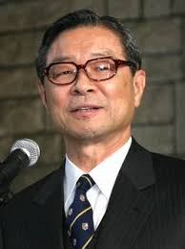
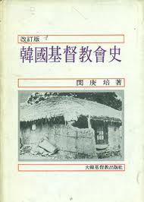
Kyeongbae Min & A History of Korean Christian Churches
Notes:
Kyeongbae Min & A History of Korean Christian Churches

Slide 8
2-3
It is true that many of the existing Korean Church histories, which often had background affiliations with certain denominations, have occasionally tended to distort the historical facts to suit particular agendas. In this regard, the “Holistic Viewpoint of History” of A History of Christianity in Korea I, II, III should be laudable. Taking all available historical sources and viewpoints into account would seem to offer the only way to maintain a semblance of objectivity. As a result, many alienated sectarian and cultic histories could come to the discourses of mainline Church events.

Slide 9
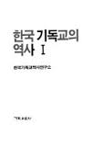
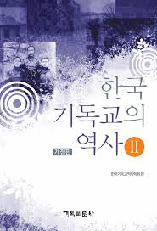
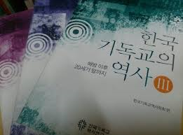
A History of Christianity in Korea I, II, III
Notes:
L. George Paik & The History of Protestant Mission in Korea, 1832-1910

Slide 10
3. The Conceptual Changes of ‘New Religion’ in accordance with the Changing
Viewpoints of Church History
Most viewpoints of the Korean Church History have expanded the width of their perspectives: In the early times, the category of Korean Church history was quite narrow and many liberal churches were regarded just as a heretical cult. However, it is very important that such churches have been changed from a cult to a sect or a part of established denomination as the Viewpoints of the Church History have been expanded in Korea. Indeed, some early leaders of the Korean Churches such as Yongdo Lee who is respected as one of ‘the real fathers’ of the Korean Protestant Churches today were excluded as members of heretical sects or alien cults by mainline churches at that times.

Slide 11
3-2
Yongdo Lee who was regarded as a heresy by the mainline churches advocating the Viewpoint of Mission History has been affirmatively described as a leading minister of the national churches in Kyeongbae Min’s A History of Korean Christian Churches. Yongdo Lee’s Jesus Church is no longer a heretical cult in Kyeongbae Min’s A History of Korean Christian Churches.

Slide 12
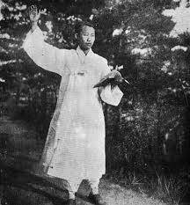
Yongdo Lee
Notes:
Yongdo Lee

Slide 13
3-3
However, Sun Myung Moon’s Unification Church and Tae Sun Park’s Olive Tree Movement are still considered as a heretical sect or an anti-Christian cult in Kyeongbae Min’s A History of Korean Christian Churches, despite the partial recognition of their Korean contribution to the world salvation histories.

Slide 14
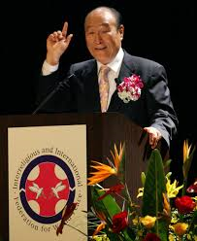
Sun Myung Moon
Notes:
Yongdo Lee

Slide 15
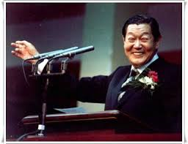
Tae Sun Park
Notes:
Yongdo Lee

Slide 16
3-4
A History of Christianity in Korea I, II, III published by the Institute of Korean Church History Studies has advocated the Holistic Viewpoint of History and thus it might be said to have focused on the scientific explanation of objective facts rather than the theological dogmas or subjective ideologies. In this context, there seems to be no clear borderline to speak of between the early mystic leaders like Yongdo Lee and the recent new religious leaders such as Sun Myung Moon and Tae Sun Park. It just reports the positions or the disciplinary actions of the orders without its own judgments. It depends upon the reader’s judgment whether a described order is a cult or a sect and belongs to the mainline church. It means that the concept of cult (or New Religion) is more open.

Slide 17
4. A Typological Reflection of Religious Organization from the Korean Viewpoints of
Church History
It is usually said that people tend to create New Religions from what is around them. Thus, religious ferment reflects the change of the religious worldview that can be called as the new transformation of the leading religious view in the culture. It might mean the change of the Viewpoints of Church History in the above mentioned Korean case.

Slide 18
4-2
In Korea called as “a country of morning calm,” Christianity appeared as a strong shock for Korean people in the beginning with a lot of western missionaries. There was no room for other religious group like a sect or a cult at that time. In the meantime, it was natural that Church history has been written from the standpoint of mission. However, as Christianity has been gradually indigenized in Korea, new perspectives to see it from traditional religious legacy come to prevail. It was in the context that the Viewpoint of Mission History was replaced with the Viewpoint of National Church History in order to reveal the subjective meaning of changed people’s life in Korea.

Slide 19
4-3
We might think that the Holistic (and Scientific) Viewpoint is an attempt to overcome ideology-laden perspective to narrate the story of Korean Church as it is. In this regard, many of the previous heretical Christian new religions are recognized as a sect or even one of the main Christian denominations. At least, their previous pejorative meanings come to be futile.

Slide 20
4-4
We might suggest that the concept of the cults and sects have been relative in Korean context from time to time and that the Viewpoints of the Church History could be one of the critical elements in the conceptual formation of Christian cult in Korea.

