Slide 1
Mormons and Alterity. Analysis of the « I’m a Mormon » Advertising Campaign.
Mathilde Vanasse-Pelletier
Ph.D. candidate, university of montreal.
Religion innovation and change in the 21st Century, cesnur.
Tallinn University, Friday june 19th 2015.

Slide 2
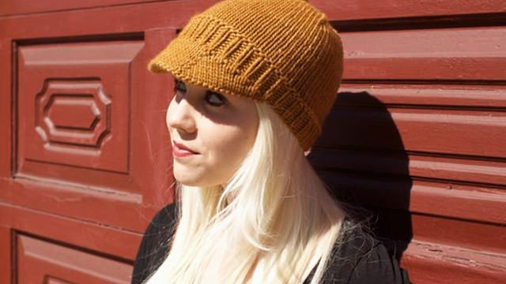
Smith 2012 p.4
« Hi I’m Jenna. I love writing jokes. I love making people laugh. I’m a comedian! And I’m a mormon. »
« Jenna Kim Jones is living the kind of life that would make a hip young college graduate green with envy as the logo on her venti Starbucks cup. An aspiring comedian living in New York City, she graduated fron NYU and scored a coveted job with The Daily Show With John Stewart, while practicing her own comedy routine on the side. She is young, scrappy, and driven. She prides herself on being a New Yorker. She loves making people laugh. She is also a Mormon ».
http://www.mormon.org/jenna

Slide 3
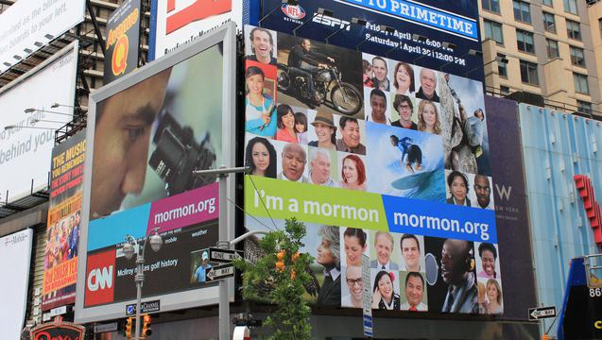
Context of Emergence
The Campaign on Time Square
The LDS Church hired 2 publicity firms in 2009
Attempt to distance the Church’s image from the terms « secretive» and « cultish » as well as from fundamentalist groups
Expansion of the campaign in 2011: larger cities including New York
Broad-scale media effort
http://www.mormonnewsroom.org/article/mormon-ads-new-york-city

Slide 4
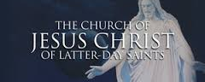
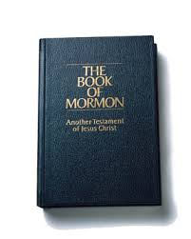
Focus on the Christian identity of Mormons
http://www.examiner.com/article/the-lds-church-on-homosexuality
“We are Christians in a very real sense and that is coming to be more and more widely recognized. Once upon a time people everywhere said we are not Christians. They have come to recognize that we are, and that we have a very vital and dynamic religion based on the teachings of Jesus Christ. We, of course, accept Jesus Christ as our Leader, our King, our Savior...the dominant figure in the history of the world, the only perfect Man who ever walked the earth, the living Son of the living God. He is our Savior and our Redeemer through whose atoning sacrifice has come the opportunity of eternal life. Members of The Church of Jesus Christ of Latter-day Saints pray and worship in the name of Jesus Christ. He is the center of our faith and the head of our Church. The Book of Mormon is Another Testament of Jesus Christ and witnesses of His divinity, His life, and His Atonement.”
http://mormonbeliefs.org/mormon-scriptures-book-of-mormon
Quote from Church President Gordon B. Hinckley (1910-2008)

Slide 5
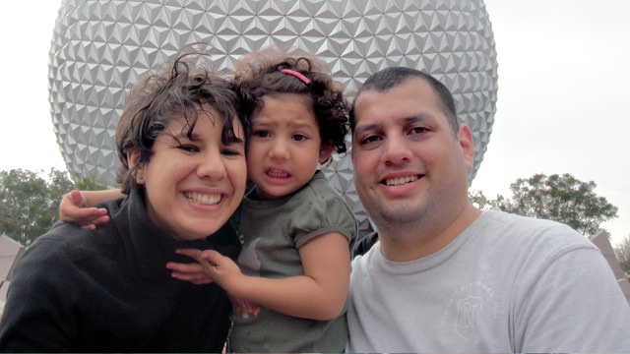
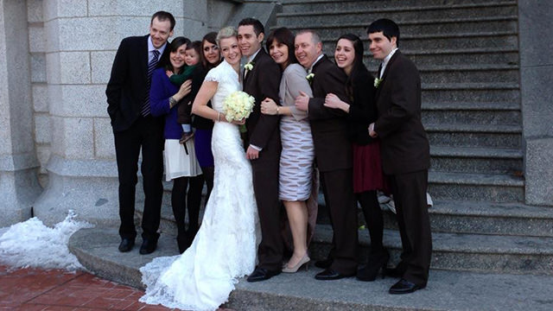
Choices and Methods
« Hi I’m Irene. I live in Costa Rica. I play the viola. Music, nature, good friends and my beloved family are what make me happy. I’m a Mormon. »
« Hi I’m Jason. I’m Irish, I’m a 4 time Paralympic gold medalist, a world record holder, a husband and I’m a Mormon. »
http://www.mormon.org/irenem
http://www.mormon.org/jasons

Slide 6
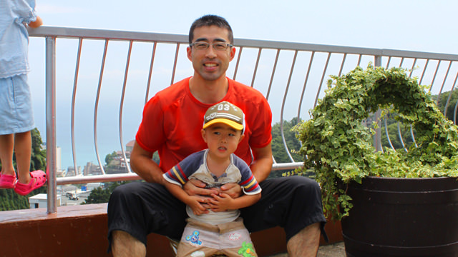
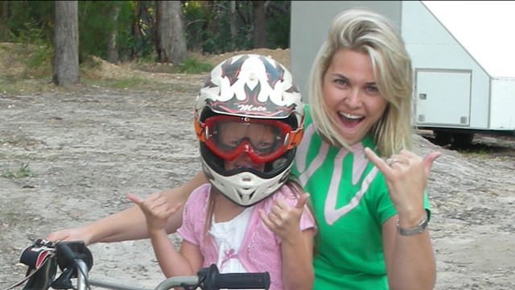
Main Findings
« Hi I’m Michio. I am a husband and the father of five children, and I live in Akishima City in Tokyo, Japan. I am a fireman, and as the leader of a fire crew we are prepared to deal with day-to-day calamities. I have been training in Kendo (fencing with bamboo swords) since I was a child and I am still doing it today. »
« Hi I’m Sarah. I an Aussie country girl, I’m a mother, I’m a wife, I’m a TV publicist and I’m a Mormon. »
http://www.mormon.org/michio
http://www.mormon.org/sarah

Slide 7
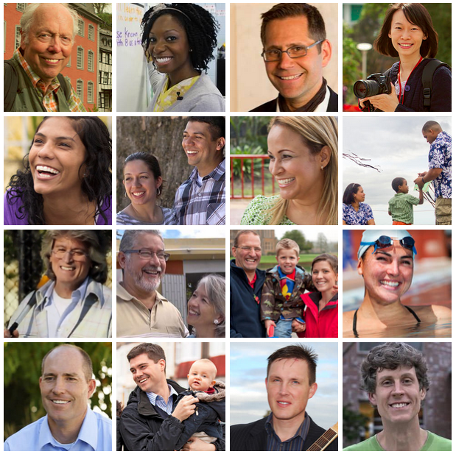
Main Results
Discourse about religion is often absent from the capsules, or is presented through vague or general terms
Empahsis on the importance of sacrifice: this resonates with mormon theology
But the main focus is on normality
Screen capture: http://www.mormon.org/people

Slide 8
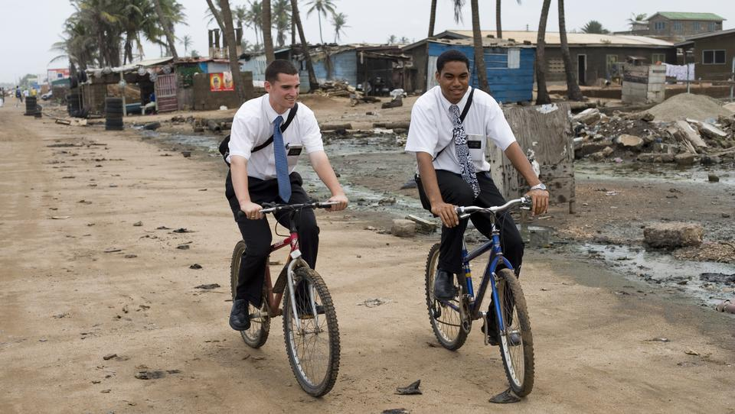
Alterity and Church History
Controversy surrounding ethnicity and stereotypes concerning the Church: often considered to be a white, American and exclusive religion
Missionary effort: striving to inform people about Christ’s true religion
Baptism of the dead and genealogy: there is a desire to include, to convert, to integrate
This desire to include comes in contrast with the stereotypical image of the Church as xenephobic
http://www.mormonnewsroom.org/topic/missionary-program

Slide 9
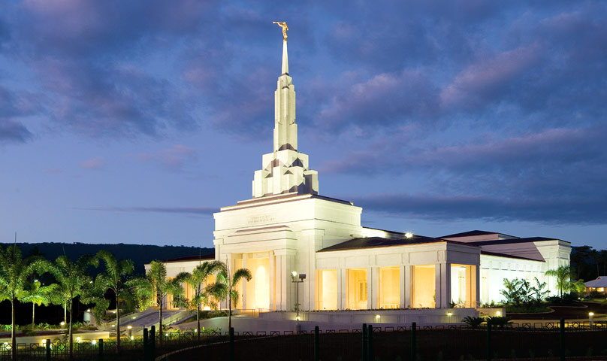
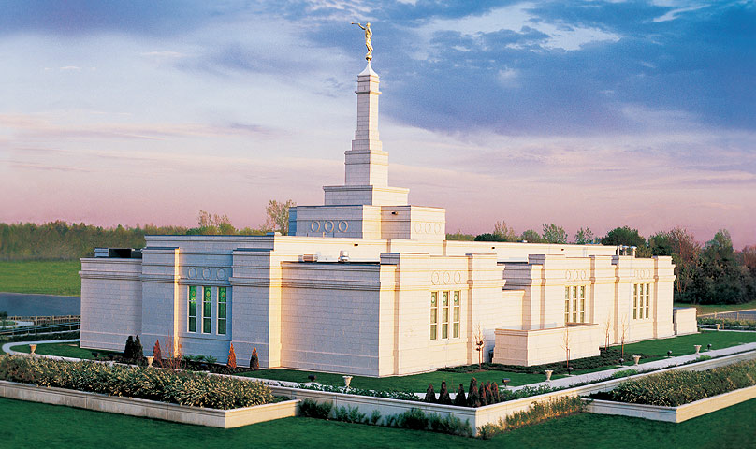
A Mormon Ethnicity?
Samoa
https://www.lds.org/church/temples/apia-samoa?lang=eng
« The ensemble of traits, objects and symbolic productions in which a collectivity recognizes itself and through which it is recognized by others. You could also say : every cutural or symbolic characteristic shared by the members of a collectivity that produce an effect of singularisation of this collectivity. In this sense, ethnicity refers to anything that nourrishes a sense of identity, of belonging, and the expressions that result from those sentiments. (Translated from Bouchard 2001 p.319).
Canada
https://www.lds.org/church/temples/montreal-quebec?lang=eng

Slide 10
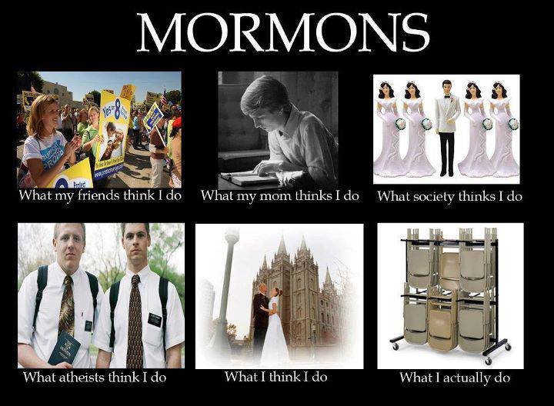
Conclusions
Desire of the LDS Church to make its way into the American mainstream
The campaign shows a certain openness to cultural and social diversity
Normalisation from a religious identity often associated with its controversial past
Efforts to break stereotypes and to be included into the greater Christian family
https://www.pinterest.com/kthemormon/mormon-memes/

