Slide 1
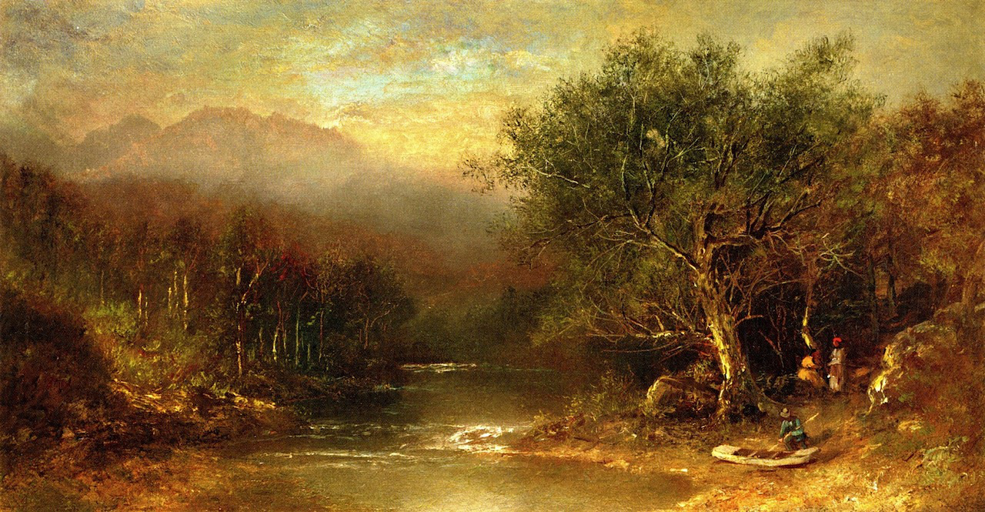
Concentric Circles
Swedenborg and the Visual Arts
Massimo Introvigne
Swedenborg and the Arts International Conference
Bryn Athyn, June 6-7, 2017

Slide 2
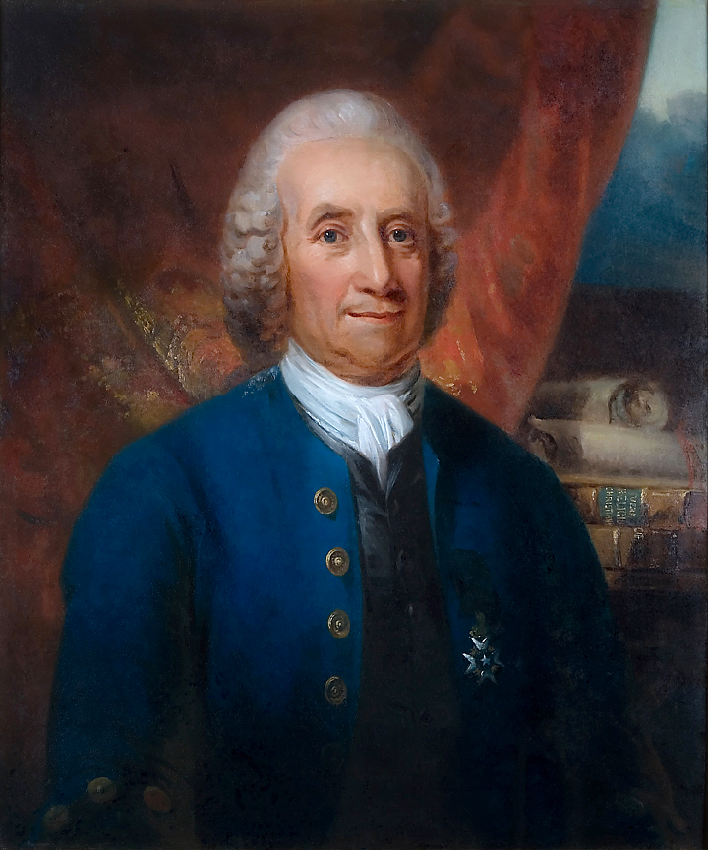
The Swedenborg Paradox
In more than 13,000 pages of his collected writings, where he discussed an immense variety of different topics, Emanuel Swedenborg (1688-1772) did not offer a theory of aesthetics or art. Yet, according to American art historian Joshua Charles Taylor (1917-1981), among the new spiritualities, in the 19th century “only the Swedenborgian teaching had a direct impact on art”

Slide 3
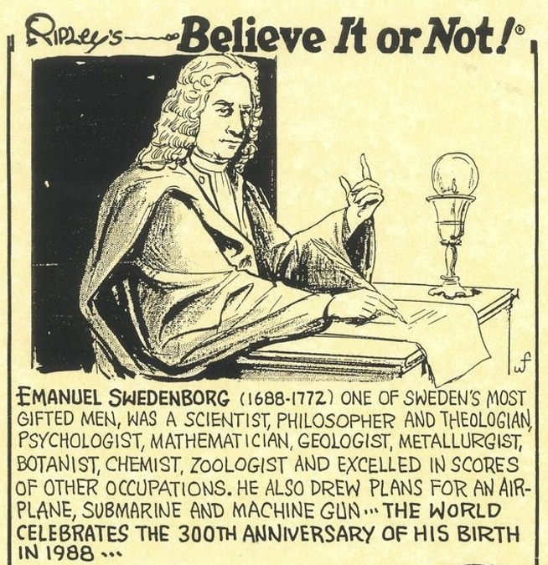
Believe It or Not…
Taylor’s comment should be qualified since, internationally, at least Rosicrucianism should be added, while Theosophy and Christian Science had their greatest impact on art in the 20th century. There is, however, little doubt that Swedenborg had an influence on artists which can only be qualified as exceptional, the more so if we consider that the Swedenborgian movement was, and remains, comparative small. How was this possible?

Slide 4
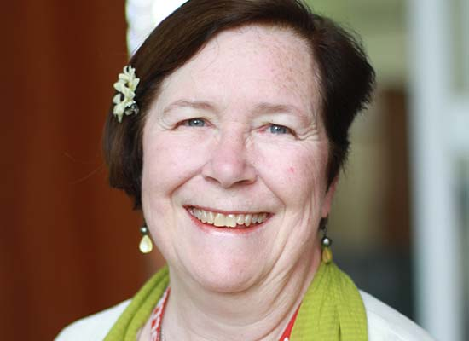
Implicit Aesthetics
In the works of several leading spiritual teachers – including Theosophy’s Madame Helena Blavatsky (1831-1891) and Christian Science’s Mary Baker Eddy (1821-1910) – there is no explicit theory of aesthetics, but there is what Jane Williams-Hogan called, with reference to Swedenborg, an “implicit aesthetic philosophy”

Slide 5
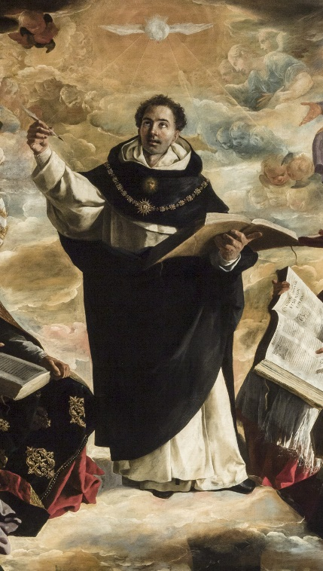
1. Beauty and Truth
First, Swedenborg maintained that “beauty is predicated of truth, and its intelligence.” This is based on a solid tradition. For Thomas Aquinas (1225-1274), “pulchrum proprie pertinet ad rationem causae formalis” (Summa Theologiae, I, q.5, a.4, ad1). That “verum et bonum et pulchrum convertuntur” was often repeated by later theologians, although neither Aquinas nor his predecessors explicitly used these words
Right: Francisco de Zurbarán (1598-1664), Triumph of Thomas Aquinas

Slide 6
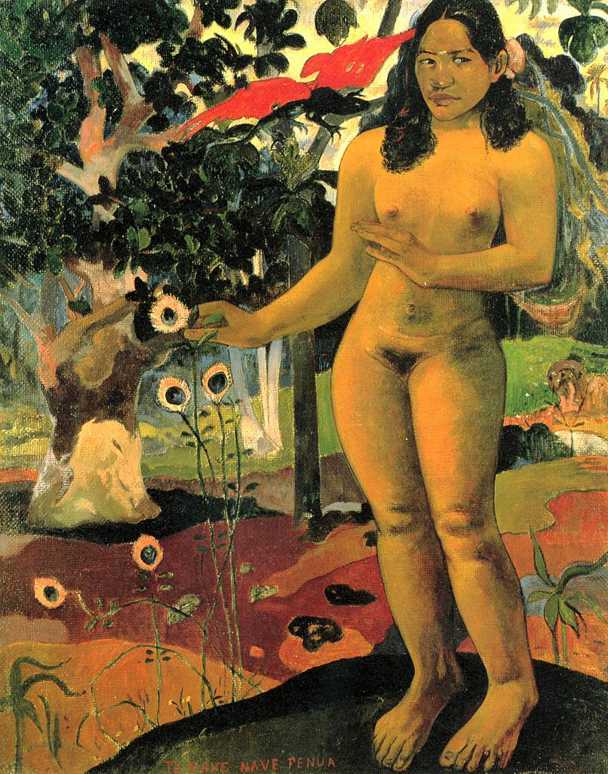
2. The Lost Sight of the Ancients
Truth for Swedenborg has two foundations, “one from the Word [the divine Revelation], and the other from nature.” The first human beings were able to see immediately the truth of the Revelation in the Word, and to see nature as a manifestation of the divine. Unfortunately, we have lost this ability. But we are not without hope
Left: The Delightful Land (Te Nave Fenua), Gauguin’s 1892 rendering of the Garden of Eden

Slide 7
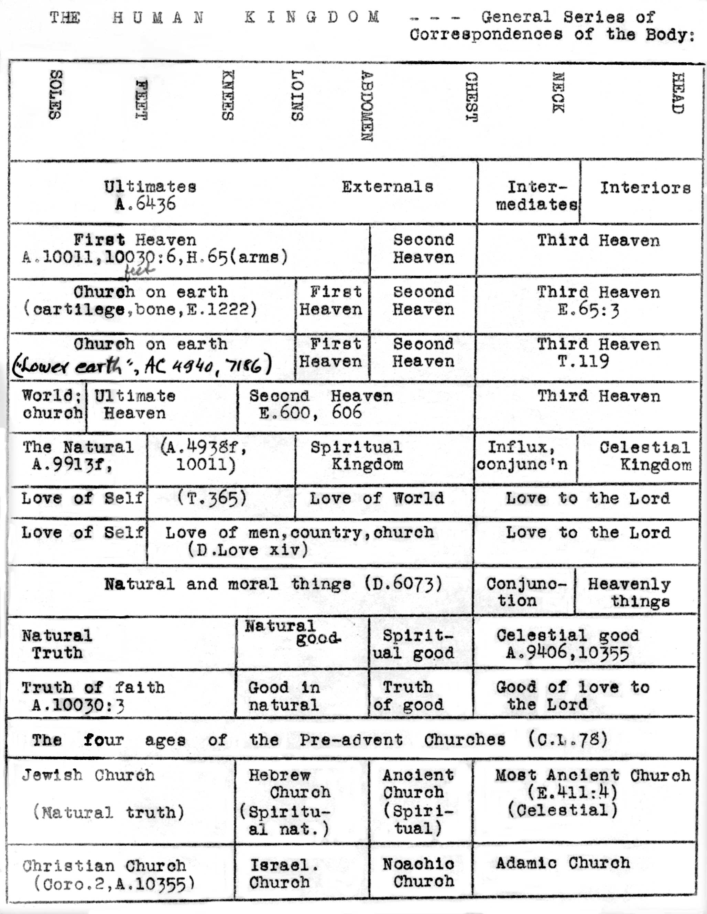
3. Correspondences
For Swedenborg, the tool for recovering something of the lost gaze of the ancients is the theory of correspondences: “Nothing can exist anywhere in the material world that does not have a correspondence with the spiritual world.” “Everything in the material world is an effect. The causes of all effects lie in the spiritual world, and the causes of those causes in turn […] lie in a still deeper heaven”
Table of correspondences of the body from a lesson by Hugo Odhner (1891-1974)

Slide 8
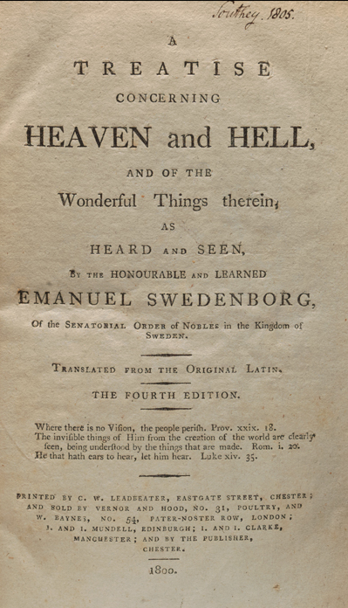
4. The Artist’s Mission
“Art,” Swedenborg wrote, “comes to us from Heaven.” While his theory of correspondences can be applied by anybody to both the study of the Bible and personal spiritual life, real artists are inherently equipped to perceive, and show to others, the divine cause beyond all natural effects

Slide 9

Concentric Circles
This vision obviously appealed to artists. We can distinguish three concentric circles: those baptized into a Swedenborgian church or maintaining at any rate Swedenborgianism as a primary interest in their lives; those directly influenced by Swedenborg’s writings; and those reached by Swedenborg indirectly, i.e. through other artists or writers

Slide 10
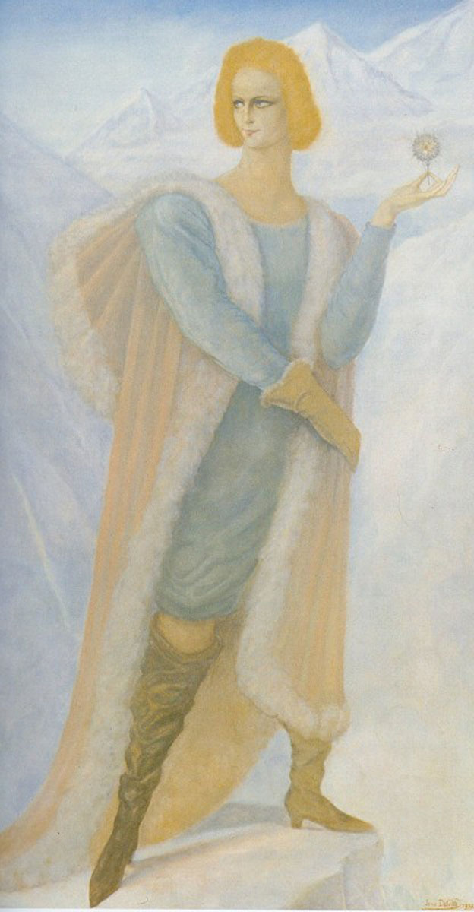
The Third Circle
We cannot elaborate here on the third circle. One example would be the Belgian symbolist painter Jean Delville (1867-1953). He probably did not read Swedenborg personally, but was influenced by novelists and painters interested in Swedenborg, such as Balzac (1799-1850) – in 1932, he painted a Séraphita (left) – and Fernand Khnopff (1858-1921)

Slide 11
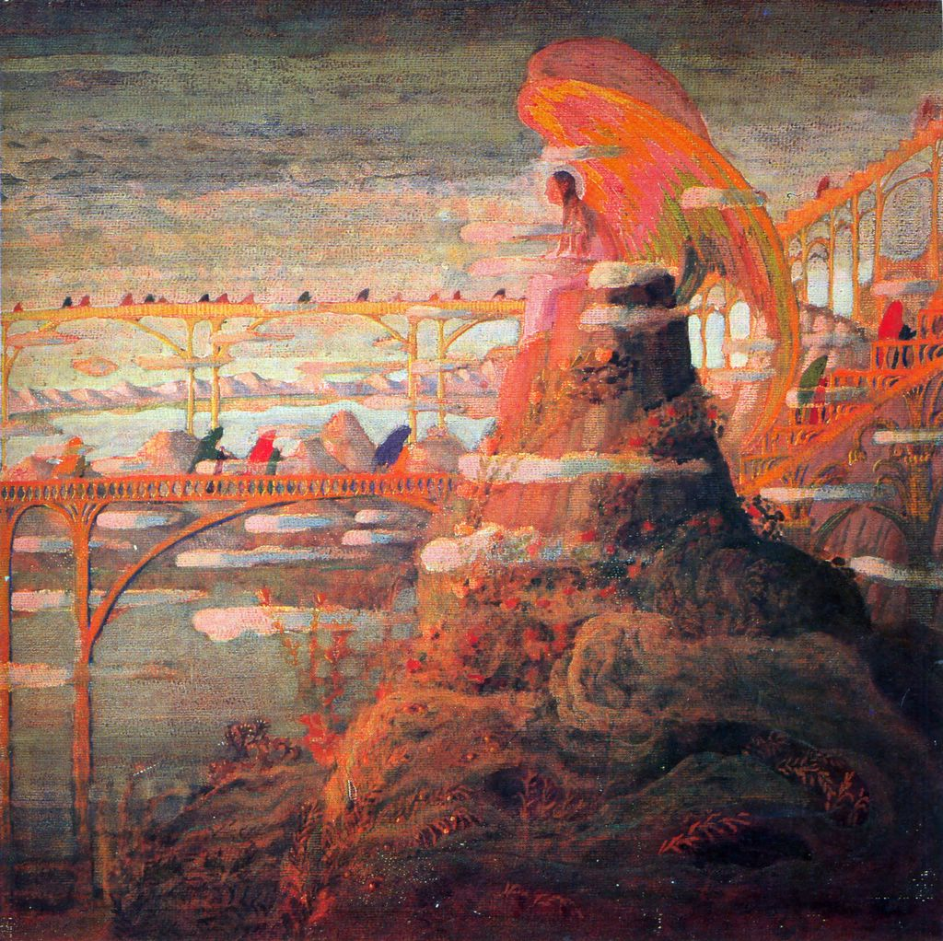
Mikalojus Konstantinas Čiurlionis
Another example is Lithuanian painter and composer M.K. Čiurlionis (1875-1911). Scholars of Čiurlionis, including Genovaitė Kazokas (1924-2015), found in his works influences of Swedenborg’s theories of correspondences and of angels (although his, unlike Swedenborg’s, have wings: Angel Prelude, 1909, right), which possibly reached the artist through Charles Baudelaire (1821-1867)

Slide 12
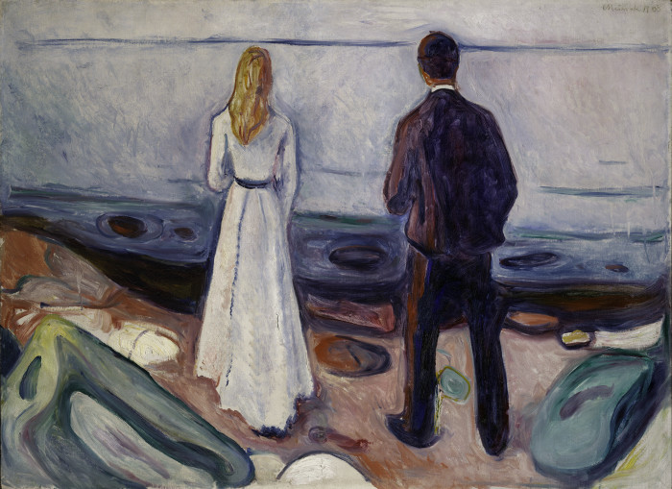
Edvard Munch
A further example of the third circle is Norwegian painter Edvard Munch (1863-1944: Two Human Beings, 1905, left), who learn of Swedenborg during his Berlin years through Swedish writer and painter August Strindberg (1849-1912)

Slide 13
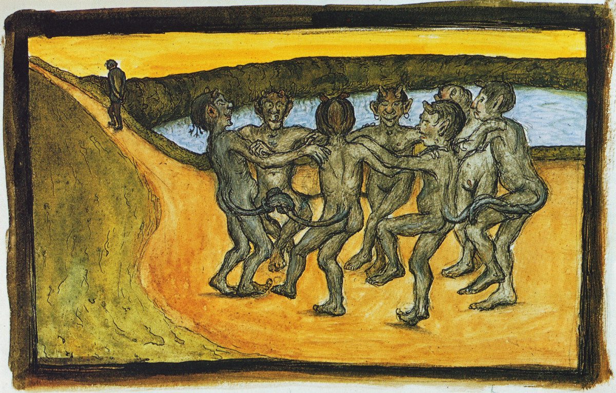
Swedenborg in Finland
Nina Kokkinen studied Finnish symbolist painter Hugo Simberg (1873-1917: Piiritanssi, 1898, above) as an artist who referred explicitly to Swedenborg only once but was deeply influenced by Finnish master Akseli Gallen-Kallela (1865–1931), who had read a number of Swedenborg’s works

Slide 14
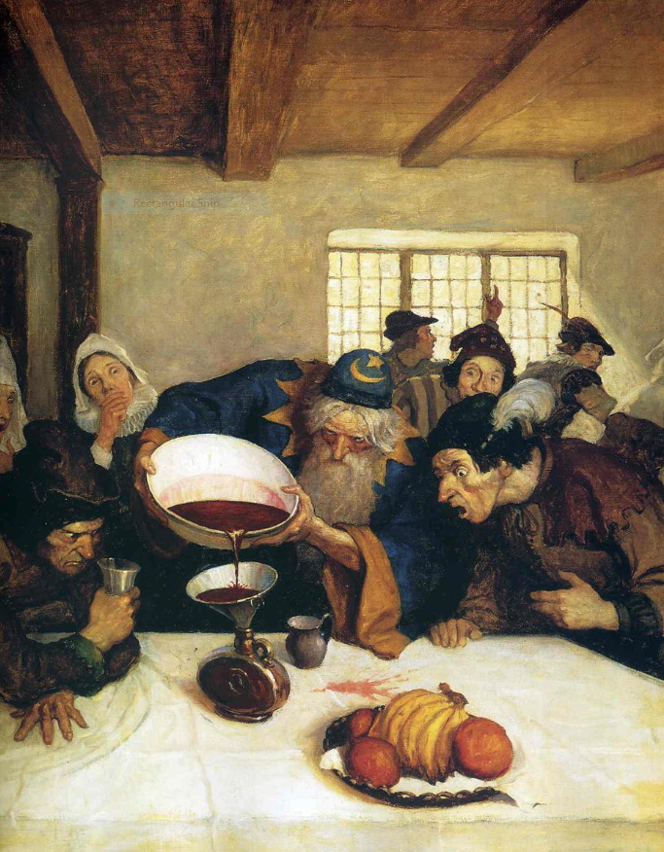
Newell Convers Wyeth
Another example if N.C. Wyeth (1882-1945, left). Celebrated as one of America’s greatest illustrators, he recalled how Swedenborg was read to him by his teacher and mentor, Swedenborgian Howard Pyle (1853-1911). Fellow illustrator Jessie Willcox Smith (1863-1935) had the same experience with Pyle

Slide 15
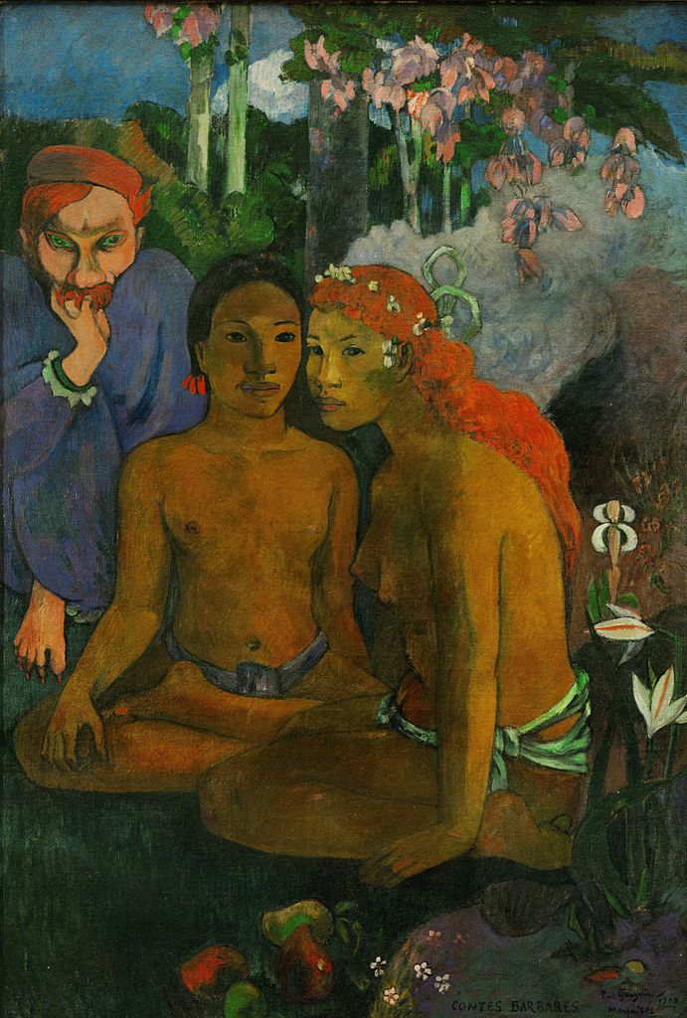
The Second Circle: Gauguin
Perhaps the most illustrious representative of the second circle was Paul Gauguin (1848-1903). He learned about Swedenborg by reading Balzac and Baudelaire, but studied further and explicitly acknowledged Swedenborg’s influence. Jane Williams-Hogan has analyzed his mature painting Contes Barbares (1902, left) as a clear example of his use of Swedenborg’s theory of correspondences

Slide 16
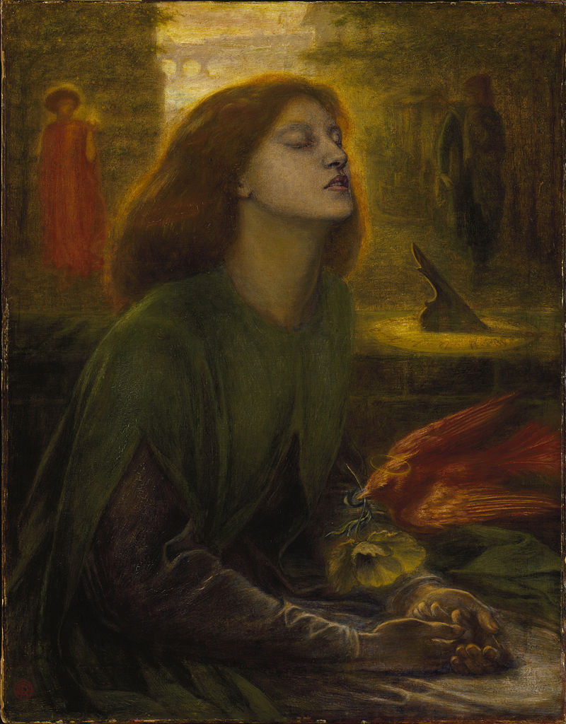
Dante Gabriel Rossetti
A further example of the second circle is Pre-Raphaelite British painter D.G. Rossetti (1828-1882). In 2013, Anna Francesca Maddison demonstrated in her Ph.D. dissertation that Rossetti was part of English circles studying both Spiritualism and Swedenborg, whose influence is apparent in paintings such as Beata Beatrix (right, 1864-1870)

Slide 17
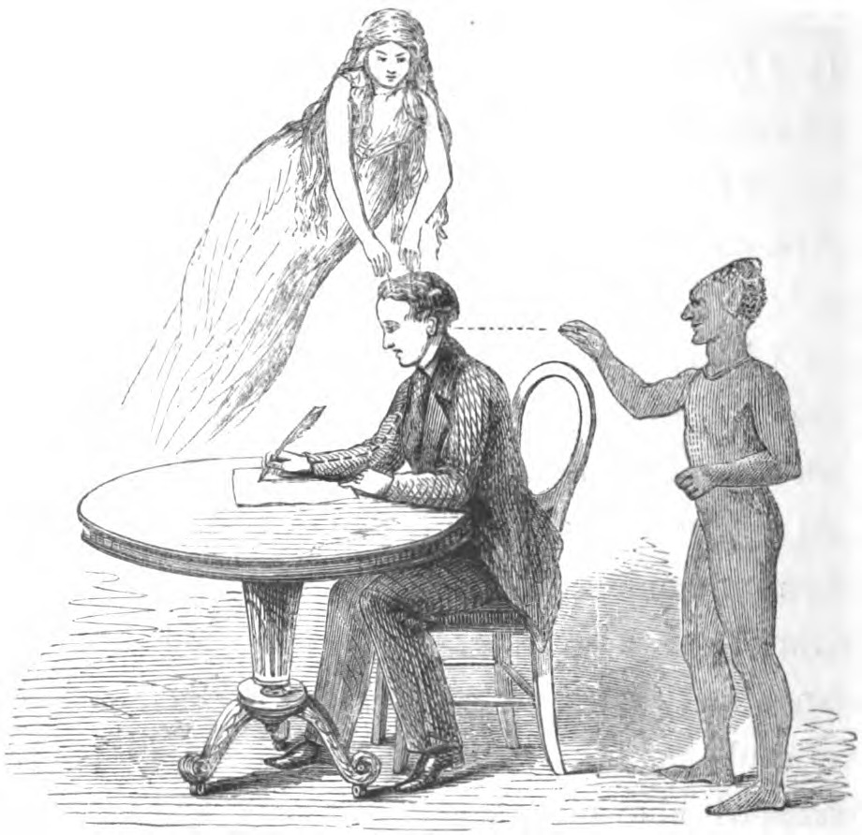
Sophia de Morgan
Prominent in what Addison calls the “Swedenborgian-Spiritualist” milieu of London was Sophia de Morgan (1809-1892), mother of potter William de Morgan (1839-1917), whose wife Evelyn (1855-1919), a Spiritualist, is something referred to as the last Pre-Raphaelite painter. Sophia had a lifelong interest in Swedenborg and proposed her own Swedenborgian interpretation of Spiritualist phenomena (see one of her sketches, left)

Slide 18
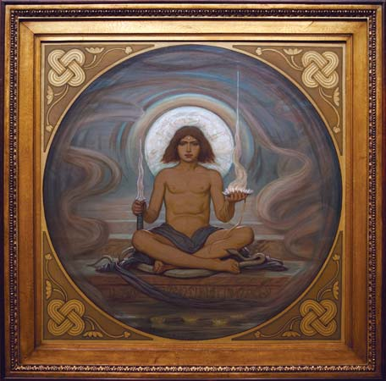
Elihu Vedder
Symbolists were often interested in Swedenborg, including in the U.S. Elihu Vedder (1836-1923: The Keeper of the Threshold, 1897-98, left) had his “Swedenborg period” in the years following the Civil War, although his enthusiasm for the Swedish mystic seems to have waned in his later years

Slide 19
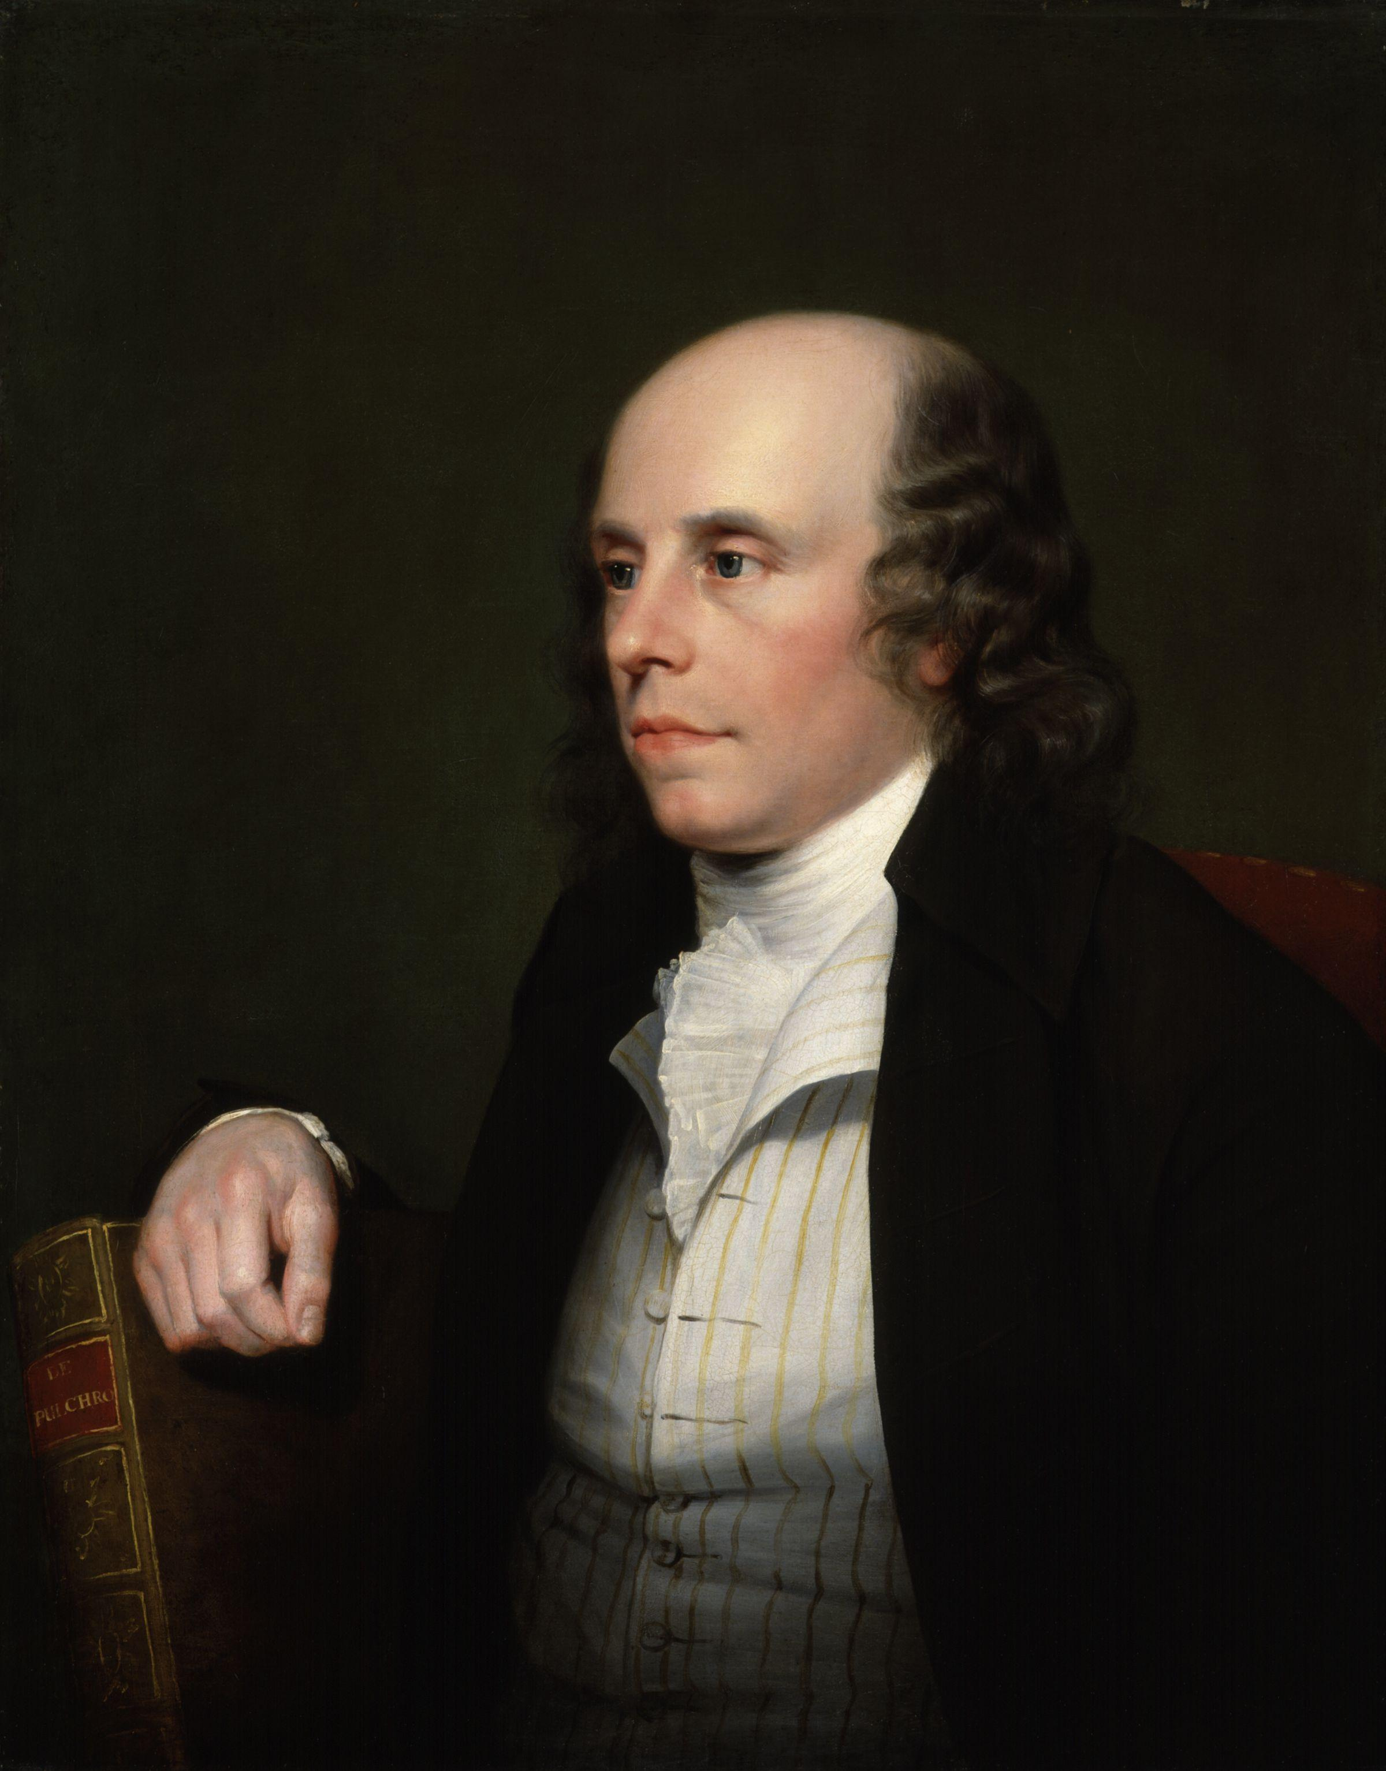
The First Circle: John Flaxman
We would now focus on the first circle. Among the members of the Theosophical Society, created in London in 1783 to promote Swedenborg (not to be confused with Blavatsky’s Theosophical Society, founded in 1875 in New York), at least seven were professional artists. One was John Flaxman (1755-1826), the most celebrated English sculptor of his time
Guy Head (1760-1800), Portrait of John Flaxman

Slide 20
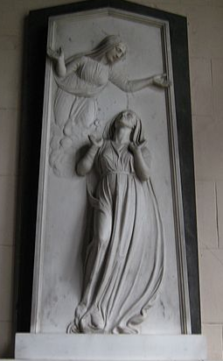
Souls in Human Form
Art historian Horst Waldemar Janson (1913-1982) claimed that, in his prolific funerary work, Flaxman was the first to depict the soul in human form, an idea that later became common but was clearly based on Swedenborg

Slide 21
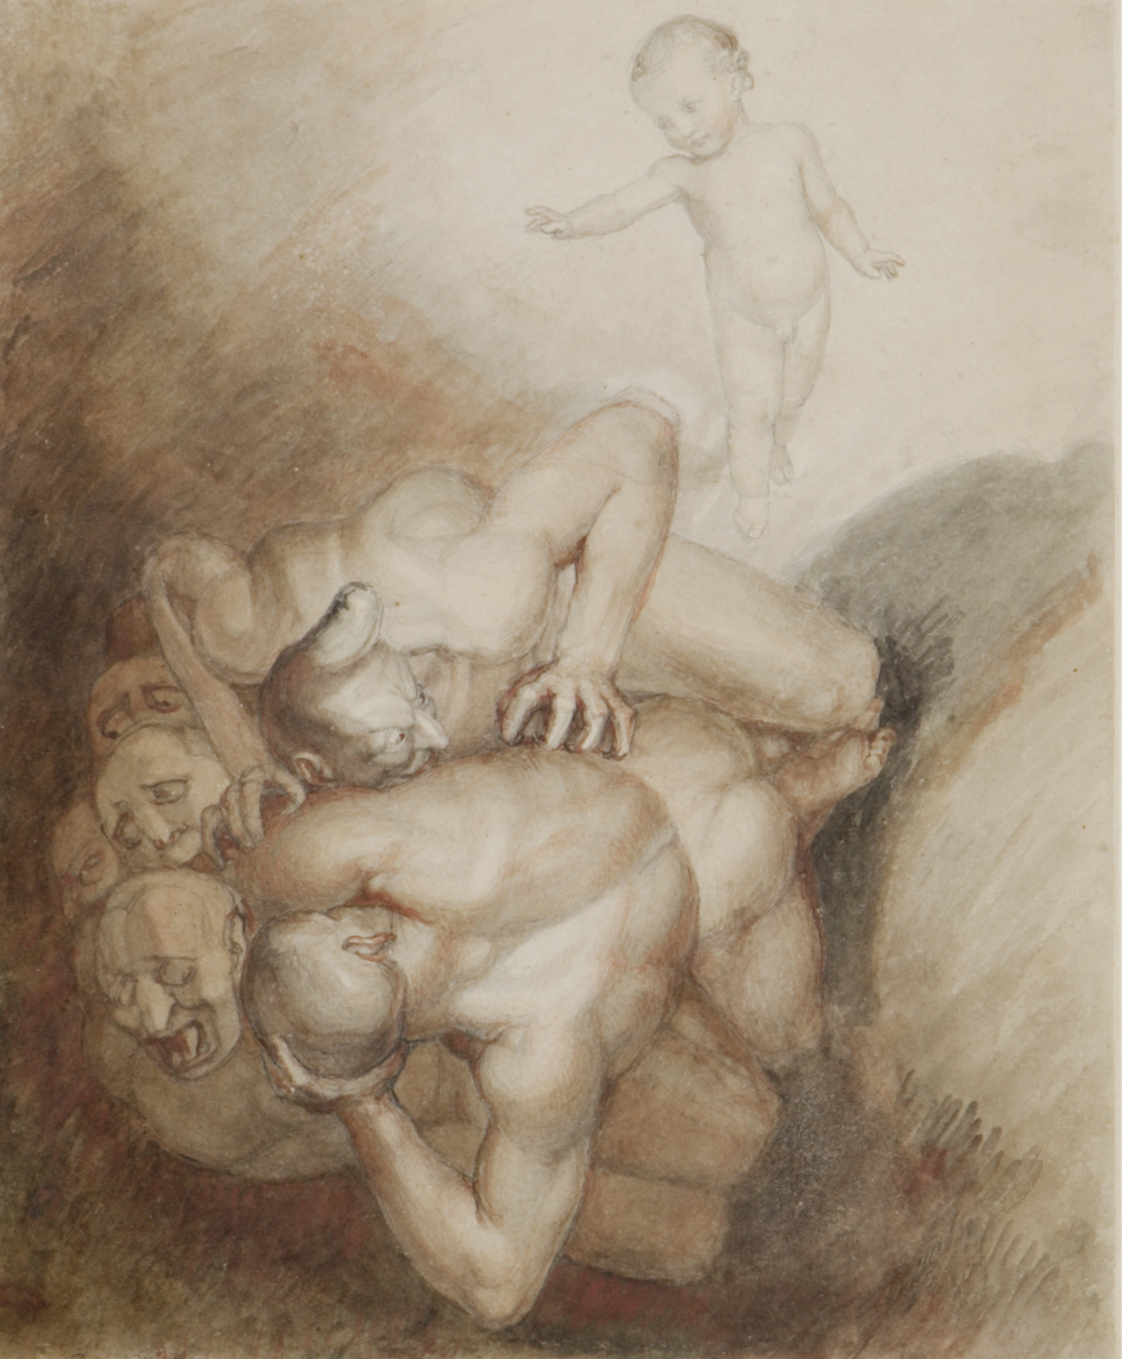
Evil Spirits Thrust Down by a Little Child
Jane Williams-Hogan analyzed this drawing by Flaxman, intended to illustrate Arcana Cœlestia §1271 and §1272, as true to both the letter (including the image of “women wearing black peaked hats” as part of the evil spirits) and the worldview of Swedenborg

Slide 22
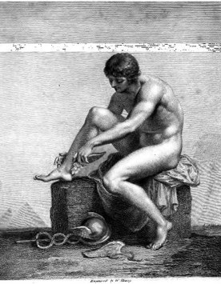
Other Early Swedenborgian Artists
Among the other members of the Swedenborgian Theosophical Society were painters Richard Cosway (1742-1821), Philippe-Jacques de Loutherbourg (1740-1812), Daniel Richardson (active 1783-1830), and John Sanders (1750-1825), and engravers John Emes (1762-1810) and William Sharp (1749-1824: Mercury Putting On His Winged Sandals, 1798, left)

Slide 23
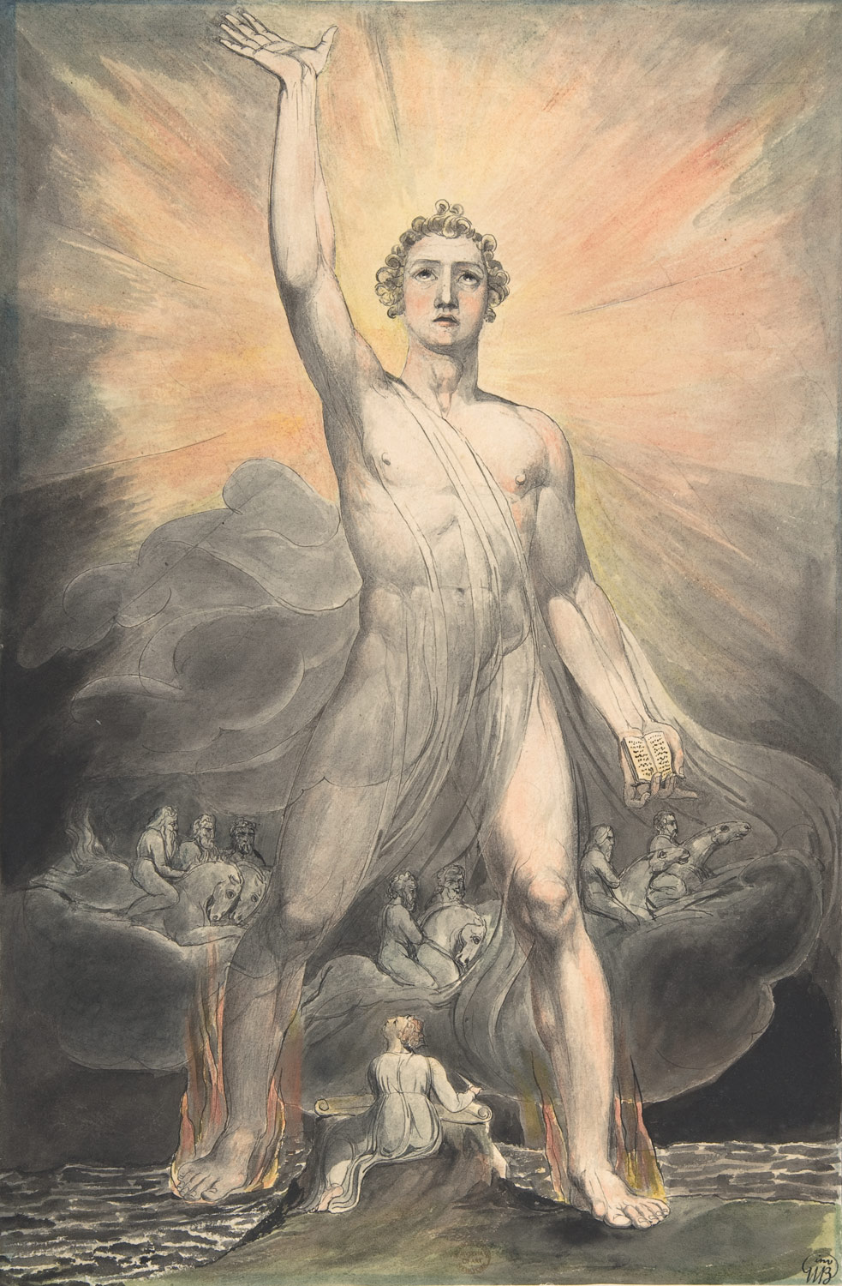
William Blake and Swedenborg
William Blake (1757-1827: Angel of Revelation, ca. 1803-1805, right), one of the leading artists associated with Swedenborg, was a friend of both Flaxman and Sharp. Both he and his wife Catherine Boucher (1762-1831) signed the minutes of the General Conference, which convened in 1789 as a development of the early Theosophical Society, to establish a church based on Swedenborg’s writings

Slide 24
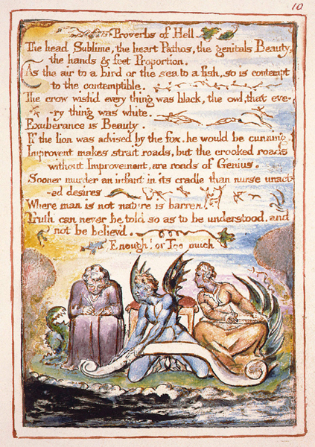
A Complicated Relationship
Later, however, Blake grew disenchanted with Swedenborg and in 1790 wrote an anti-Swedenborgian satire, The Marriage of Heaven and Hell (left). On the other hand, Blake remained influenced by the Swedish mystic’s doctrines, including the theory of correspondences, until the very end of his life

Slide 25
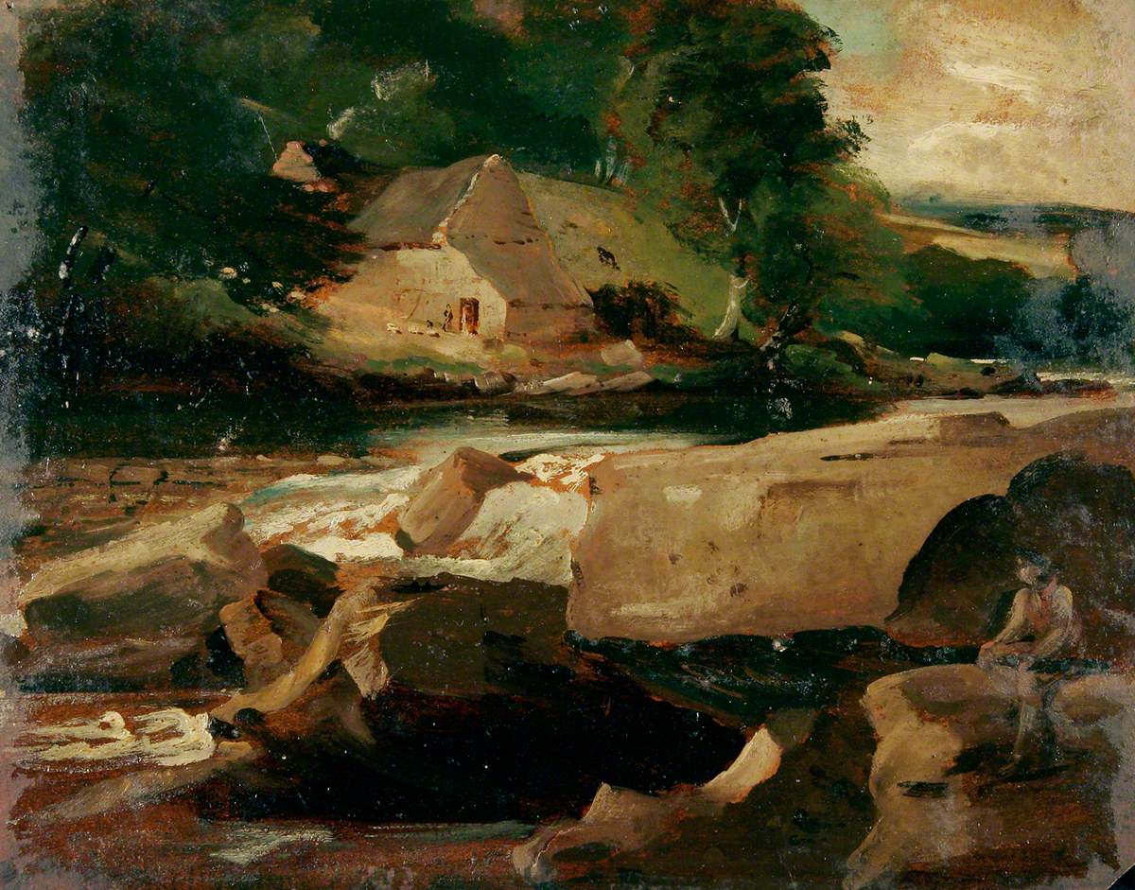
Joseph Clover
Another early member of the General Conference was Joseph Clover (1779-1853), a British painter and the uncle of Victorian pioneer of anesthesia, Joseph T. Clover (1825-1882), also a Swedenborgian. Clover (River Landscape with Rock on the Foreground, n.d.) was one of the founders of the Norwich School of landscape art

Slide 26
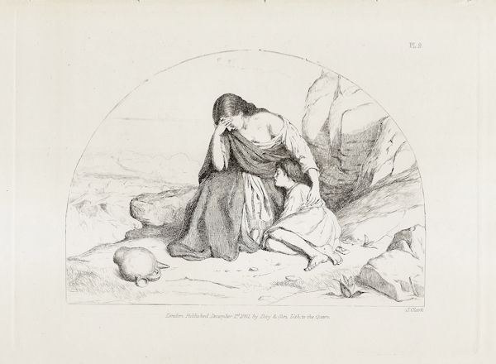
Joseph Clark
Joseph Clark (1834-1926), a member of the Argyle Square and later Willesden Swedenborgian churches in London, was mostly well-known for his paintings of family life. In his painting and etching Hagar and Ishmael (1860, left), Clark interpreted the biblical story according to Arcana Cœlestia § 2661, with reference to the Spiritual Church

Slide 27
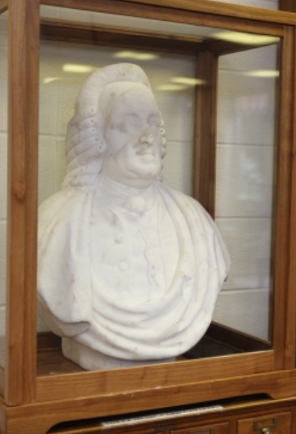
The Ecksteins
John Eckstein (1735-1817) might have been the first American Swedenborgian artist. A well-known Prussian sculptor, he moved to Philadelphia in 1793, where he became a member of the local branch of New Church together with his son, Frederick Eckstein (1787-1832). John Eckstein also sculpted the first known bust of Swedenborg, in 1817 (left)

Slide 28
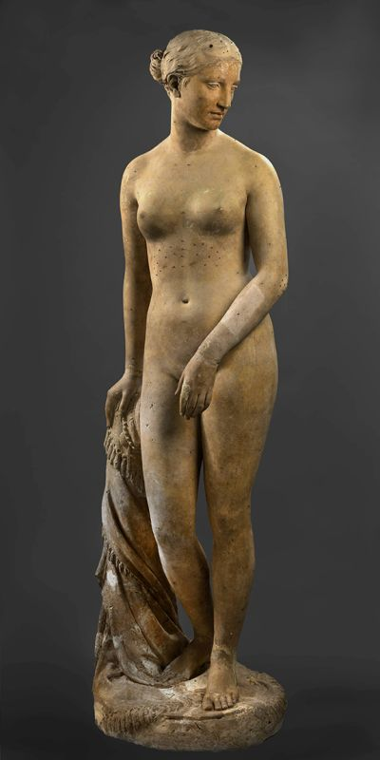
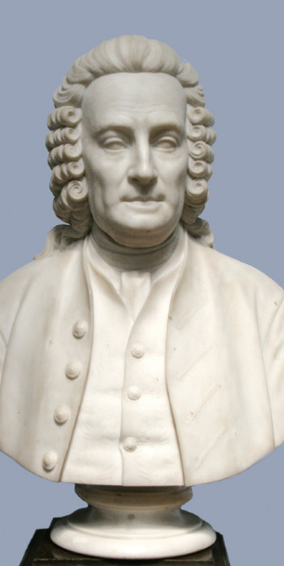
The Powers
2
1
Eckstein Jr. was also an artist and the teacher of Hiram Powers (1805-1873), who would become the leading American neoclassical sculptor (Greek Slave, 1843: 1). Hiram was in turn a devoted Swedenborgian, unlike his son Preston Powers (1843-1931), who however sculpted another popular bust of Swedenborg (1879: 2)

Slide 29
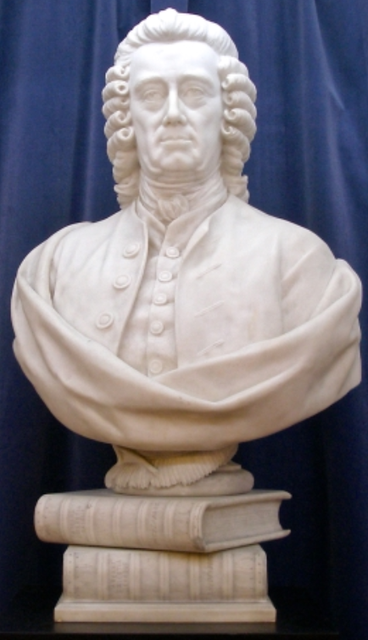
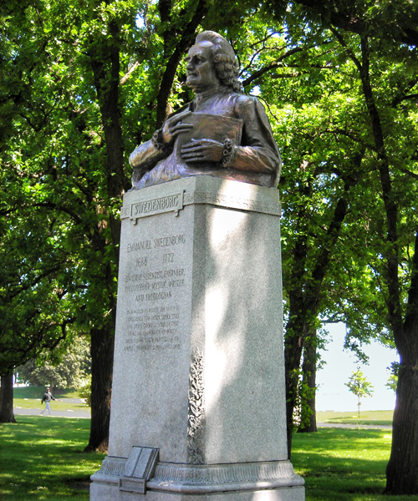
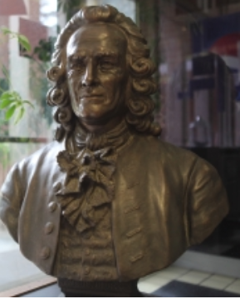
Sculpting Swedenborg
1
2
Sculptors often took Swedenborg as a subject. Caroline Shawk Brooks (1840-1913: 1), famous for her sculptures in butter, was not a Swedenborgian, but Swedish Adolf Jonsson (1872-1945), whose bust is in Chicago’s Lincoln Park (2) was a reader of Swedenborg and Swiss Fanny Lee Byse (1849-1911: 3) was a devout Swedenborgian
3

Slide 30
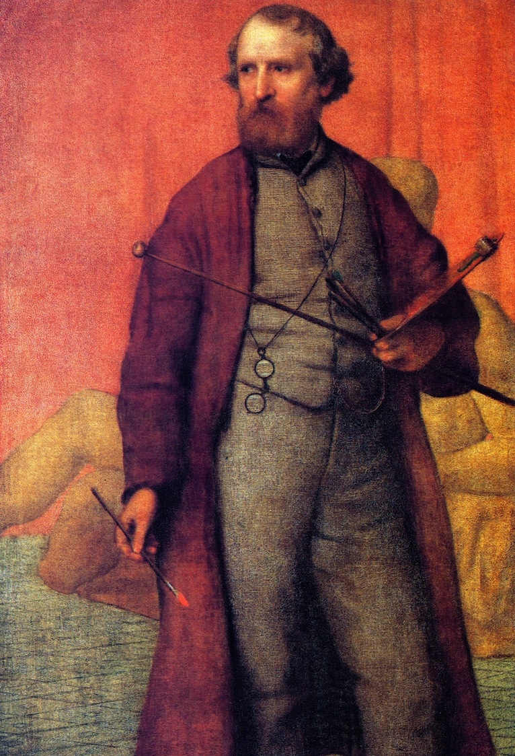
Swedenborg in Florence
Hiram Powers spent a good part of his life in Italy and hosted the first New Church services there in his home in Florence. Among those in attendance was American painter William Page (1811-1885: Self Portrait, 1860-1861, left), who was deeply influenced by Swedenborg’s doctrine of correspondences, although he was also a Spiritualist

Slide 31
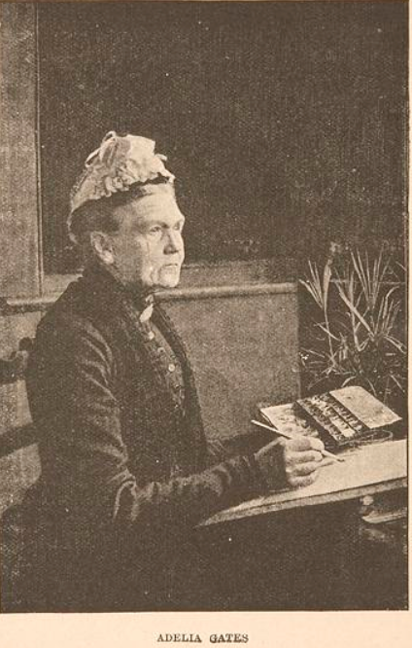
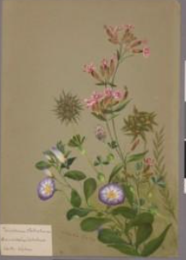
Adelia Gates, Botanical Missionary
A special case of Swedenborgian artist was Adelia Gates (1825-1912). A specialized botanical painter whose drawings (now at the Smithsonian Institution) greatly helped the science of botany, Gates was a pious Swedenborgian who traveled through several continents in search of plants, always trying to spread at the same time the knowledge of Swedenborg

Slide 32
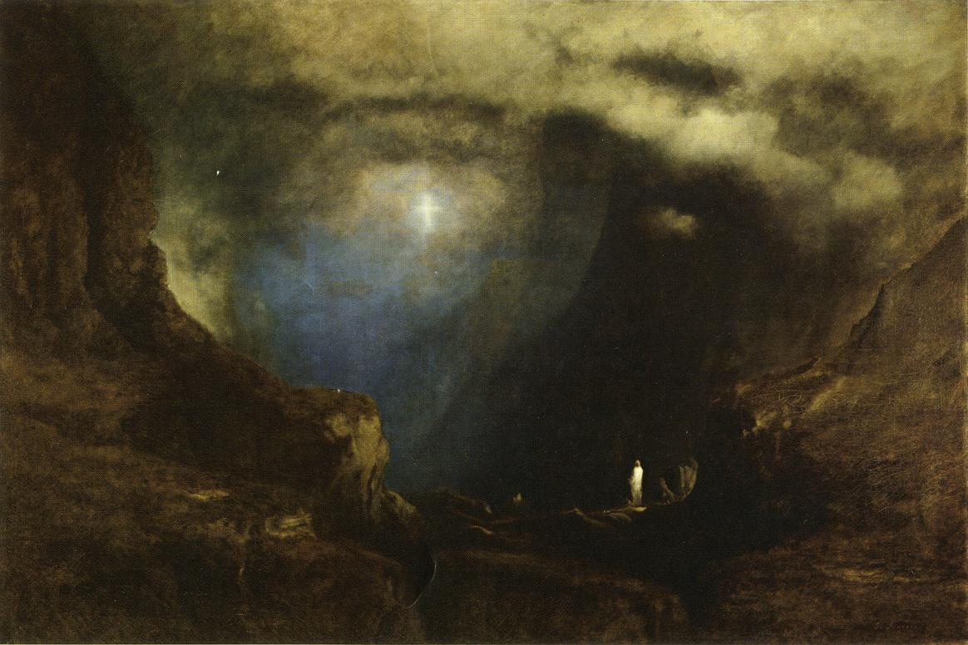
George Inness
Perhaps America’s greatest Swedenborgian artist was George Inness (1825-1894), formally baptized in the New Church in 1868. He offered Swedenborgian interpretations of some of his paintings, including The Valley of the Shadow of Death (1867), which he explained through Swedenborg’s notion of spiritual rebirth

Slide 33
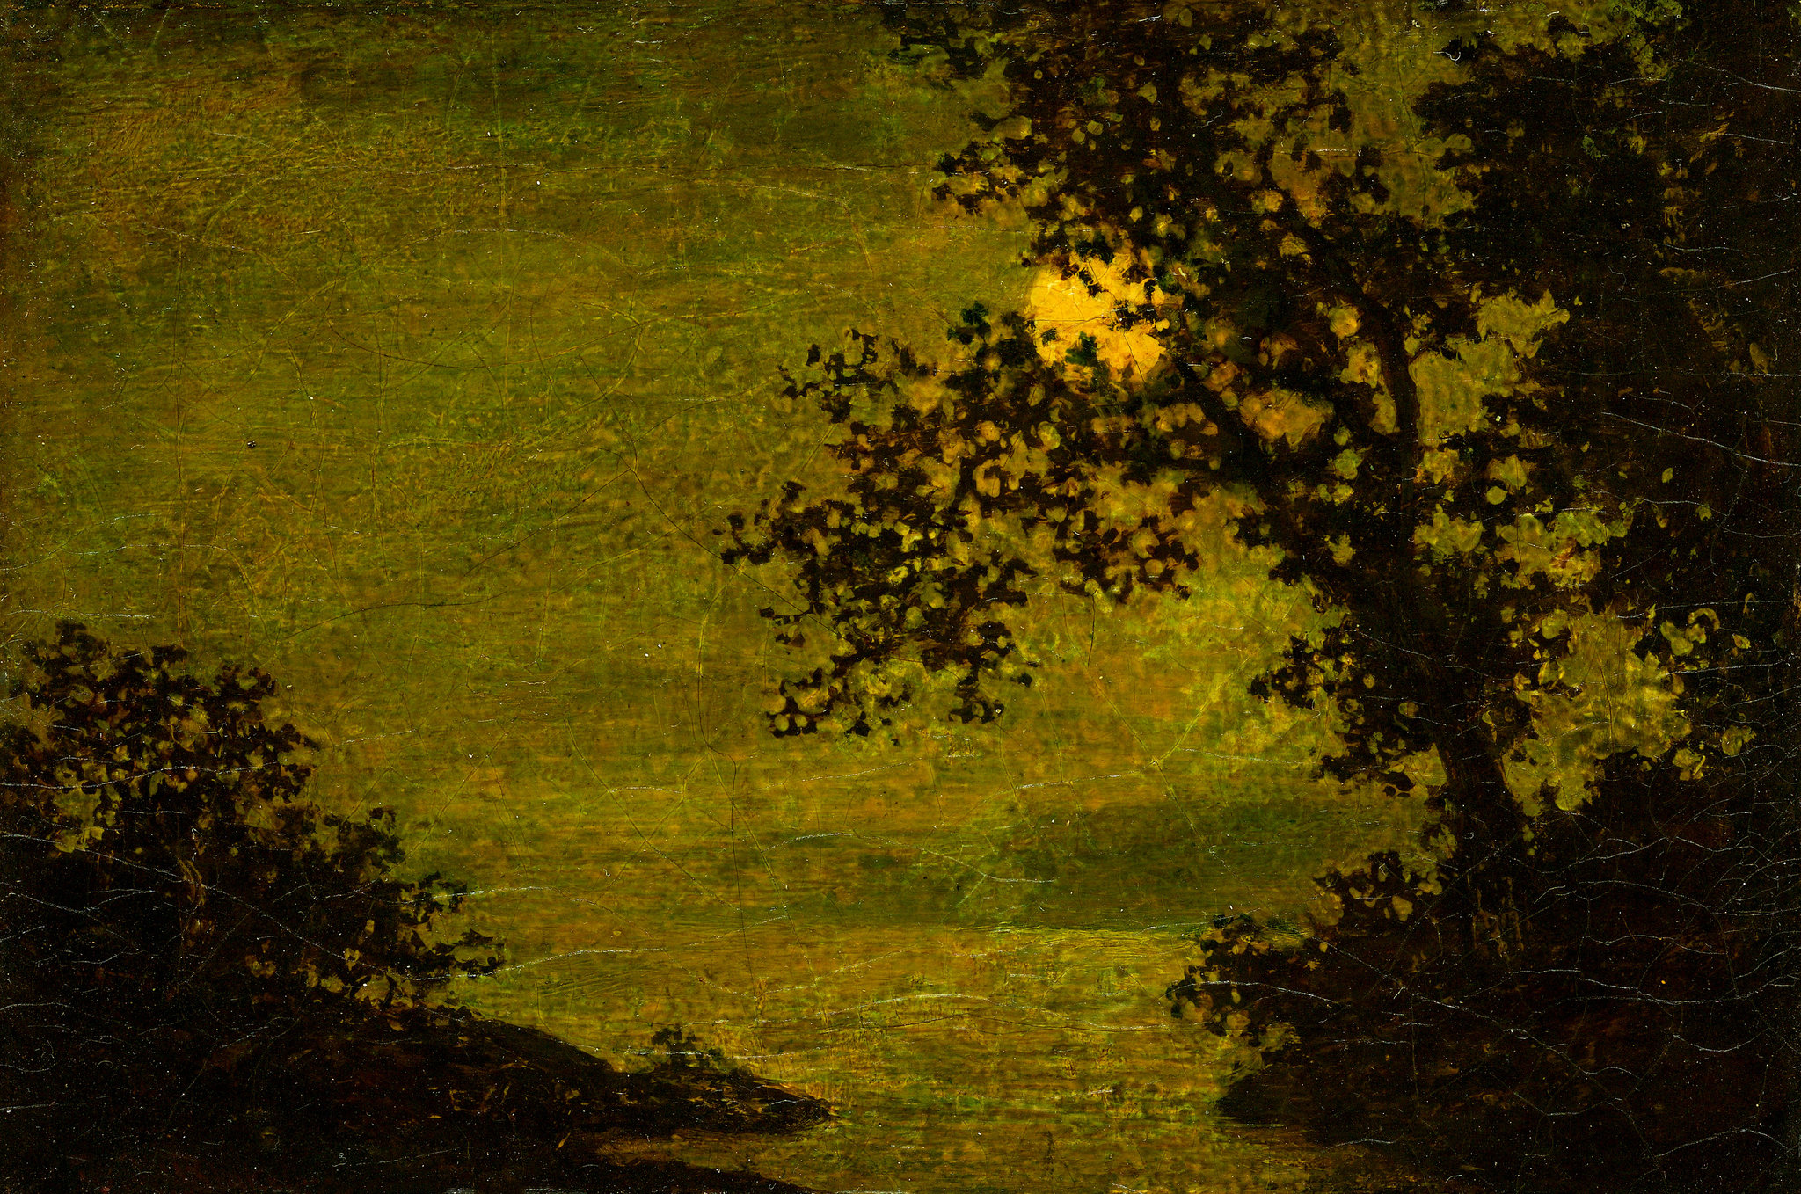
Ralph Albert Blakelock
R.A. Blakelock (1847-1919: Rising Moon, n.d., right), a member of the Swedenborgian church of East Orange, New Jersey, was rediscovered recently and hailed as the American Van Gogh, both for his color palette and for the fact that he spent part of his life in psychiatric institutions

Slide 34
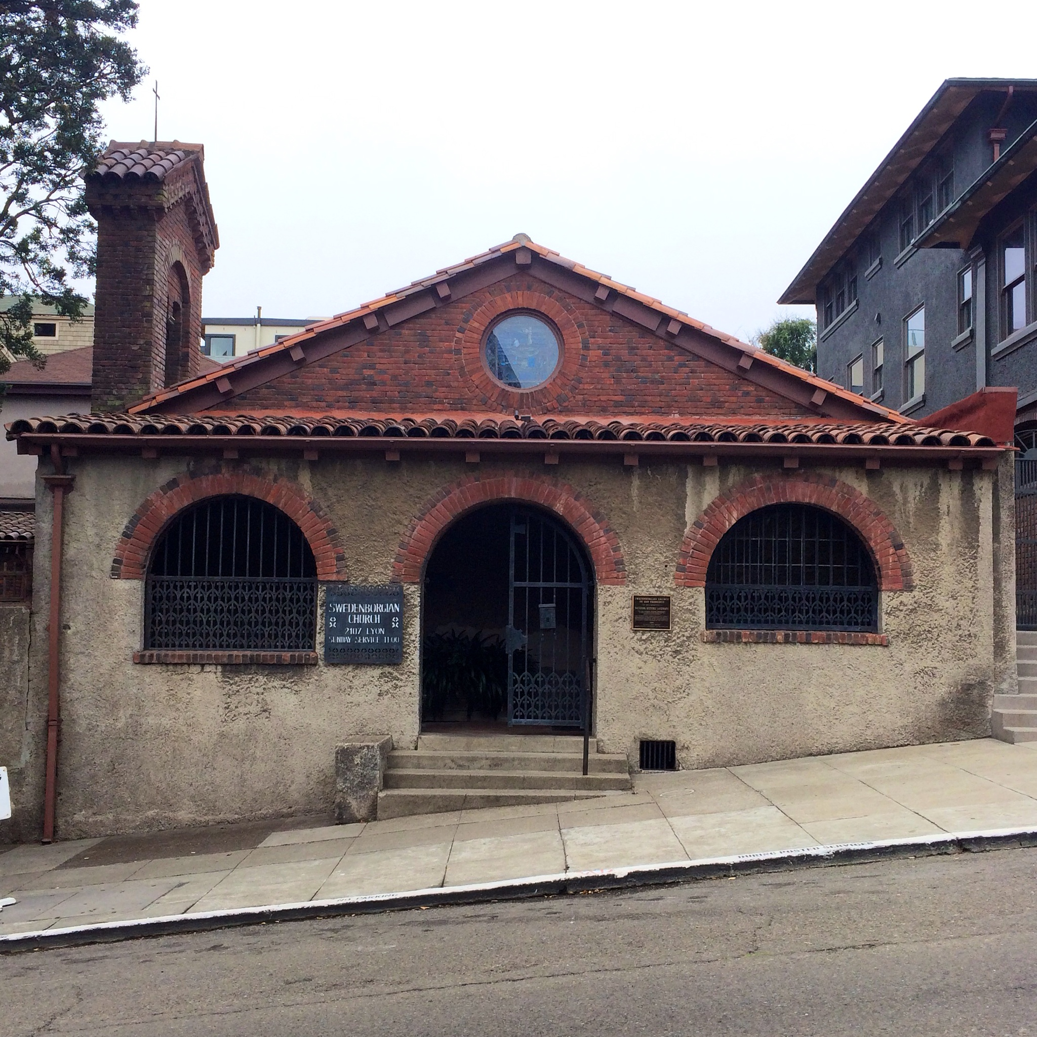
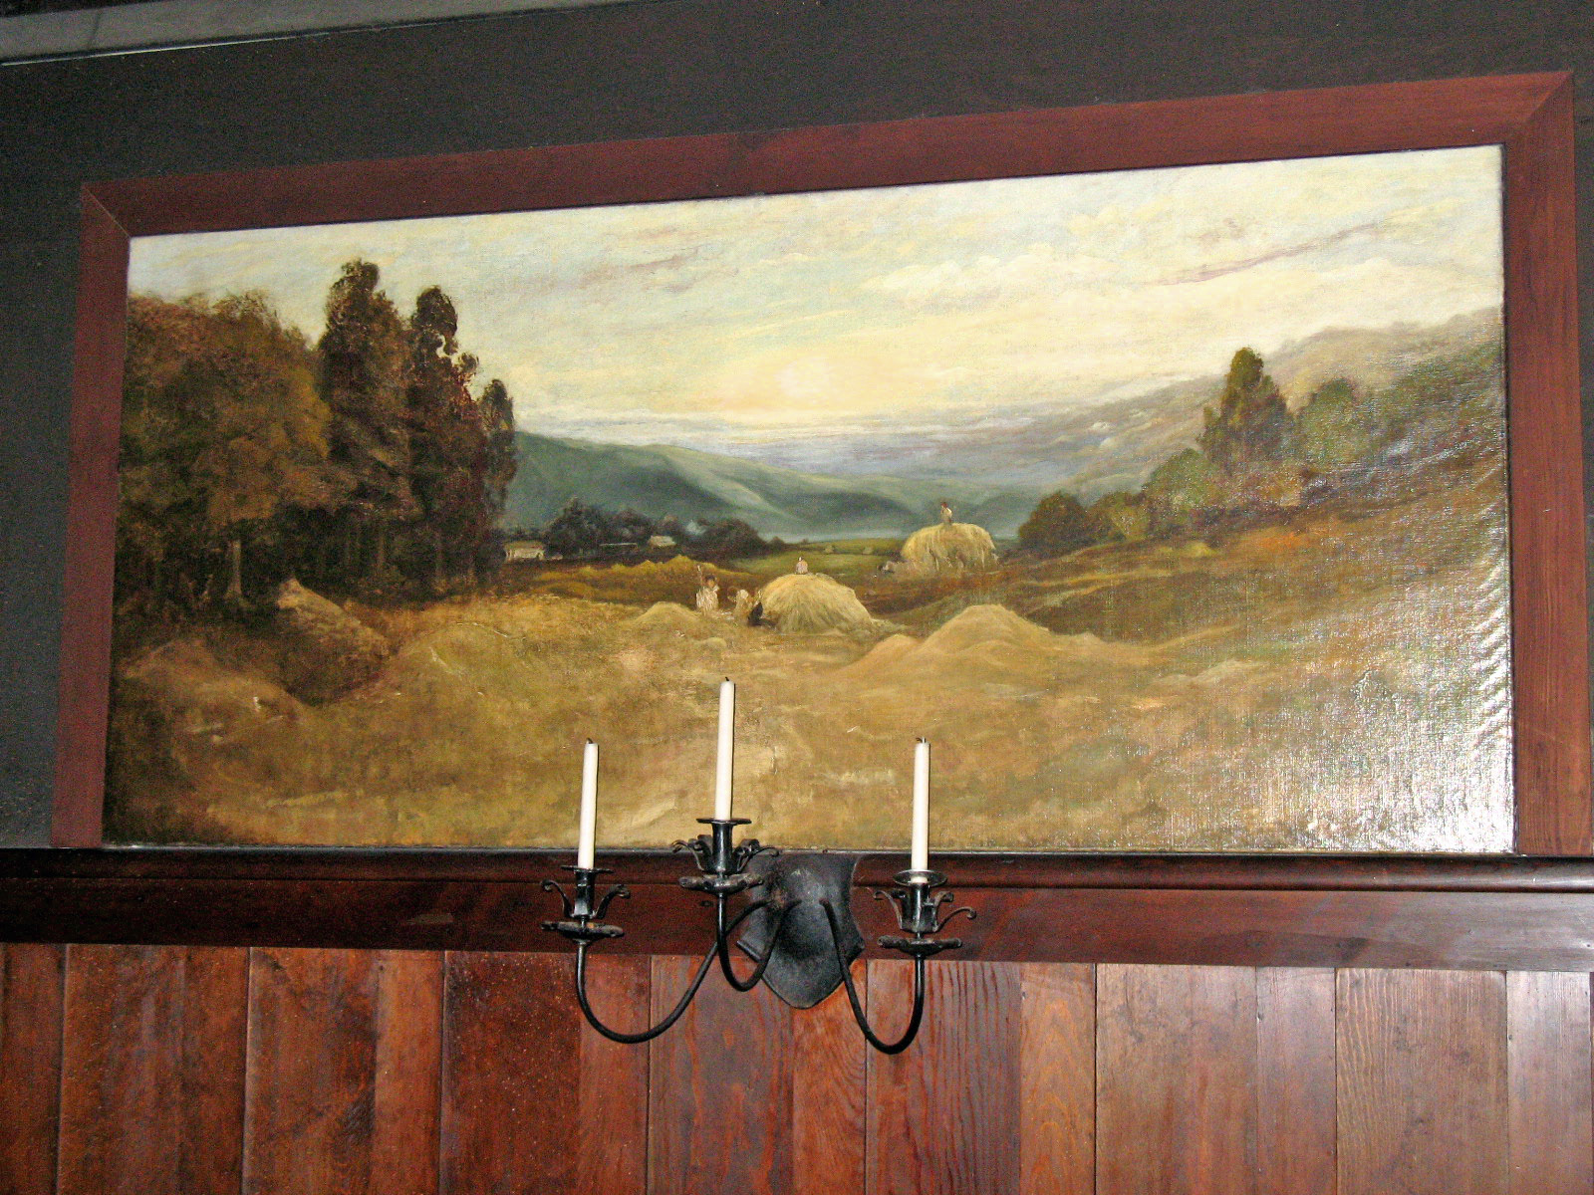
Swedenborg in San Francisco
The construction of the Swedenborgian Church of San Francisco in 1867 saw the cooperation of several Swedenborgian artists: Joseph Worcester (1836-1913), minister of that church and decorator; Bruce Porter (1865-1953), painter and stained glass artist, and William Keith (1838-1911, right), a Scottish-American painter

Slide 35
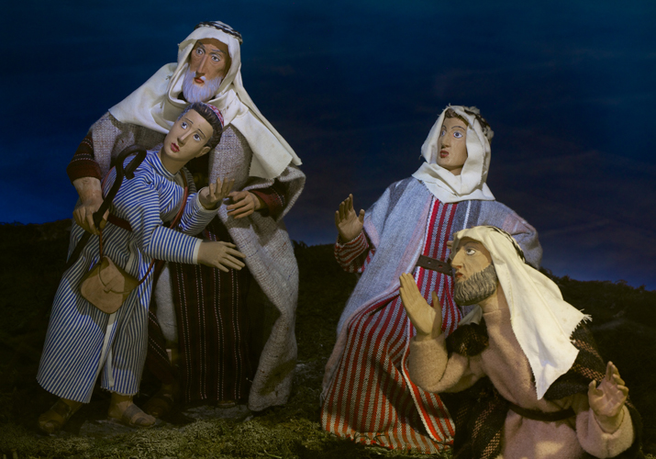
Winfred Hyatt
A Canadian artist engaged in multiple Swedenborgian projects was Winfred Hyatt (1891-1959). The principal stained glass artist and designer for Bryn Athyn Cathedral and later Glencairn, he also produced Nativity scenes, including one for the Eisenhower White House (right)

Slide 36
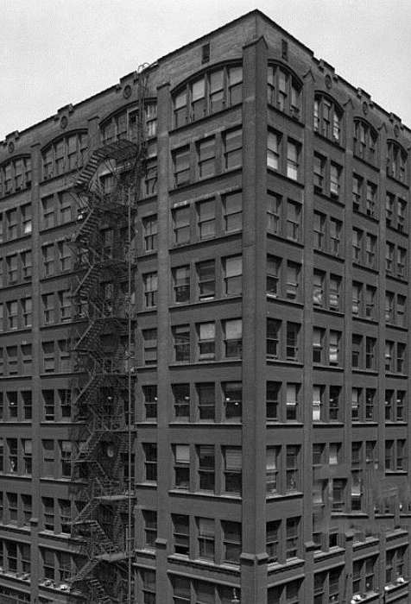
D.H. Burnham, Swedenborgian Architect
Architects have not been absent among Swedenborgian artists. Daniel H. Burnham (1846-1912) was for forty years a member of the Swedenborgian Church of Chicago. Hailed as “the father of urban planning,” his 1909 Plan of Chicago was influenced by Swedenborg’s idea that the structure of a city should reflect the divine order. He was also called “the father of the Chicago skyscraper” (see the now demolished Rand McNally building, left)

Slide 37
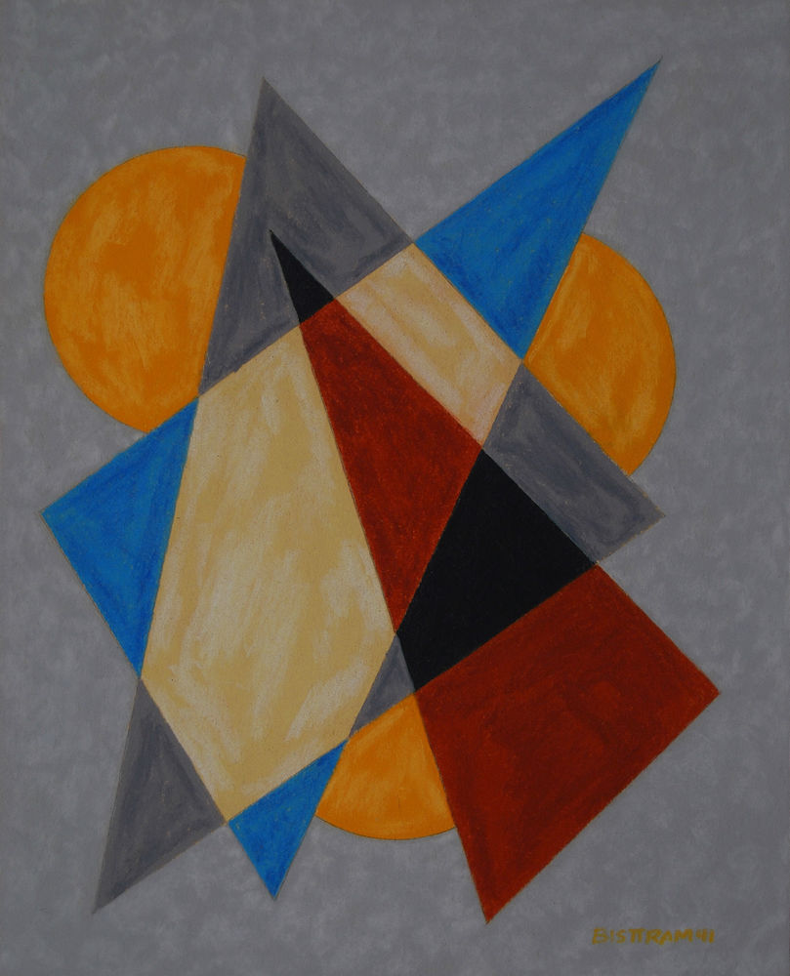
Swedenborgian Art Teachers
Thomas Pollock Anshutz (1851-1912), Howard Pyle, Alice Archer Sewall James (1870-1955), and Howard Giles (1876-1955), were Swedenborgian artists who mostly excelled as art teachers. Giles had between his students the Hungarian-American painter Emil Bisttram (1895-1976), who maintained throughout his life a serious interest in Swedenborg, although he was mostly inclined towards Theosophy and Agni Yoga. His encaustics (right) were intended as portals leading into an imminent New Age

Slide 38
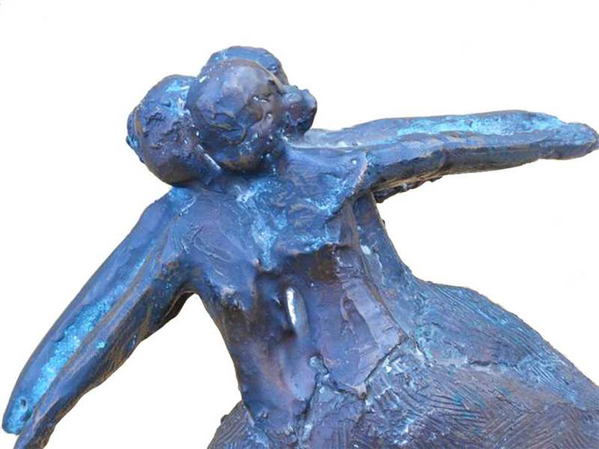
John William Cavanaugh
Among the pupils of Alice James was John William Cavanaugh (1921-1985: Alegro [sic]: Dance in Motion, n.d. right), "the 20th century's master of hammered lead." The artist studied at the Swedenborgian Theological School in Cambridge, although later he went through a religious crisis

Slide 39
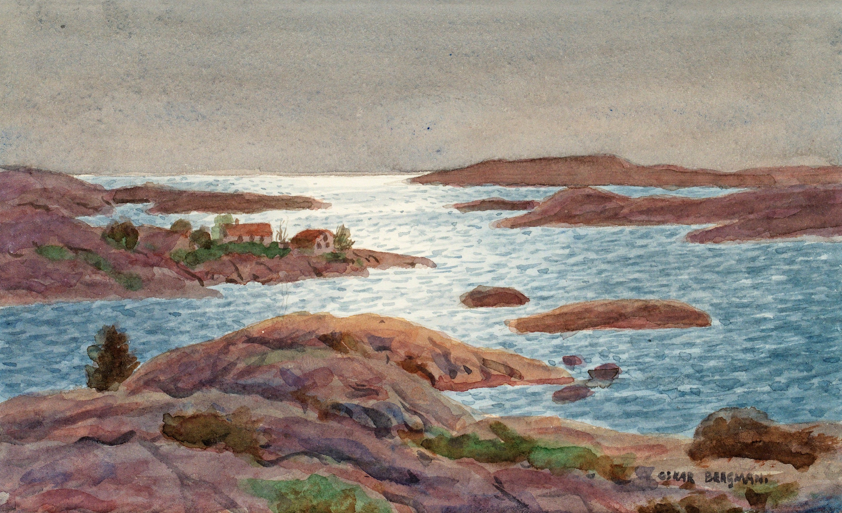
Swedish Artists and Swedenborg: Bergman
In Sweden, artists with Swedenborgian connections included sculptors Adolf Jonsson and Carl Milles (1875-1945), and painters Carl August Tholander (1835-1910), Ivan Aguéli (1869-1917), who eventually converted to Islam, and Oskar Bergman (1879-1963: Västkust, n.d., above). Bergman also collected valuable first editions of Swedenborg but, when Ethiopian Emperor Haile Selassie (1892-1975) visited Sweden in 1954, he gave all these books to him, believing he was somewhat connected with Swedenborg’s prophecies

Slide 40
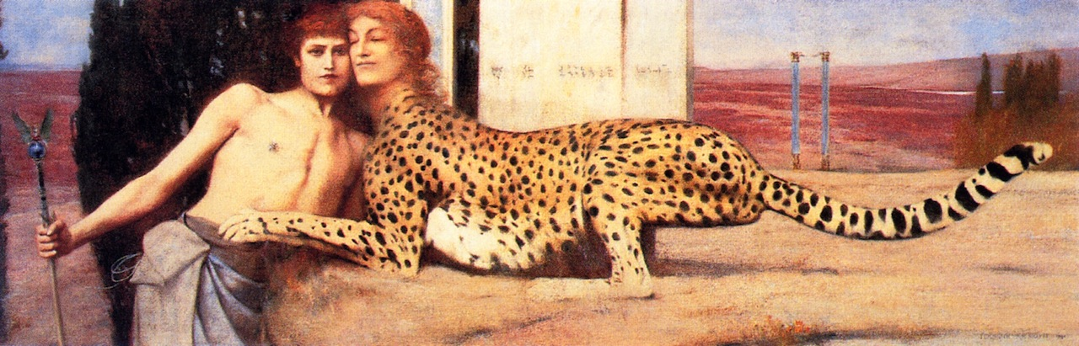
Swedenborg in Belgium
In Belgium, a number of symbolist painters were interest in Swedenborg as part of their eclectic explorations of esotericism. They included Delville and Fernand Khnopff (The Sphinx, 1896, above), who for some years attended Swedenborgian services in Brussels

Slide 41
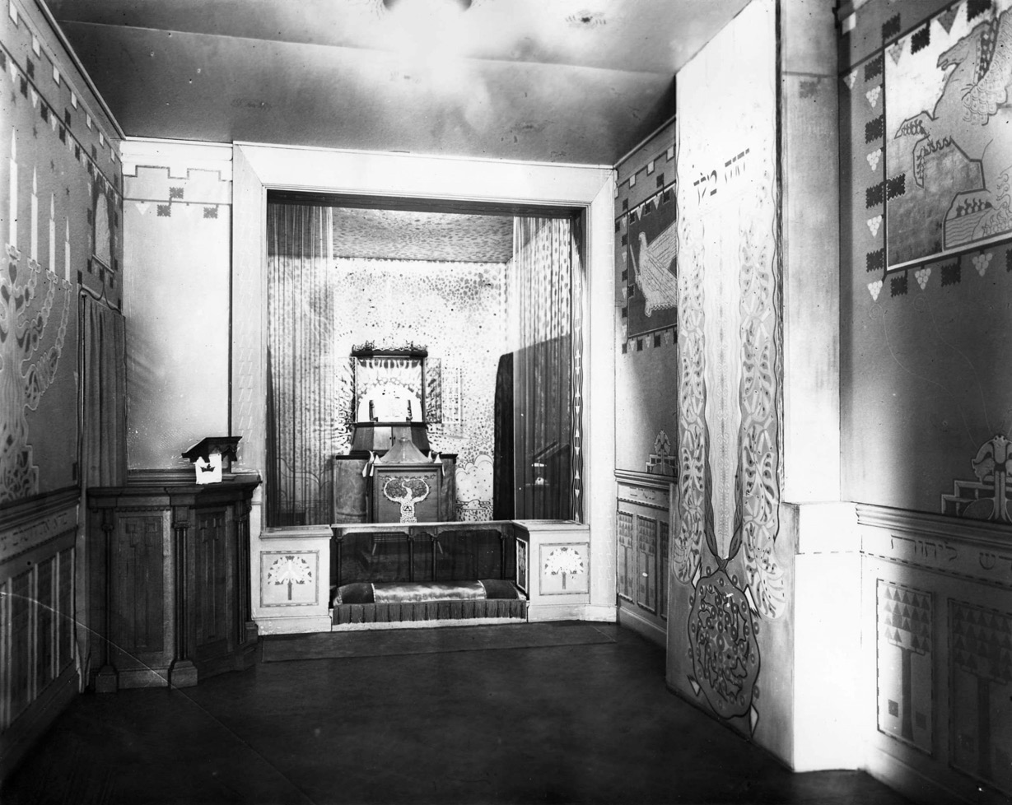
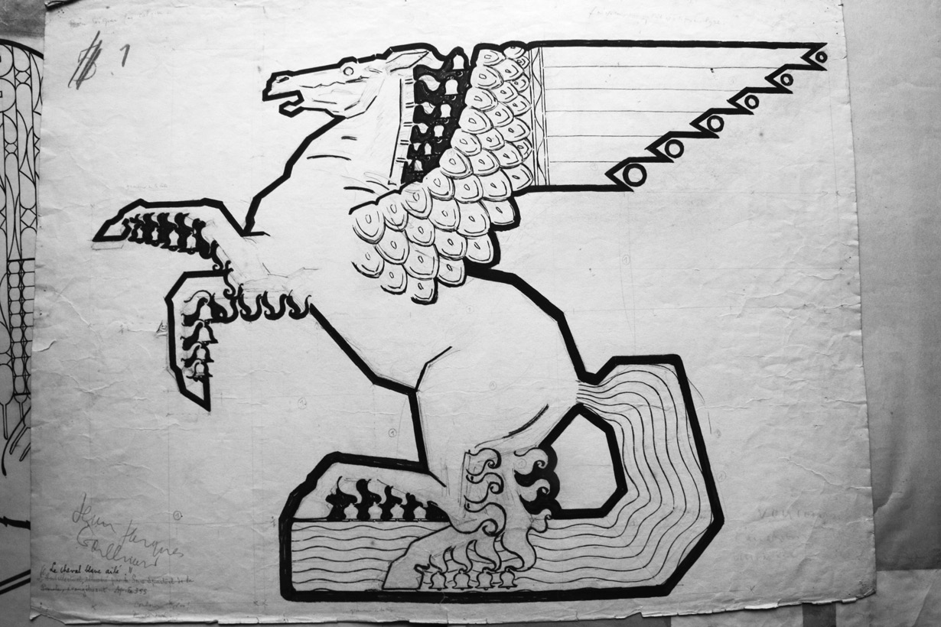
Jean-Jacques Gailliard
Belgian painter Jean-Jacques Gailliard (1890-1976), a student of Delville, was a member of the Swedenborgian Church and decorated its Brussels chapel in Rue Gachard, inaugurated in 1925.

Slide 42
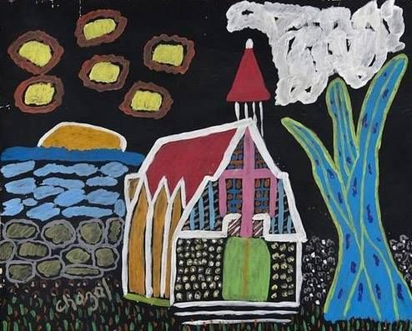
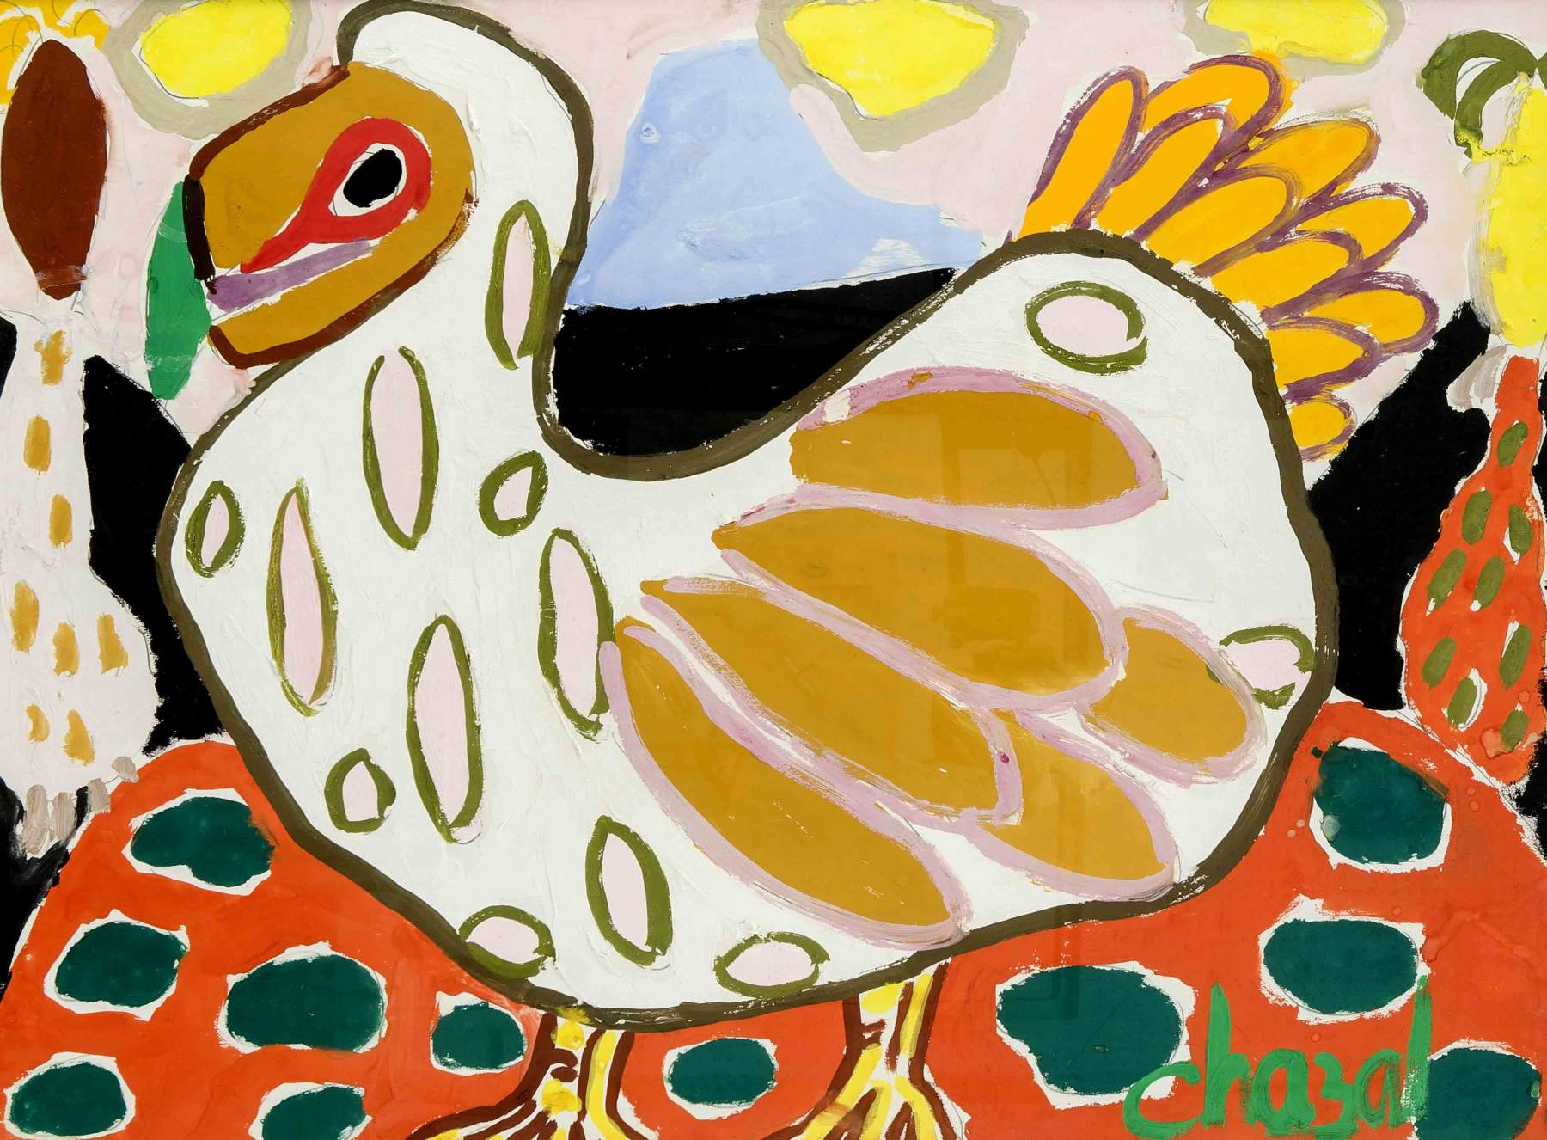
Swedenborg in Mauritius
Perhaps the most influential 20th century artist of Mauritius was poet ad painter Malcom de Chazal (1902-1981: World Before Fragmentation, left, and Dodo, right, n.d.). He was raised a Swedenborgian and continued to attend for several years Mauritius’ Swedenborgian Church, whose founder had been his great uncle Joseph Antoine Edmond de Chazal (1809-1879)

Slide 43
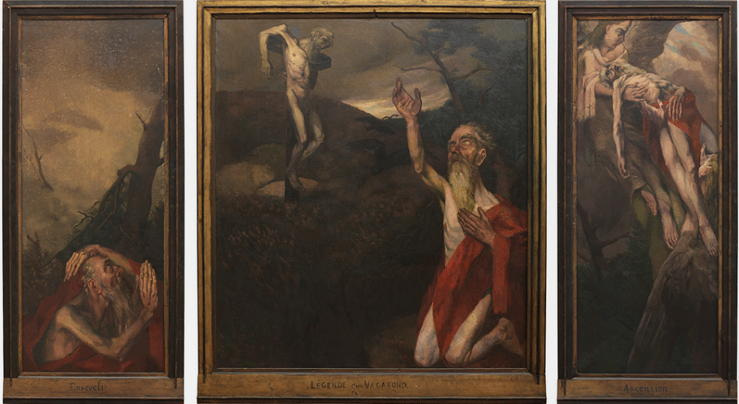
Philippe Smit
In the Netherlands, painter Philippe Smit (1886-1948: Legend of a Vagabond Triptych, above) became acquainted with the New Church when Theodore Pitcairn (1893-1973) commissioned him to paint several portraits of Swedenborgian ministers. He ended up being baptized in 1926, and believed that Swedenborg has solved the problems he had struggled with in his previous study of the Bible

Slide 44
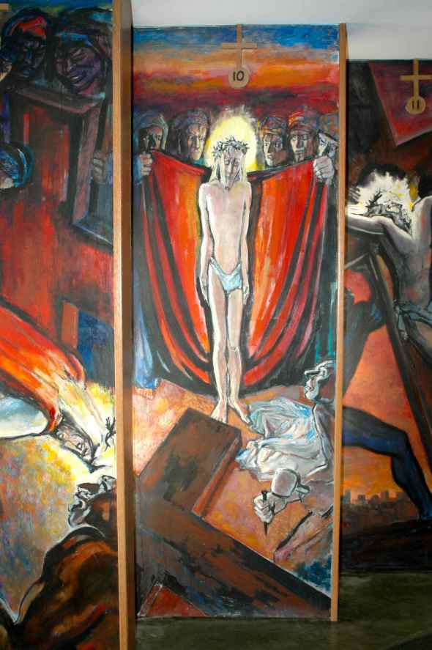
The Girard Connection
French painter André Girard (1901-1968: Station of the Cross X, 1952 Saint Ann Chapel, Palo Alto, left) also met Pitcairn through Swedenborgian composer Richard Yardumian (1917-1985), and came to accept Swedenborg’s writings as the “true light”

Slide 45


Nishan Yardumian
The composer’s son, Nishan Yardumian(1947-1986: Self-Portrait, 1977, left), studied under Girard and later taught art at the Bryn Athyn College, becoming himself a Swedenborgian painter (Annunciation to the Shepherds, 1975, right)

Slide 46

Lee Bontecou
In the early 1980s, American sculptor Lee Bontecou (b. 1931: Untitled, 1980-1998, right) moved to Bryn Athyn, where she remained until 1988. She described in an interview the community as “Swedenborg-governed,” a positive feature since Swedenborg was “a wonderful character”. She was regarded by the New York art community as “missing in action” and got the definite impression that critics did not like that an avant-garde artist was so much involved in esoteric spirituality

Slide 47



Contemporary Experiments
1
Swedenborg, however, remains a fascinating reference for contemporary artists, as evidenced by Angels of Swedenborg (1985) by American video and installation artist Ping Chong (1), The Swedenborg Room installation (2011) by Mexican Pablo Sigg (2), and the 2012 multimedia show in Strasbourg La chambre de Swedenborg by French Jean-Jacques Birgé (3)
2
3

Slide 48

But Are They “Swedenborgian”?
Jane Williams-Hogan reminds us, quoting art historian Abraham A. Davidson (1935-2011), that Swedenborg did not offer “aesthetic prescriptions.” But she adds that “his writings provide a radically new way of seeing reality,” which includes an “aesthetic judgment.” There is no “Swedenborgian art,” just as there is no “Theosophical art” or “Catholic art.” But there were and are Swedenborgian artists, who were inspired in different way, and with different results, by Swedenborg’s worldview, particularly by his theory of correspondences, to produce an art with deep spiritual implications
R.A. Blakelock, Moonlight, 1883-1889

Slide 49

For further information: maxintrovigne@gmail.com
Above: George Inness, Ariccia, 1874

