Slide 1
The Mother Goddess (Diêu Trì Kim Mẫu, Đức Phật Mẫu) of the Cao Dai Religion
Joe Hobbs
Director of the Vietnam Institute
Professor of Geography
University of Missouri
HobbsJ@missouri.edu
CESNUR Conference
Taiwan, June 2018

Slide 2
This PowerPoint represents the position of the author as presented in
the CESNUR 2018 conference, rather than of CESNUR or its directors.
Do not reproduce or quote without the consent of the author

Slide 3

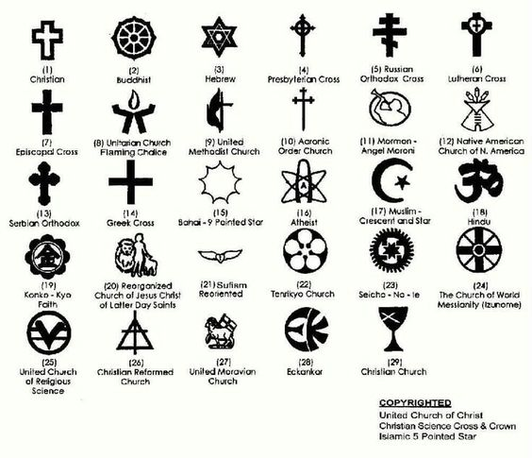


Slide 4
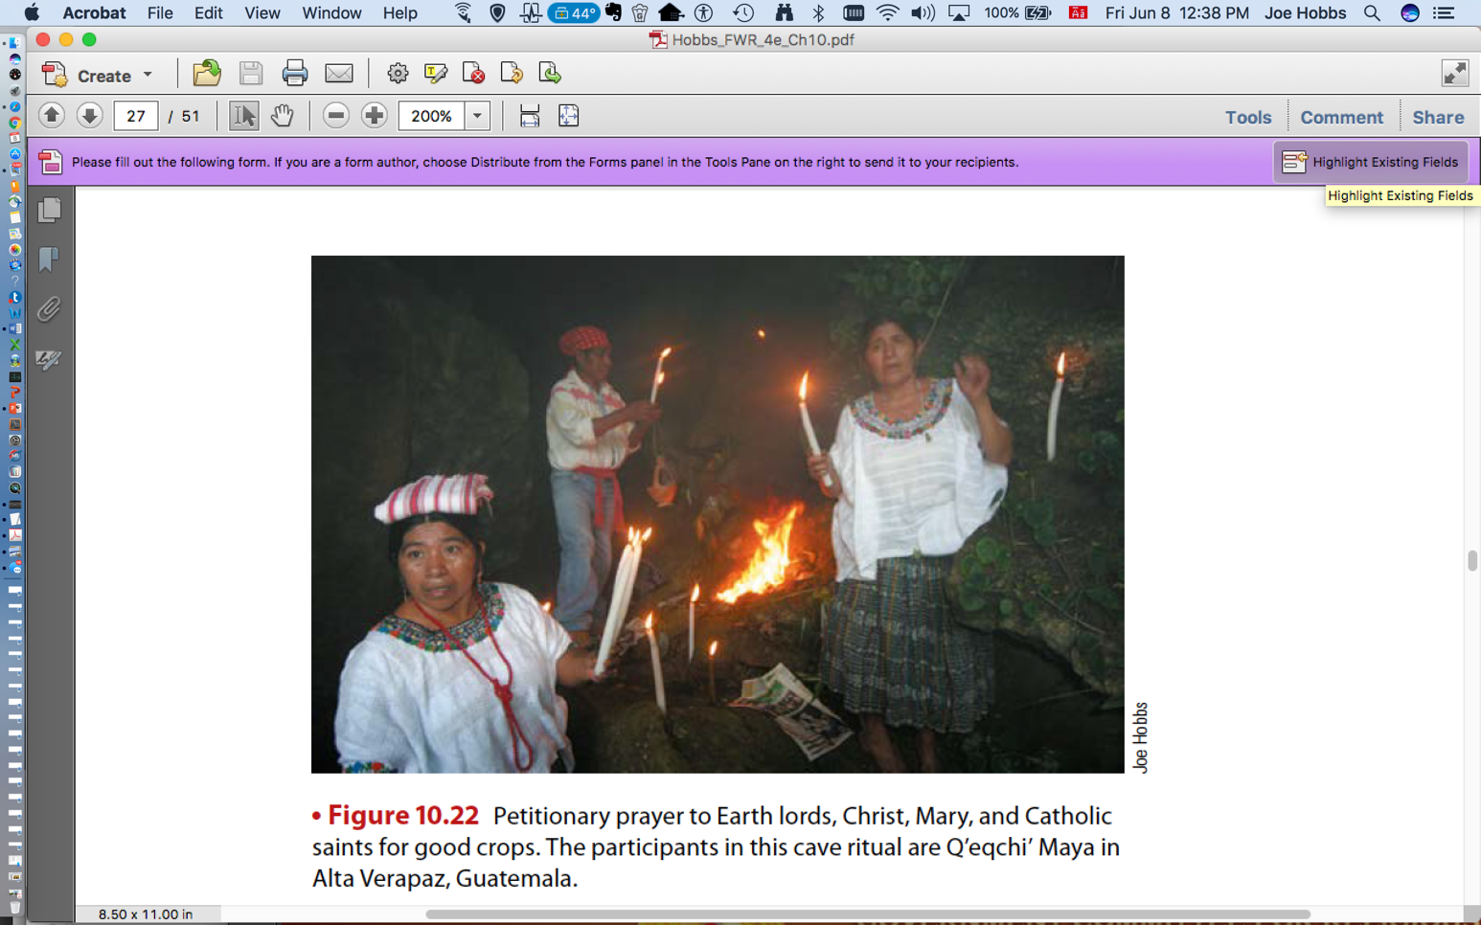

Slide 5
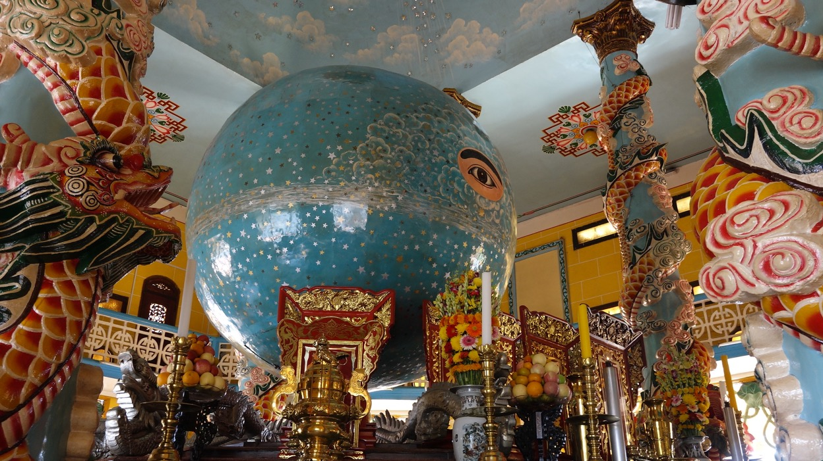

Slide 6
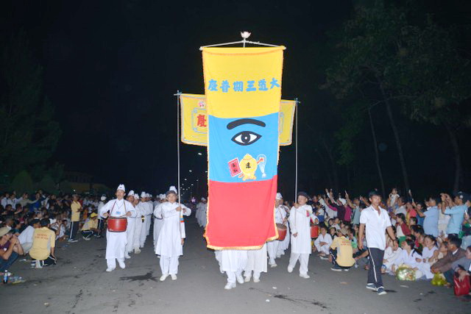

Slide 7
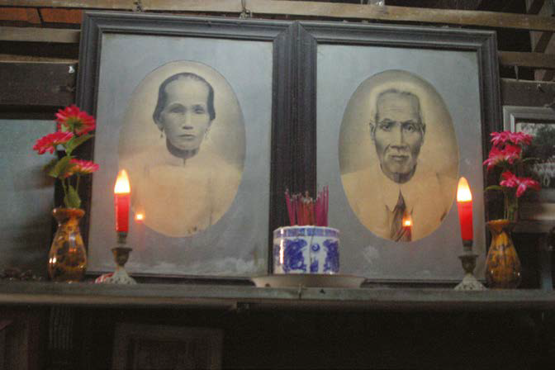

Slide 8
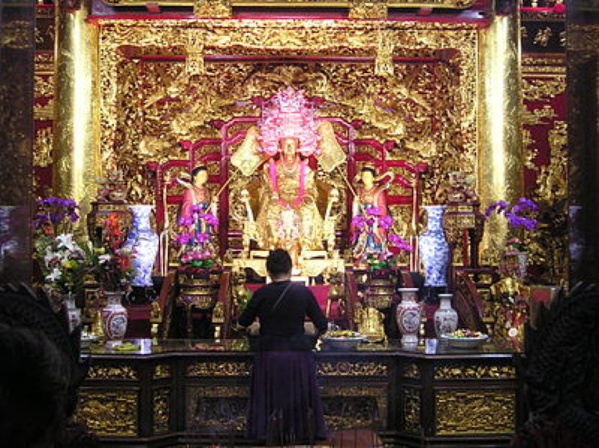
Notes:
Golden statue of Thien Hau in Taiwan
The Ma form ( 天后 聖母 ) or Thiên Hậu , also known as "Ma" (媽祖), "Mẫu Tổ" (母 祖), or "Heavenly Mother" (天上 聖母); is an important god in the belief of Chinese and Vietnamese Chinese .
She is considered as the patron deity of fishermen and seafarers, especially revered in Buddhism and Taoism in East Asian countries , and especially in Taiwan . The memorial day is March 23rd of the lunar calendar .
Địa Mẫu: Mother on Earth (see in figures). Mother Nature is a god governed in the mythology of Vietnam, she is the head of the atomic power responsible for judging the soul of the dead.

Slide 9
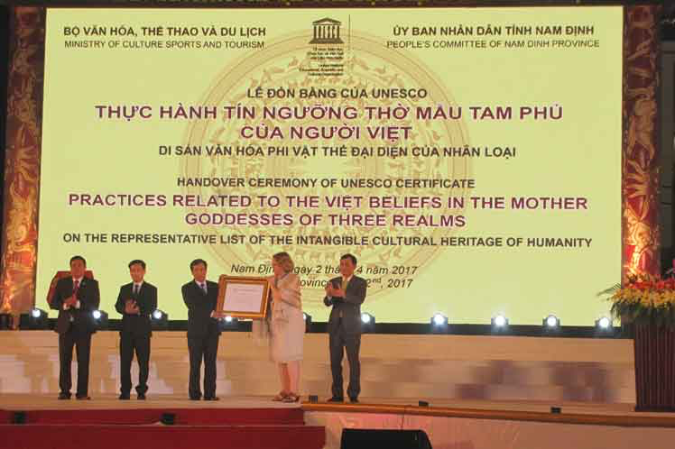

Slide 10
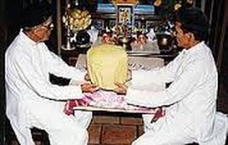

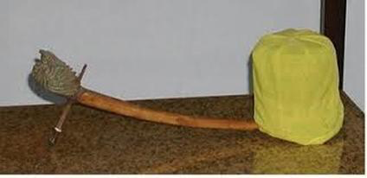
Two men performing a séance using a corbeille à bec
The holy scripture of Cao Dai,
Thánh Ngôn Hiệp Tuyển
A corbeille à bec

Slide 11
Caodai Names of God
Venerable God the Father or Venerable High Lord (Đức Cao Đài)
The Jade Emperor (Đức Chí Tôn)
The Highest Power [the] Ancient Immortal [and] Great Bodhisattva" (Cao Đài Tiên Ông Đại Bồ Tát Ma Ha Tát)
The Highest Lord or Highest Power (Cao Đài),
The Supreme Being
The Supreme God
The Supreme Spirit
The Master

Slide 12
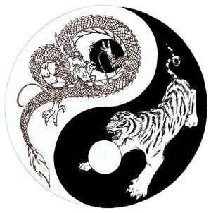

Slide 13
CAO DAI MOTHER GODDESS NAMES AND ROLES
Buddha Mother Đức Phật Mẫu
Holy Mother Goddess (Đức Phật Mẫu)
Holy Mother Goddess, Phật Mẫu
Holy Mother, Đức Mẹ Thiêng Liêng
Mother in Heaven, Thiên Hậu
Mother on Earth, Địa Mẫu
Mother Goddess, Diêu Trì Kim Mẫu in the Jade Pond Palace, Diêu Trì Cung
on the Celestial Plane of Creation or Heaven of Creation, Tạo Hóa Thiên,
the ninth/highest level of the Nine Celestial Heavens (“Cửu Trùng Thiên”).
This is on the first level or plane in the fourth layer of heaven. a place said to
be filled with miracles. She facilitates access to heaven
Chief Administrator of the Jade Pond Palace
Buddha Mother, Cửu Thiên Huyền Nữ, in the Heaven of Creation
Namo Golden Vase Mother Goddess, Nam Mô Kim Bàn Phật Mẫu in the
Jade Pond Palace, Diêu Trì Cung
Chief Administrator of the Golden Vase (Kim Bàn or Kim Bồn) Palace,
where The Holy Mother Goddess stores the original substance to create
a spirit (holy body) for all beings in the invisible world.
Holy Mother Goddess (Đức Phật Mẫu) as the Creator and Chief
Administrator of the Immortal Peach Garden (Chưởng quản Vườn Đào Tiên) in the celestial
first level/plane. Her purpose is to give “immortal peach fruit” to those initial spirits who have made
enough great achievements to reclaim their primordial positions in Nirvana or Paradise,
“Cõi Thiêng Liêng Hằng Sống.” Every year when the peaches ripen, she hosts the Peach Feast in the
Jade Pond Palace, treating Immortals and Buddhas with immortal peach fruits and wine.
Mother of Benevolence
The Global Divine/Blessed Mother
Holy Mother of all Living Beings
Holy Mother Goddess of the Dharma

Slide 14
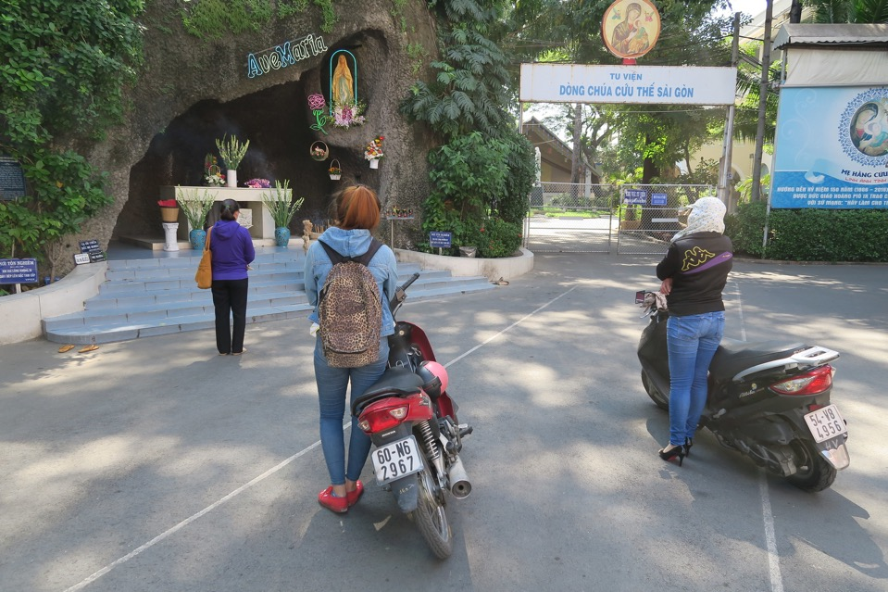

Slide 15
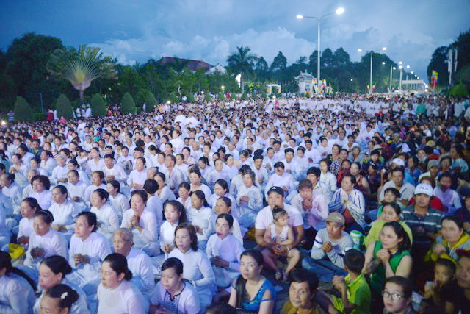

Slide 16
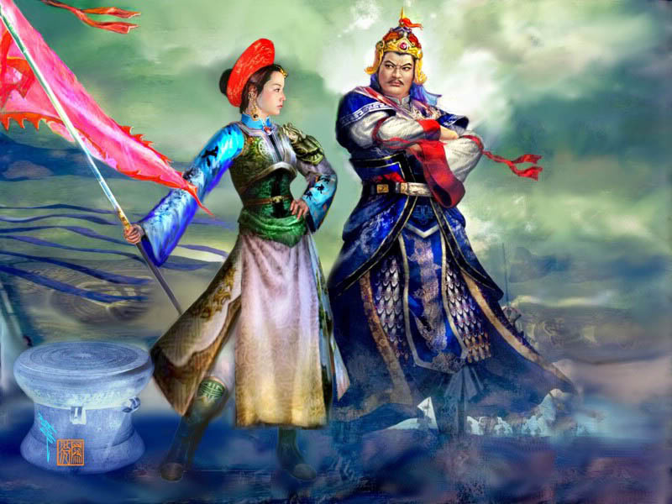
Notes:
So I have been researching heroic women in Asian history, and I must say, I am extremely impressed at the record of Asian women who defied traditional conventions and fought against a society which was very patriarchal. One such woman is Trieu Thi Trinh, also called Lady Trieu (Ba Trieu), who is considered as the Joan of Arc of Vietnam, led a rebellion against the Chinese in the year 43. Orphaned as a toddler, Lady Trieu lived with her brother in a small village in Vietnam.

Slide 17
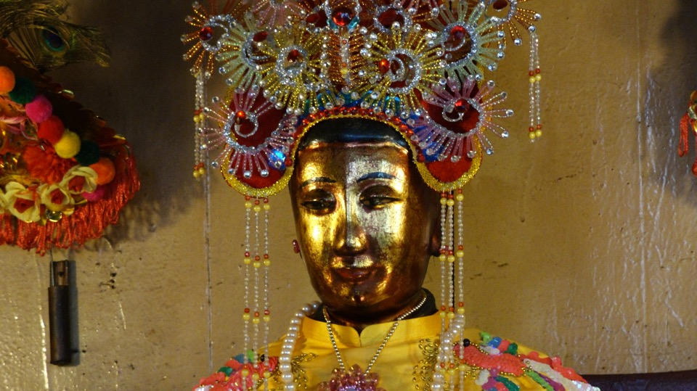

Slide 18
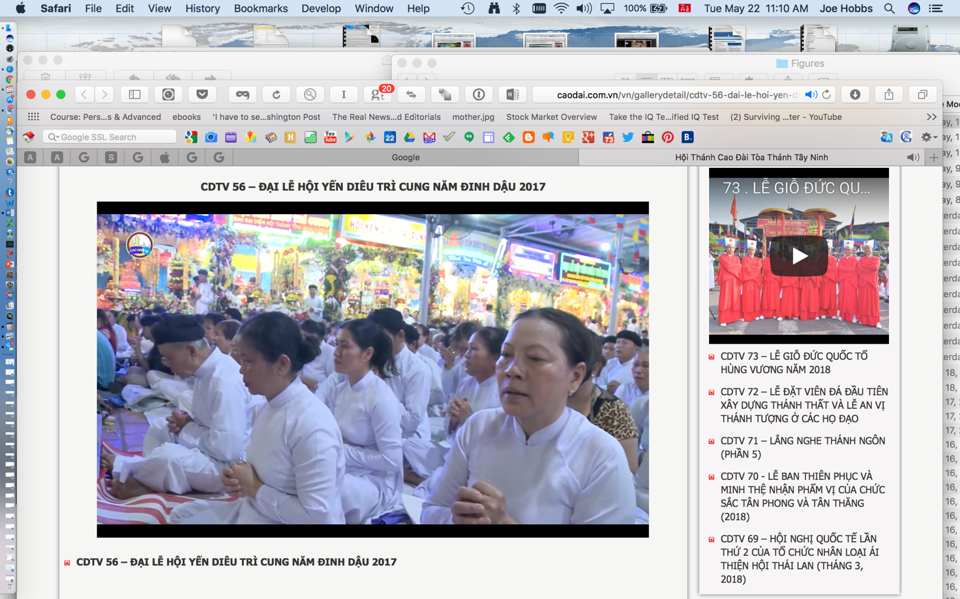

Slide 19
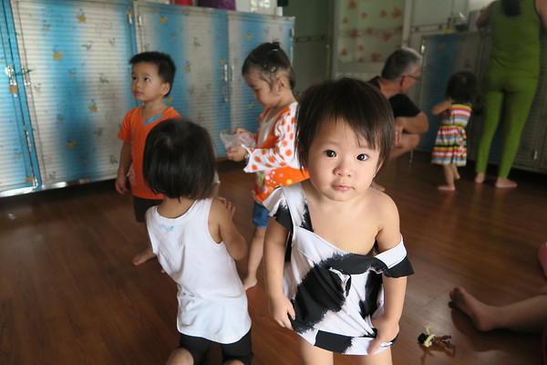

Slide 20
1. A Chinese scholar from the third millennium BC
2. The ancient Egyptian goddess Isis
3. Hera or Juno, the wife of Zeus in ancient Greek tradition
4. Demeter, the Greek Goddess of the Harvest (again, a symbol of fertility.
5. Maya, Mother of Gautama Buddha (India, approximately 400 B.C.)
6. Devibhayava or Our Lady Devi Bhagava (or Jagadambâ) in India, the embodiment of maternal love and charity, full of compassion, always caring for beings and things
7. Mary, Mother of Jesus (Israel, first century B.C.)
8. Bodhisattva (China, approximately 95 B.C., during the Emperor Wu of the Han dynasty)
9. The Mother Goddess Dieu Tri Kim Mau (Vietnam, in 1925).

Slide 21
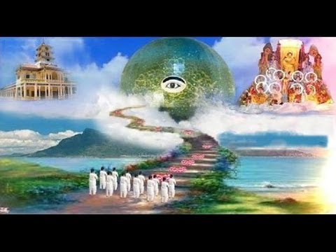

Slide 22
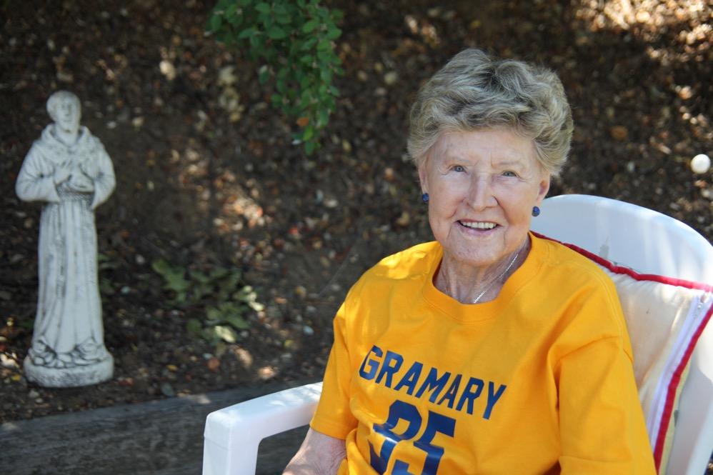

Slide 23
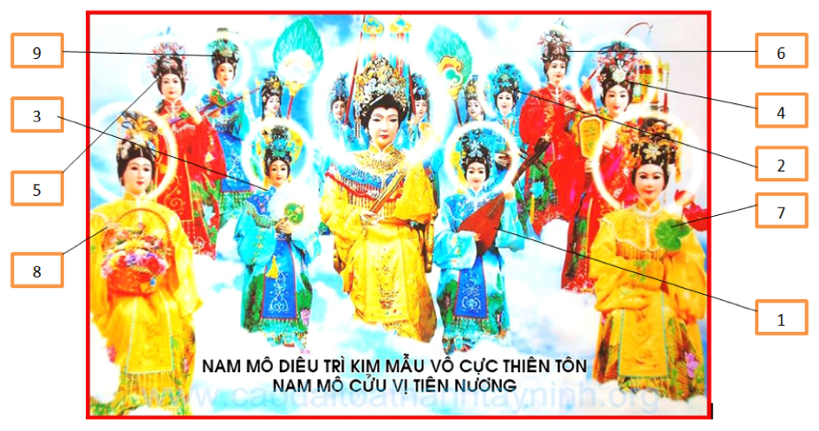

Slide 24
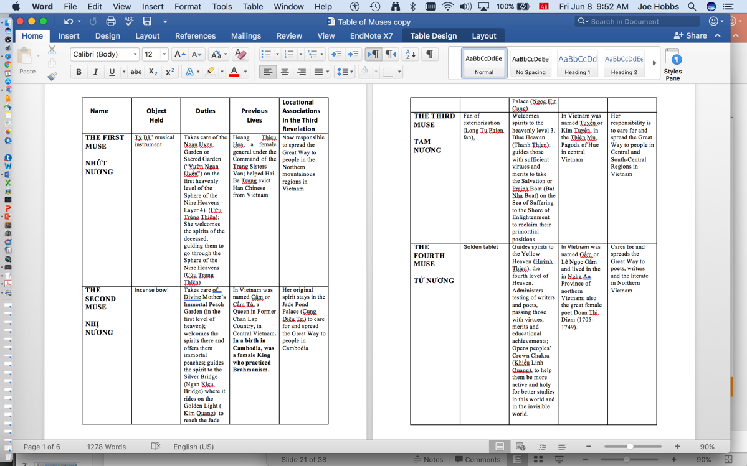

Slide 25
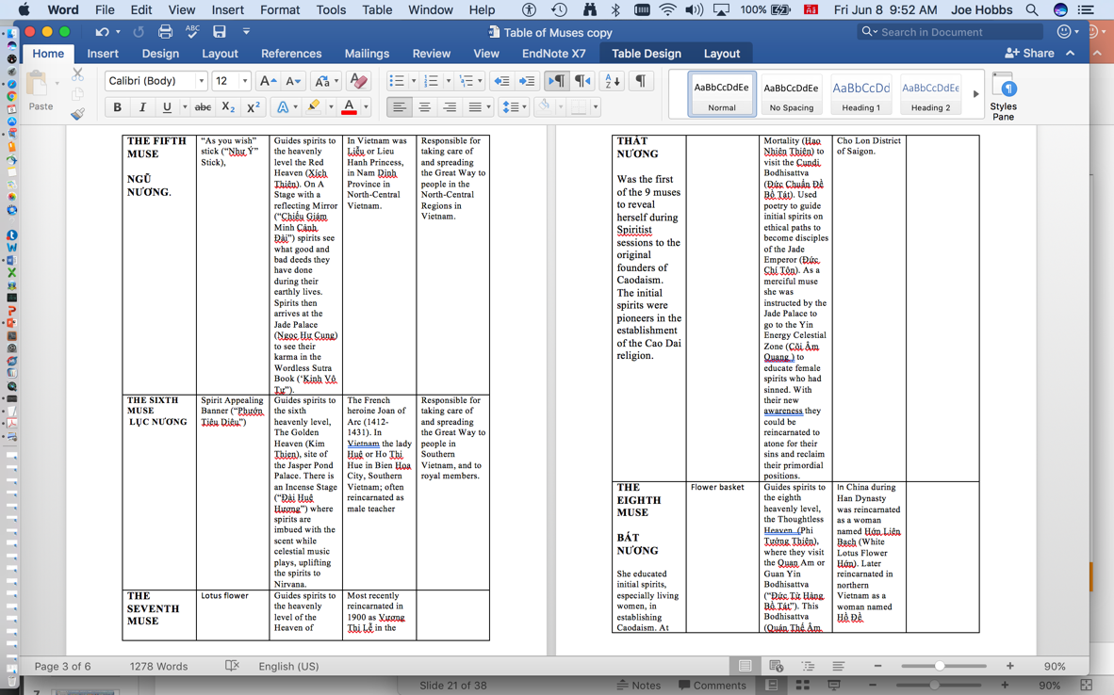

Slide 26
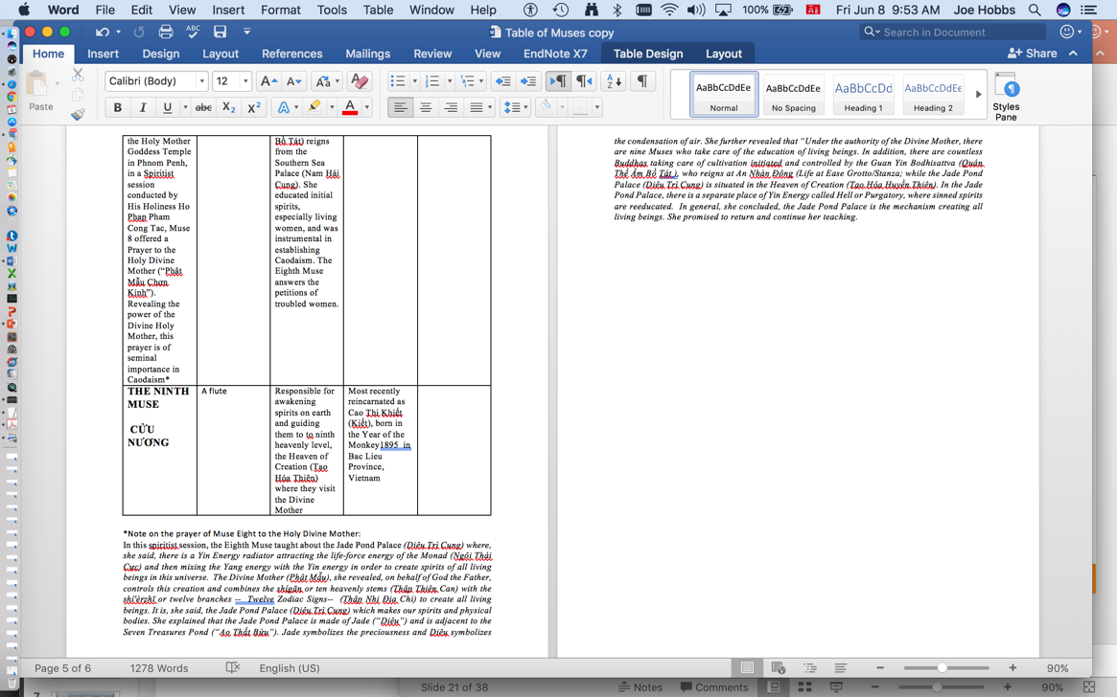

Slide 27
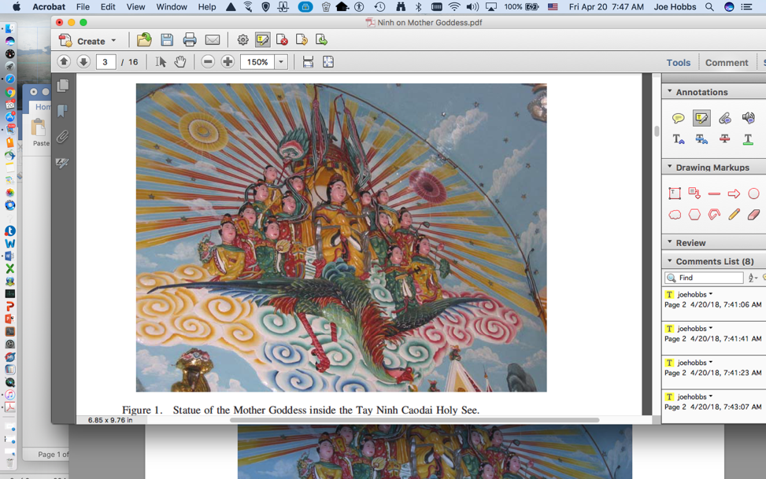

Slide 28
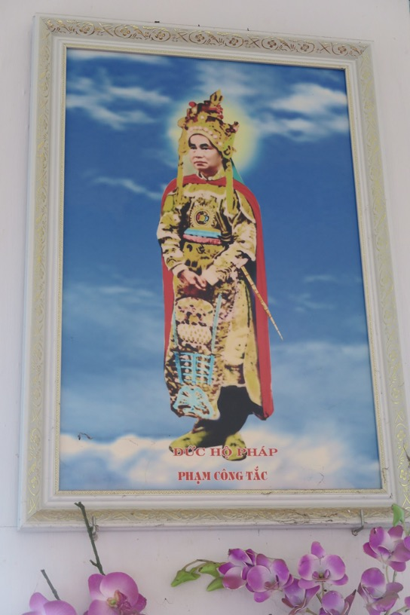

Slide 29
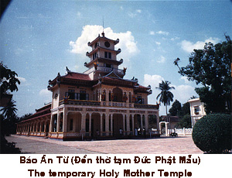

Slide 30
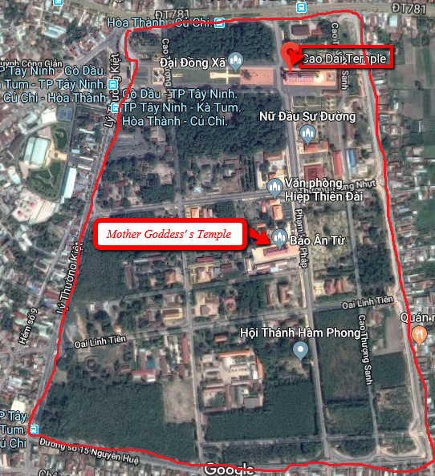

Slide 31
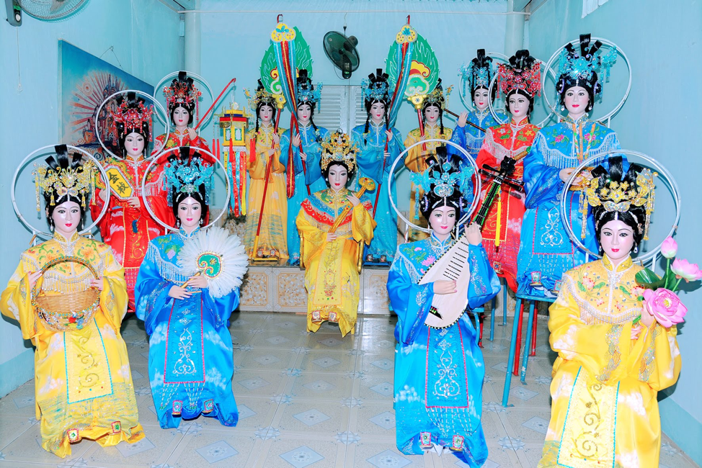

Slide 32
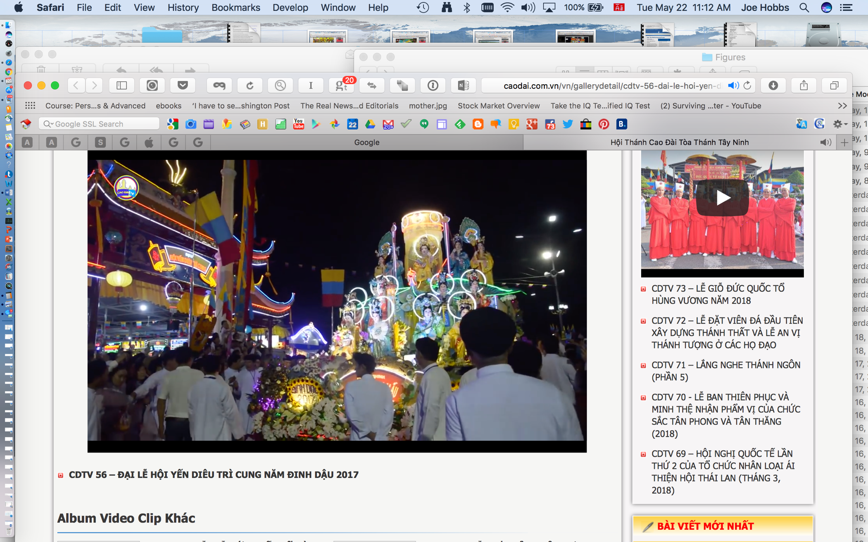

Slide 33
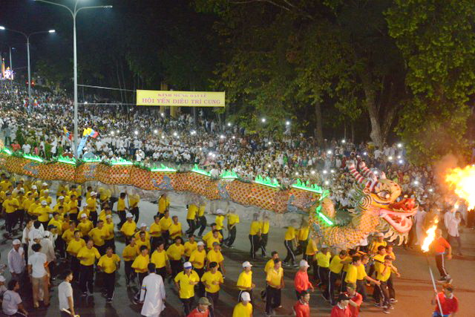

Slide 34
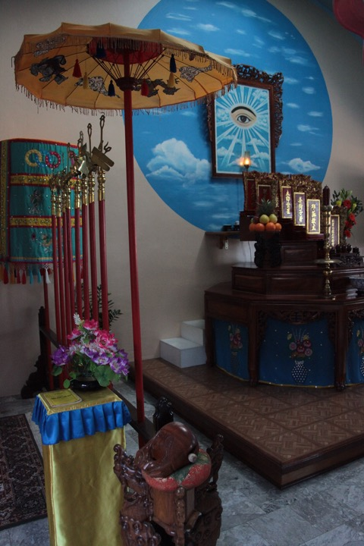

Slide 35
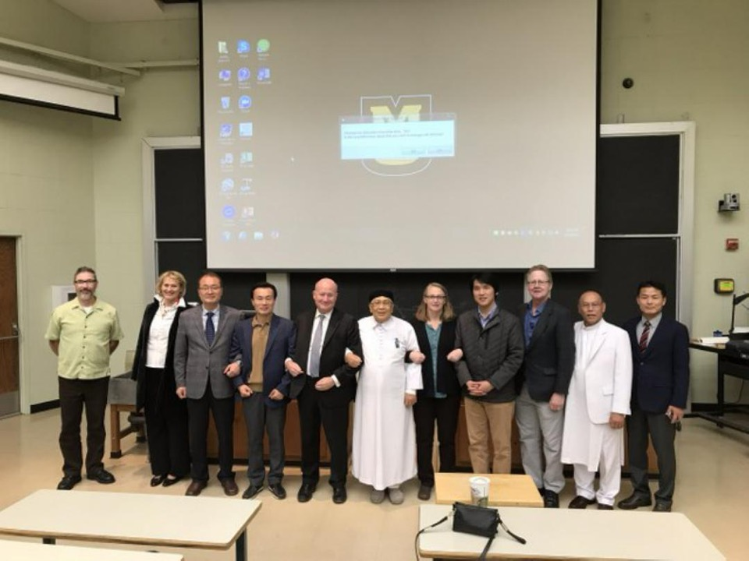

Slide 36
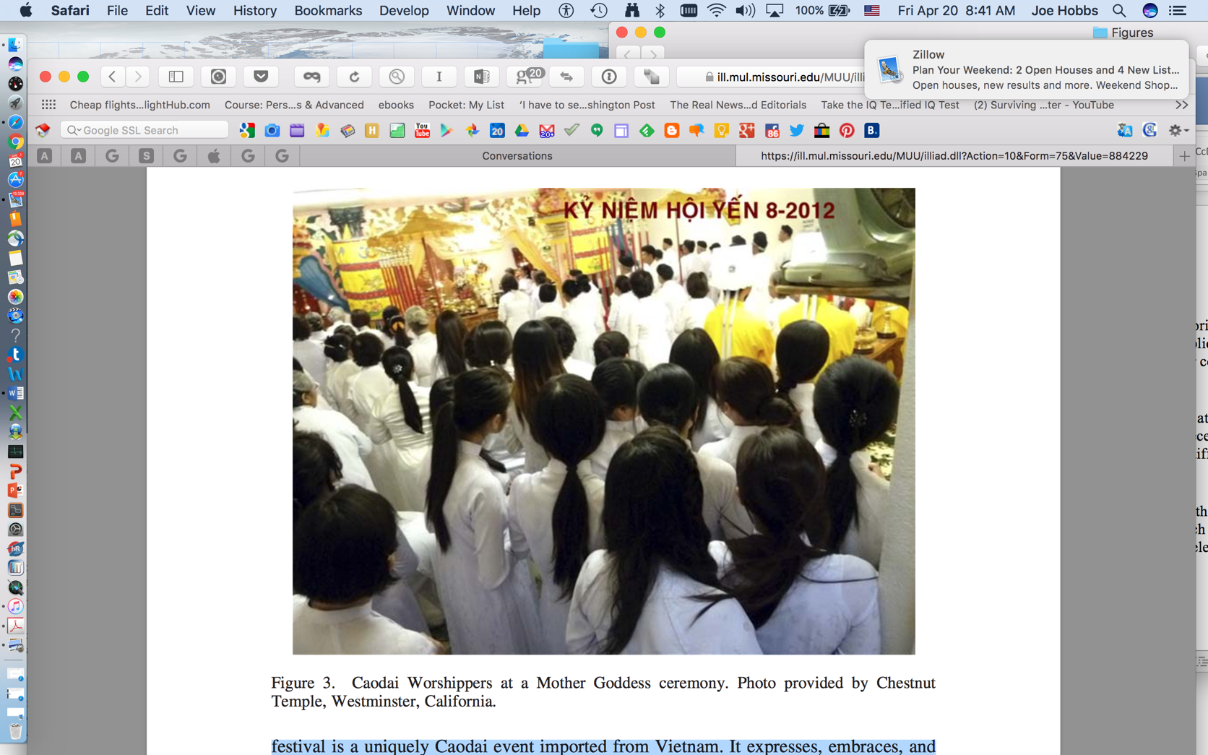

Slide 38
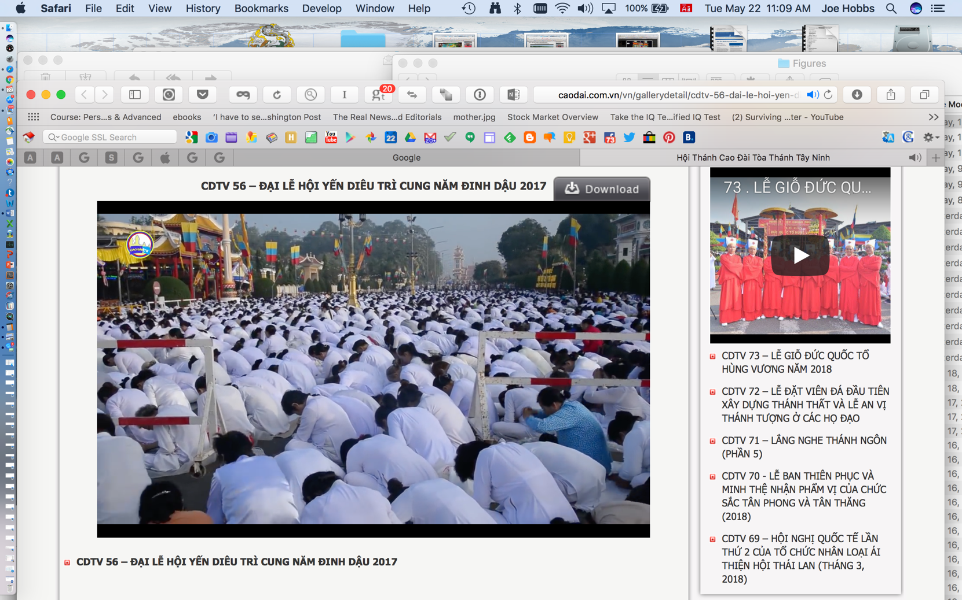

Slide 39
THANK YOU
The Vietnam Institute
Address: Room 212, Stewart Hall, The University of Missouri, Columbia,
Missouri, 65211, USA
Phone: +1-573-825-6190
Fax: +1-573-884-4239
Email: vietnam.institute@yahoo.com
Joe Hobbs: HobbsJ@missouri.edu
Website: vietnam.missouri.edu

